Slide 1

Slide 1
Notes:
slicer
No alt text provided
textbox
No alt text provided
textbox
No alt text provided
textbox
No alt text provided
textbox
No alt text provided
image
No alt text provided

Slide 2
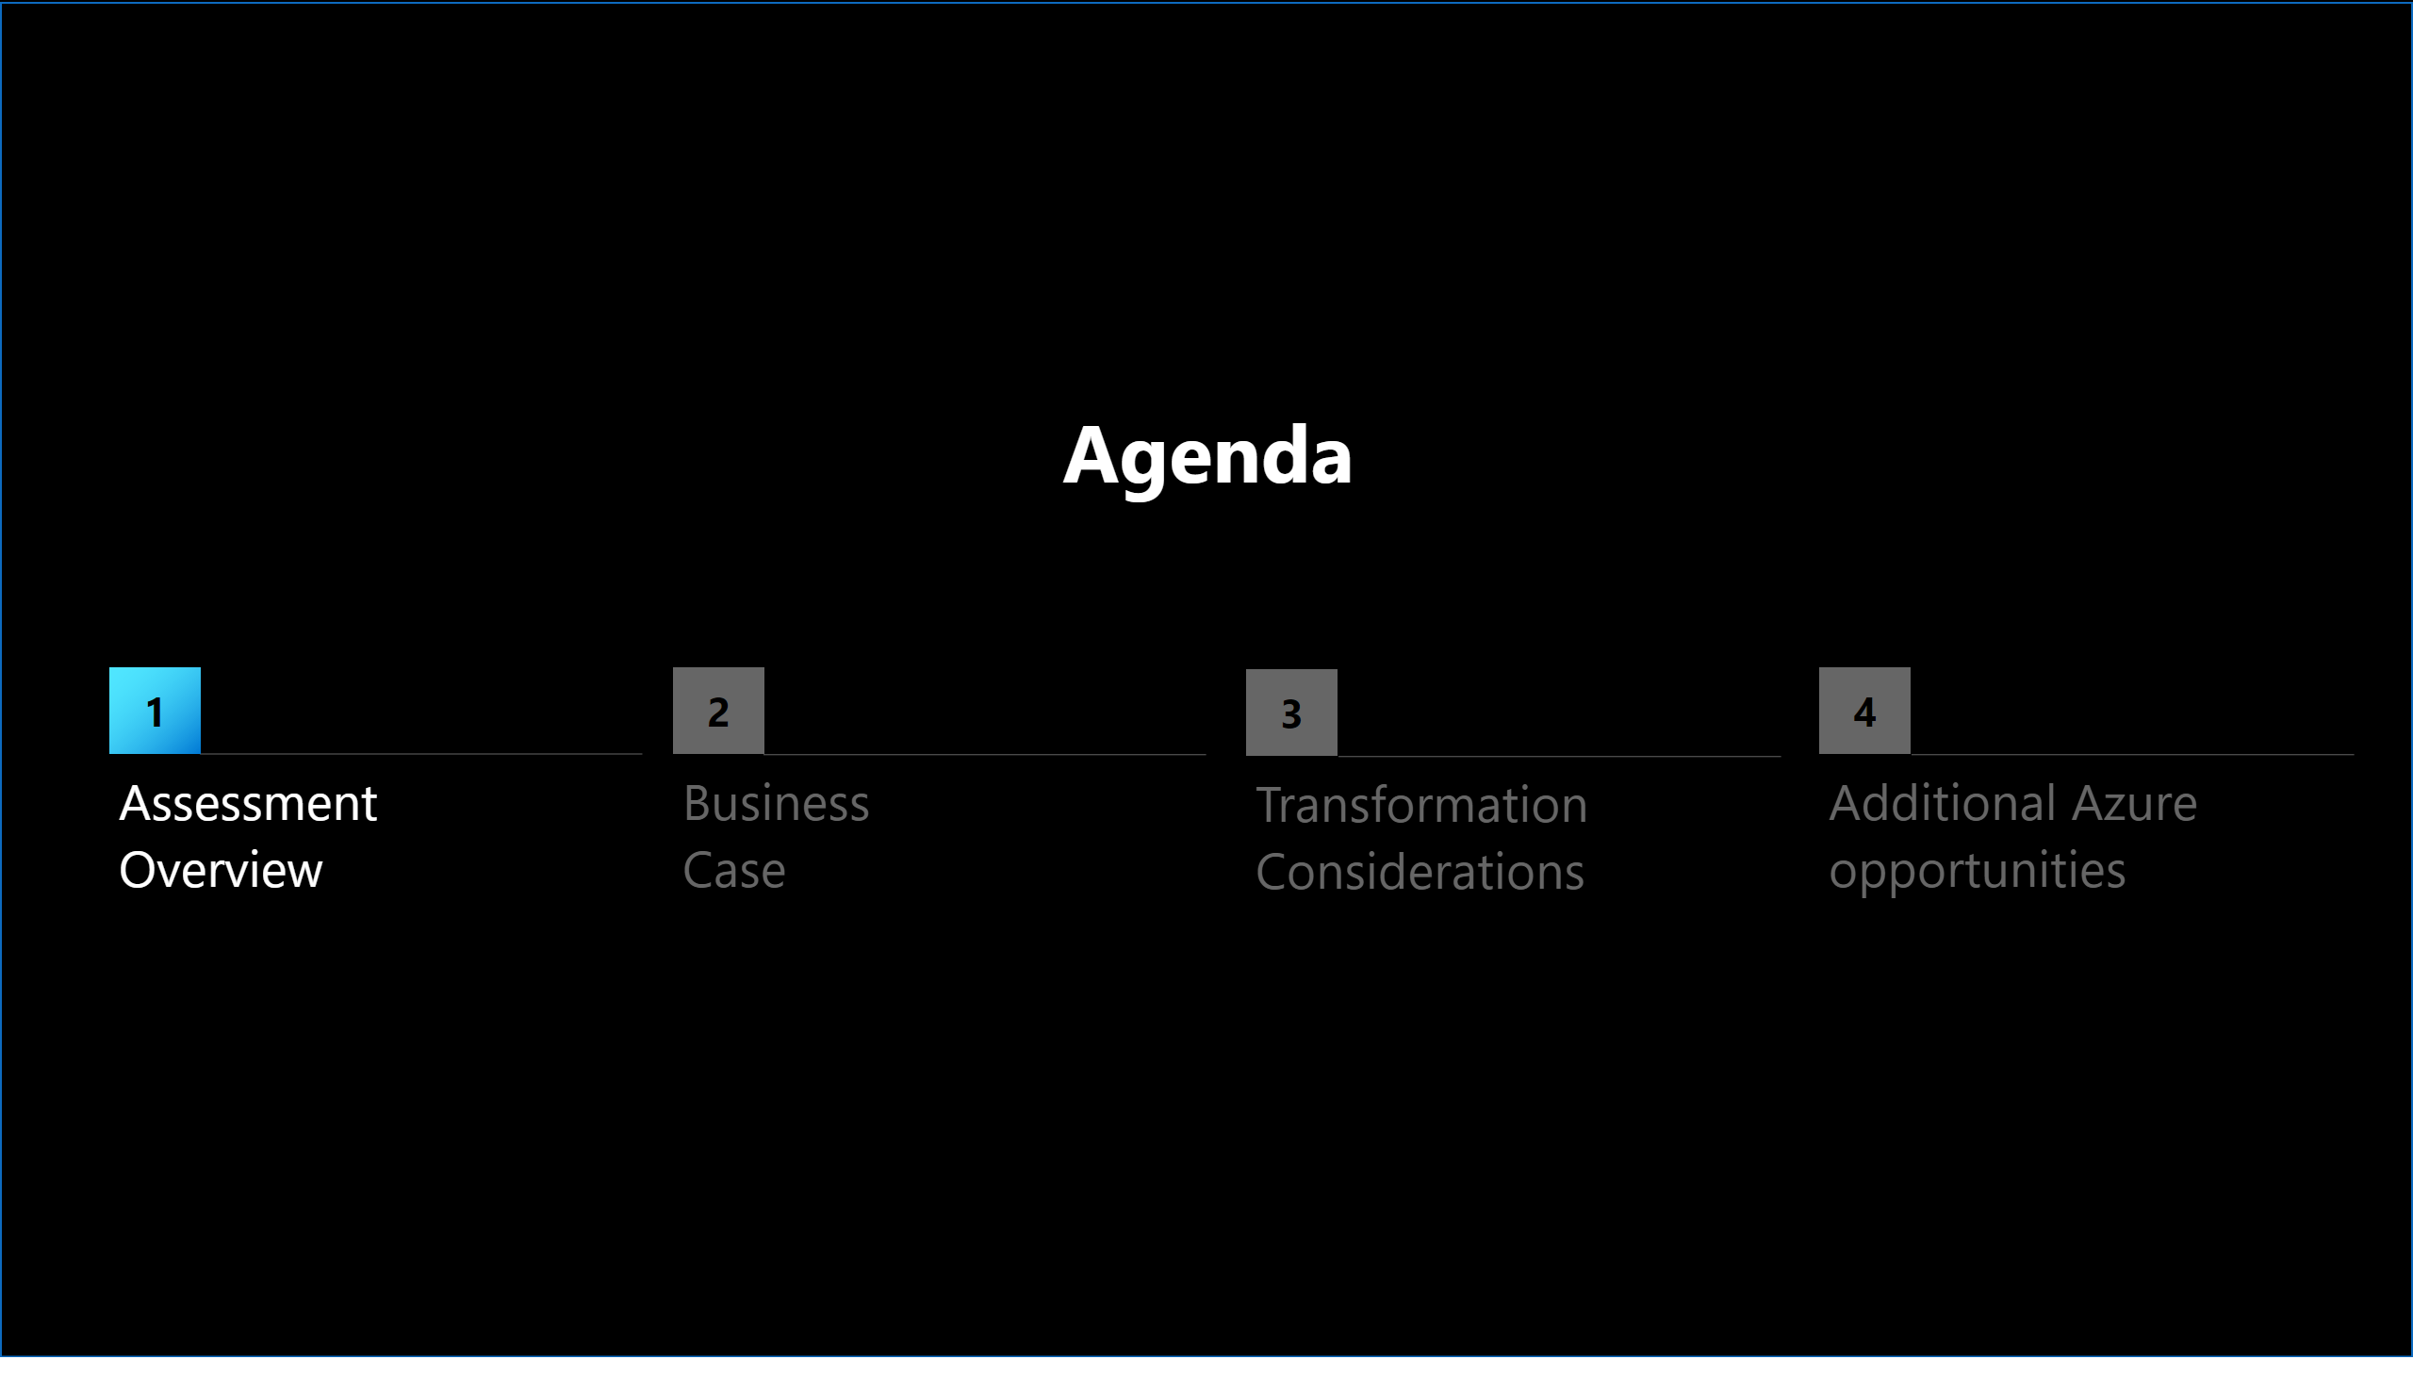
Slide 2
Notes:
shape
No alt text provided
shape
No alt text provided
shape
No alt text provided
shape
No alt text provided
textbox
No alt text provided
textbox
No alt text provided
textbox
No alt text provided
textbox
No alt text provided
textbox
No alt text provided
actionButton
No alt text provided
actionButton
No alt text provided
actionButton
No alt text provided
actionButton
No alt text provided
shape
No alt text provided

Slide 3
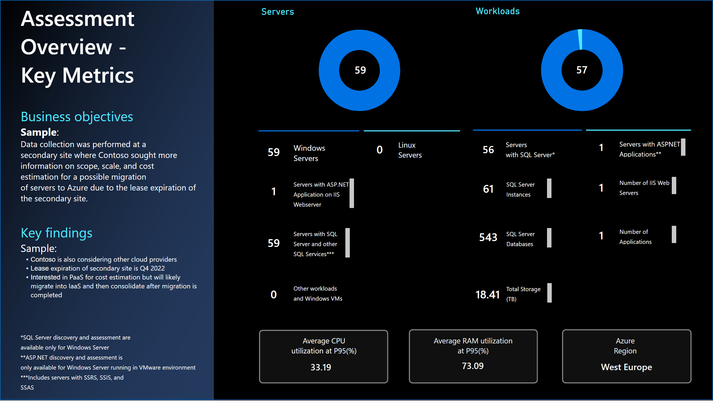
Slide 3
Notes:
card
No alt text provided
check applied filter
No alt text provided
card
No alt text provided
card
No alt text provided
card
No alt text provided
check applied filter
No alt text provided
card
No alt text provided
card
No alt text provided
card
No alt text provided
card
No alt text provided
card
No alt text provided
card
No alt text provided
card
No alt text provided
actionButton
No alt text provided
card
No alt text provided
Servers
No alt text provided
card
No alt text provided
Workloads
No alt text provided
card
No alt text provided
card
No alt text provided
actionButton
No alt text provided
Assessment Overview - Key Metrics
No alt text provided
textbox
No alt text provided
textbox
No alt text provided
textbox
No alt text provided
shape
No alt text provided
shape
No alt text provided
shape
No alt text provided
shape
No alt text provided
textbox
No alt text provided
textbox
No alt text provided
textbox
No alt text provided
textbox
No alt text provided
textbox
No alt text provided
textbox
No alt text provided
textbox
No alt text provided
textbox
No alt text provided
textbox
No alt text provided
textbox
No alt text provided
textbox
No alt text provided
textbox
No alt text provided
shape
No alt text provided
textbox
No alt text provided
textbox
No alt text provided
textbox
No alt text provided
shape
No alt text provided
shape
No alt text provided
shape
No alt text provided

Slide 4
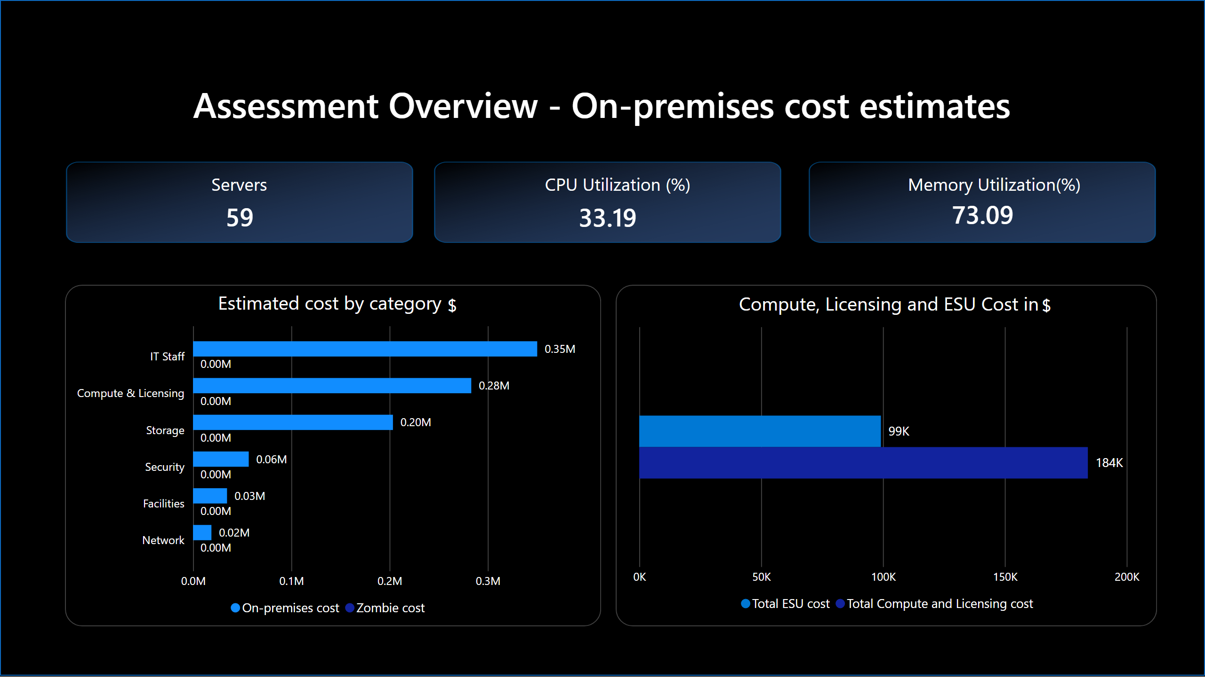
Slide 4
Notes:
Assessment Overview - On-premises cost estimates
No alt text provided
card
No alt text provided
actionButton
No alt text provided
actionButton
No alt text provided
actionButton
No alt text provided
shape
No alt text provided
shape
No alt text provided
Servers
No alt text provided
CPU Utilization (%)
No alt text provided
card
No alt text provided
card
No alt text provided
card
No alt text provided
Memory Utilization(%)
No alt text provided
card
No alt text provided
Estimated cost by category
No alt text provided
Compute, Licensing and ESU Cost in
No alt text provided
shape
No alt text provided

Slide 5
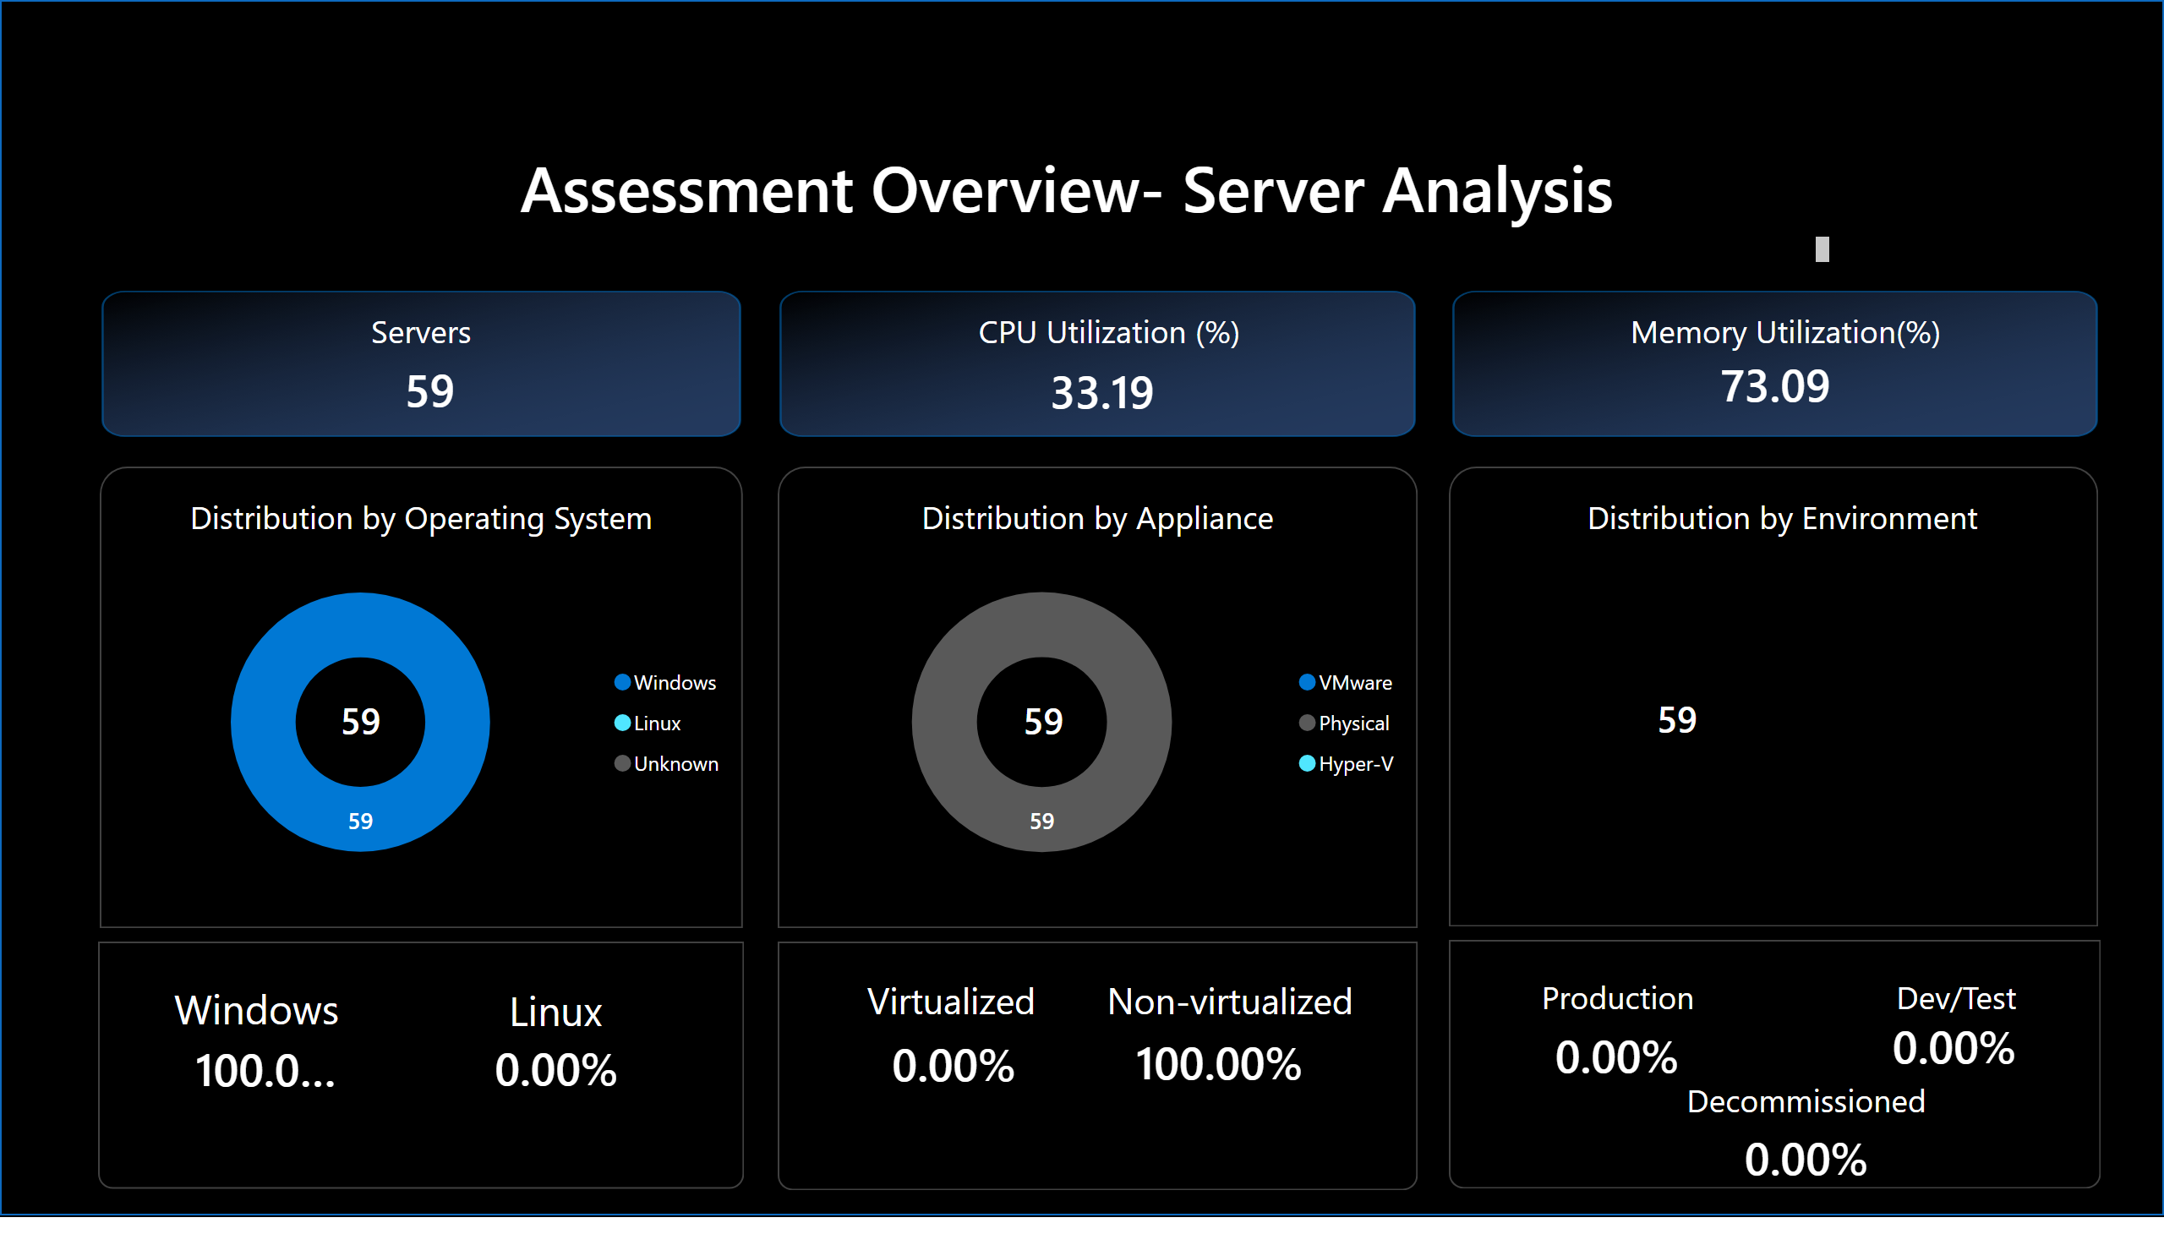
Slide 5
Notes:
Assessment Overview- Server Analysis
No alt text provided
Distribution by Operating System
No alt text provided
Distribution by Environment
No alt text provided
Distribution by Appliance
No alt text provided
card
No alt text provided
card
No alt text provided
textbox
No alt text provided
textbox
No alt text provided
card
No alt text provided
textbox
No alt text provided
card
No alt text provided
textbox
No alt text provided
card
No alt text provided
card
No alt text provided
card
No alt text provided
card
No alt text provided
card
No alt text provided
card
No alt text provided
textbox
No alt text provided
textbox
No alt text provided
textbox
No alt text provided
actionButton
No alt text provided
actionButton
No alt text provided
actionButton
No alt text provided
Servers
No alt text provided
CPU Utilization (%)
No alt text provided
card
No alt text provided
card
No alt text provided
card
No alt text provided
Memory Utilization(%)
No alt text provided
shape
No alt text provided
shape
No alt text provided
shape
No alt text provided
shape
No alt text provided
shape
No alt text provided
shape
No alt text provided
shape
No alt text provided

Slide 6
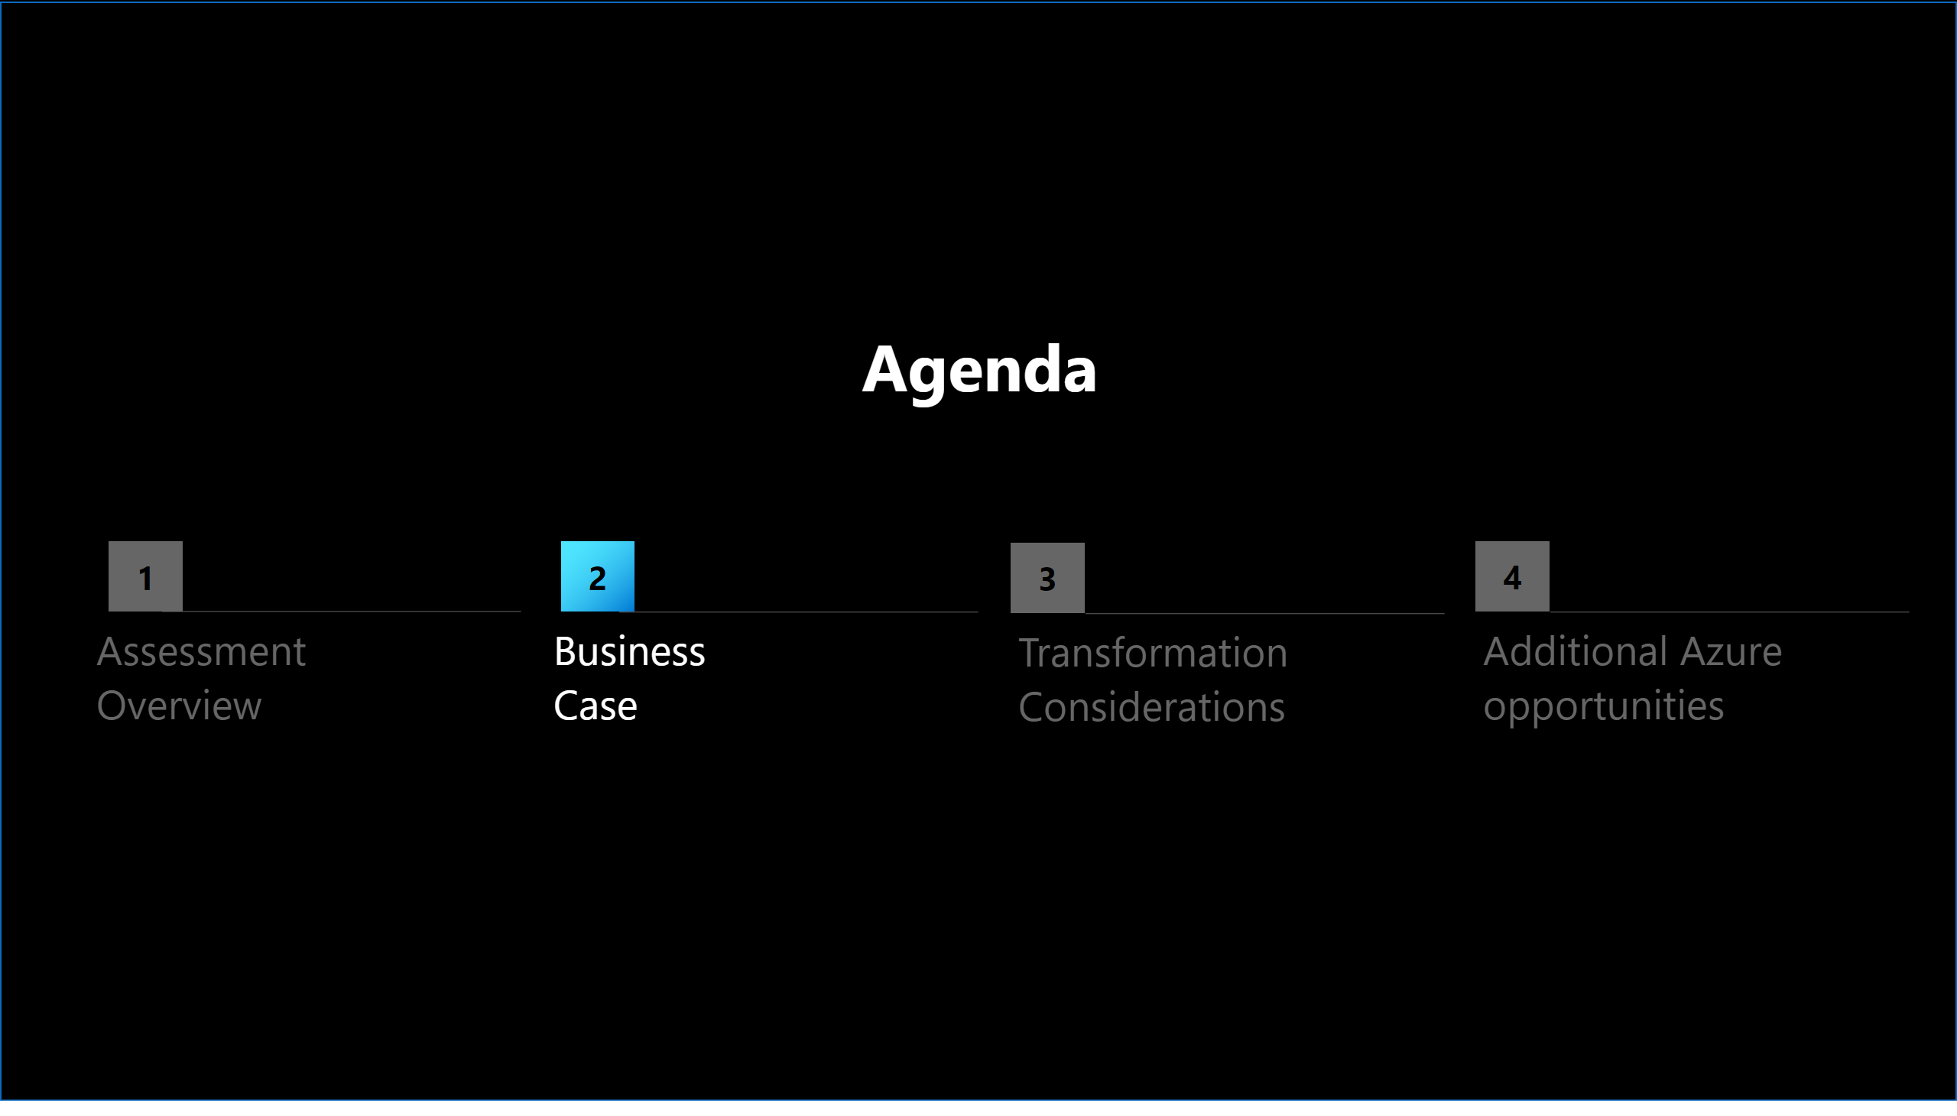
Slide 6
Notes:
shape
No alt text provided
shape
No alt text provided
shape
No alt text provided
shape
No alt text provided
textbox
No alt text provided
textbox
No alt text provided
textbox
No alt text provided
textbox
No alt text provided
textbox
No alt text provided
actionButton
No alt text provided
actionButton
No alt text provided
actionButton
No alt text provided
actionButton
No alt text provided
shape
No alt text provided

Slide 7
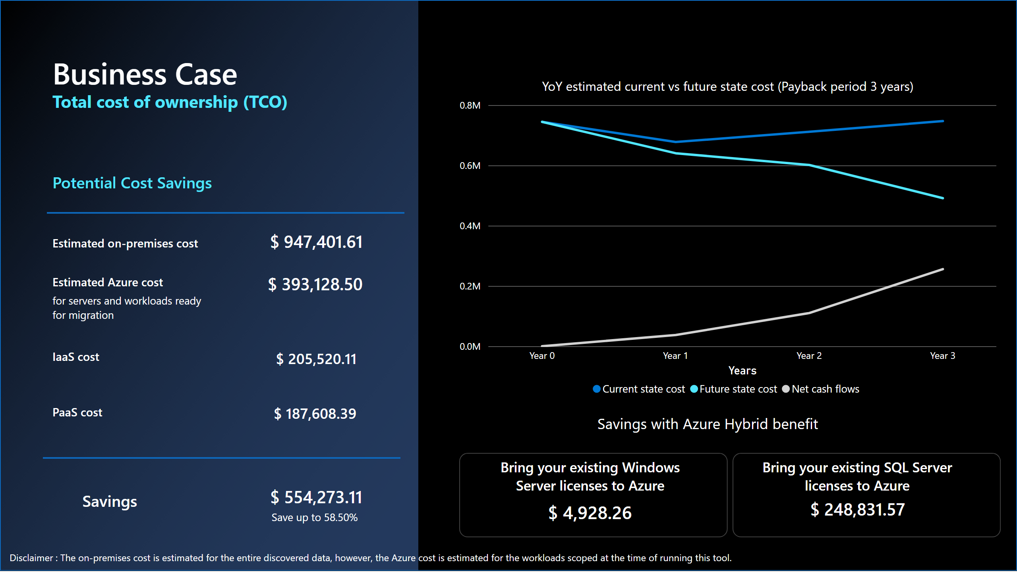
Slide 7
Notes:
Estimated on-premises cost​
No alt text provided
YoY estimated current vs future state cost (Payback period 3 years)
No alt text provided
Bring your existing Windows Server licenses to Azure
No alt text provided
Bring your existing SQL Server licenses to Azure
No alt text provided
shape
No alt text provided
shape
No alt text provided
card
No alt text provided
card
No alt text provided
actionButton
No alt text provided
card
No alt text provided
card
No alt text provided
card
No alt text provided
card
No alt text provided
Estimated on-premises cost​
No alt text provided
Estimated Azure cost​
No alt text provided
IaaS cost
No alt text provided
PaaS cost
No alt text provided
Potential Cost Savings
No alt text provided
shape
No alt text provided
shape
No alt text provided
Business Case
No alt text provided
textbox
No alt text provided
card
No alt text provided
card
No alt text provided
textbox
No alt text provided
card
No alt text provided
shape
No alt text provided

Slide 8
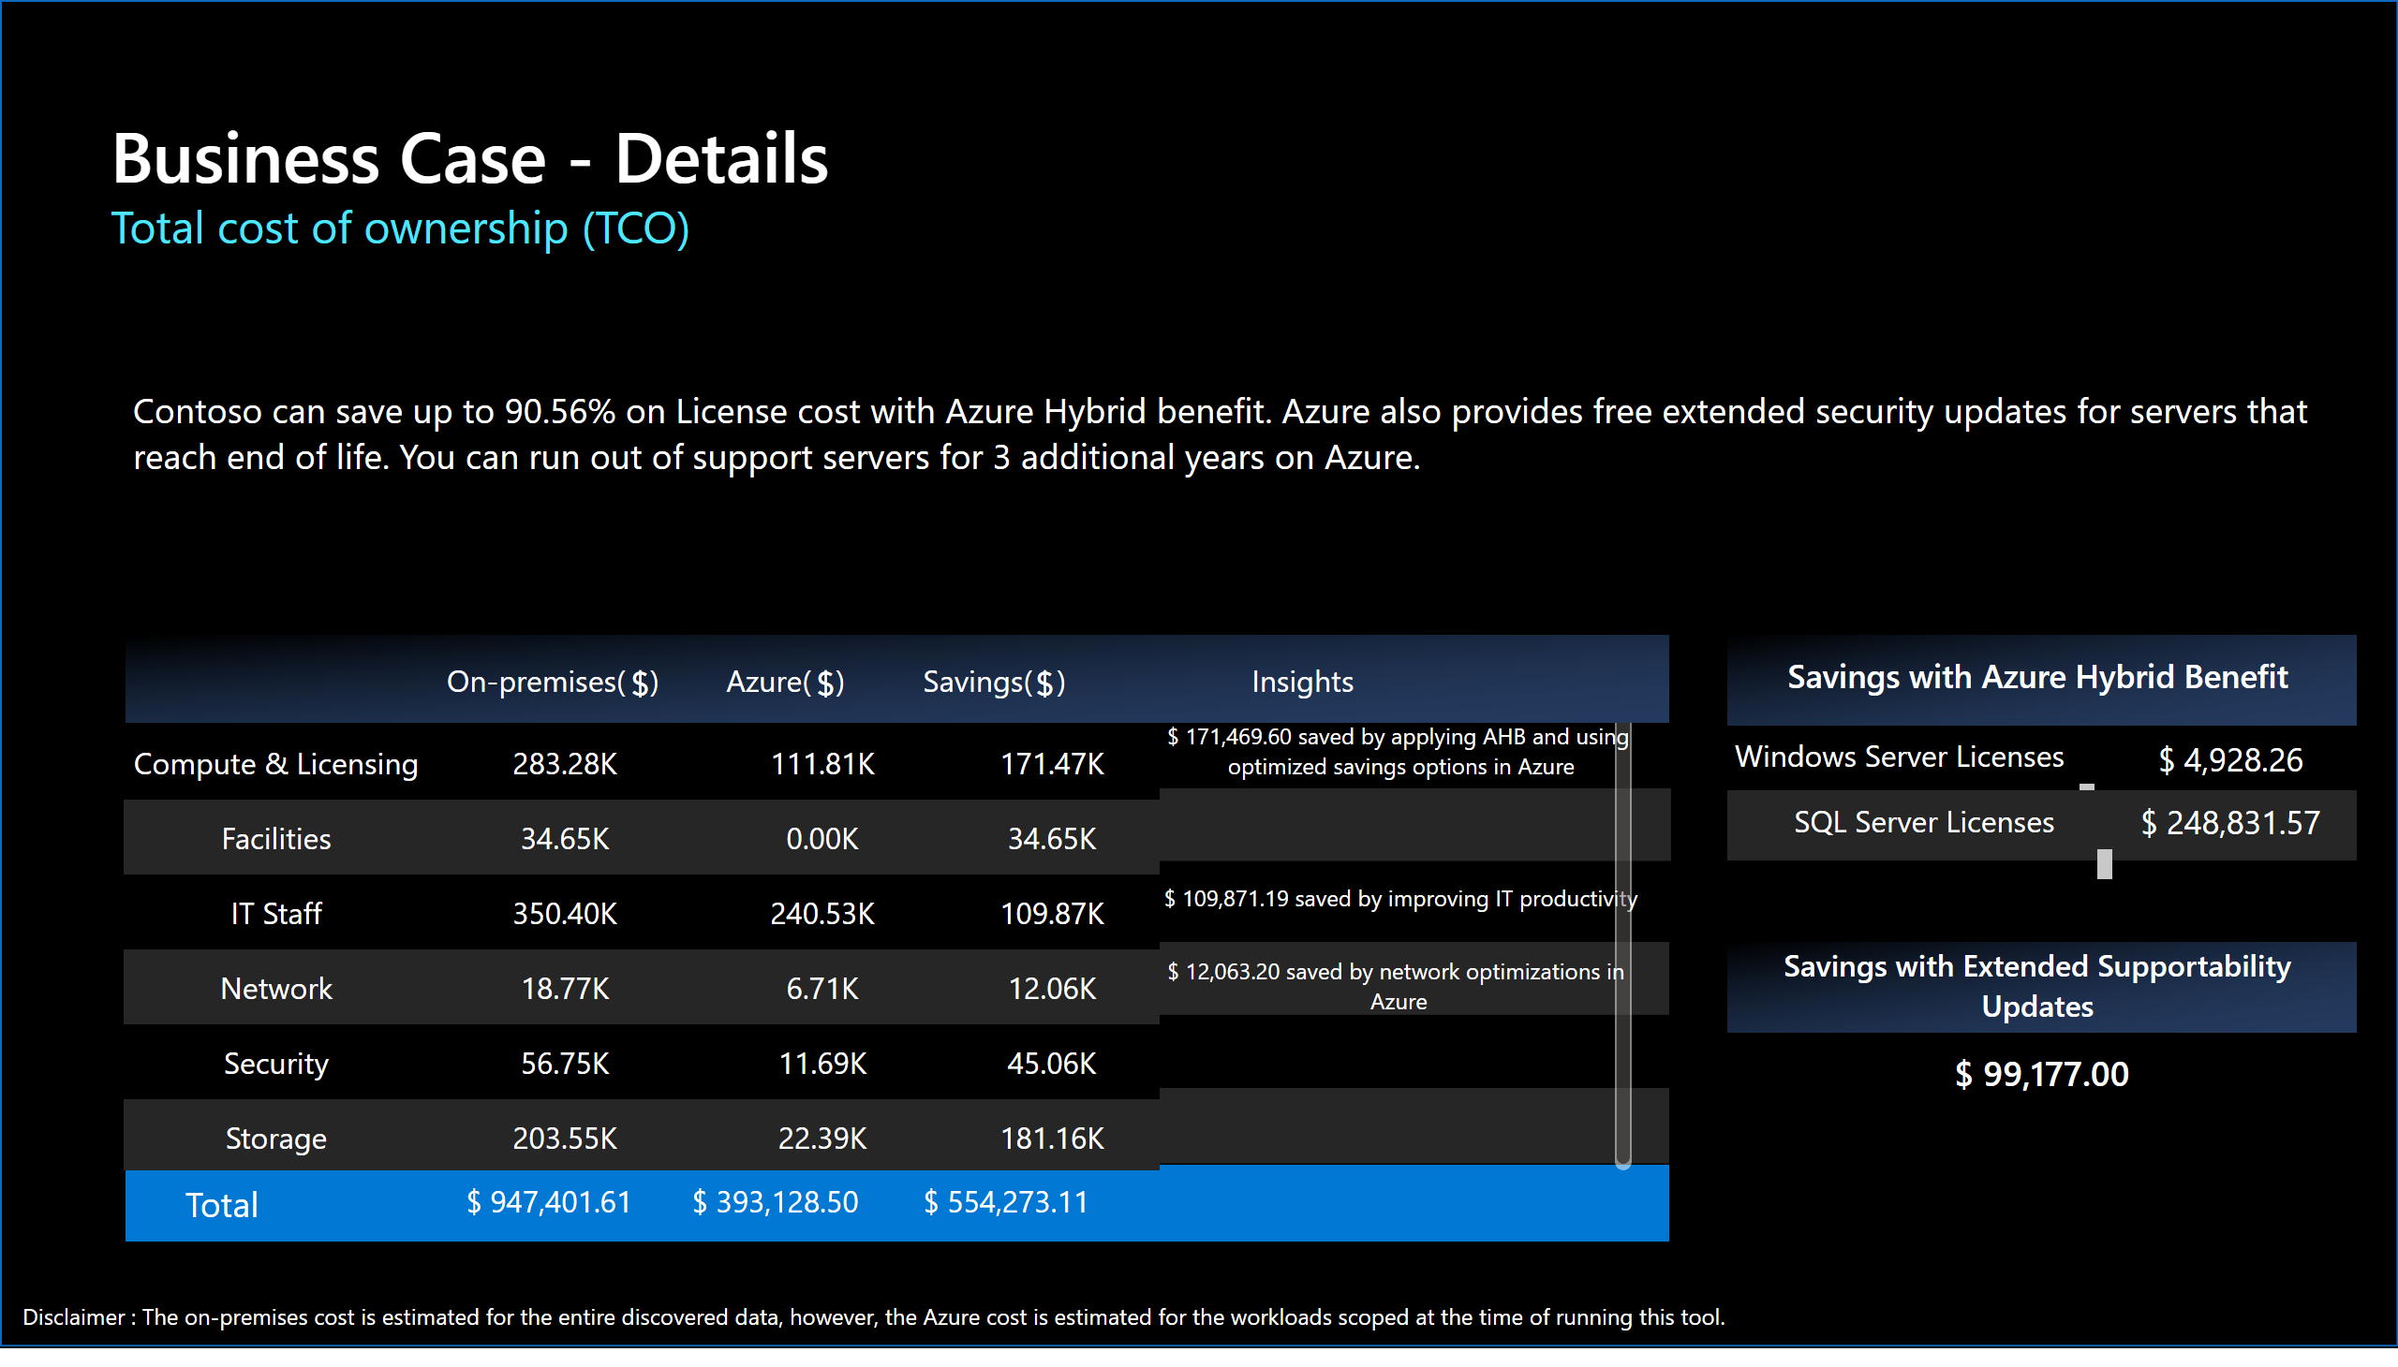
Slide 8
Notes:
Business Case - Details
No alt text provided
Total cost of ownership (TCO)
No alt text provided
card
No alt text provided
Windows Server Licenses
No alt text provided
card
No alt text provided
actionButton
No alt text provided
shape
No alt text provided
shape
No alt text provided
card
No alt text provided
actionButton
No alt text provided
shape
No alt text provided
Total
No alt text provided
card
No alt text provided
card
No alt text provided
card
No alt text provided
Savings with Azure Hybrid Benefit
No alt text provided
shape
No alt text provided
card
No alt text provided
SQL Server Licenses
No alt text provided
Savings with Extended Supportability Updates
No alt text provided
shape
No alt text provided
tableEx
No alt text provided
actionButton
No alt text provided
textbox
No alt text provided
card
No alt text provided
card
No alt text provided
card
No alt text provided
card
No alt text provided
card
No alt text provided
actionButton
No alt text provided
textbox
No alt text provided
shape
No alt text provided

Slide 9
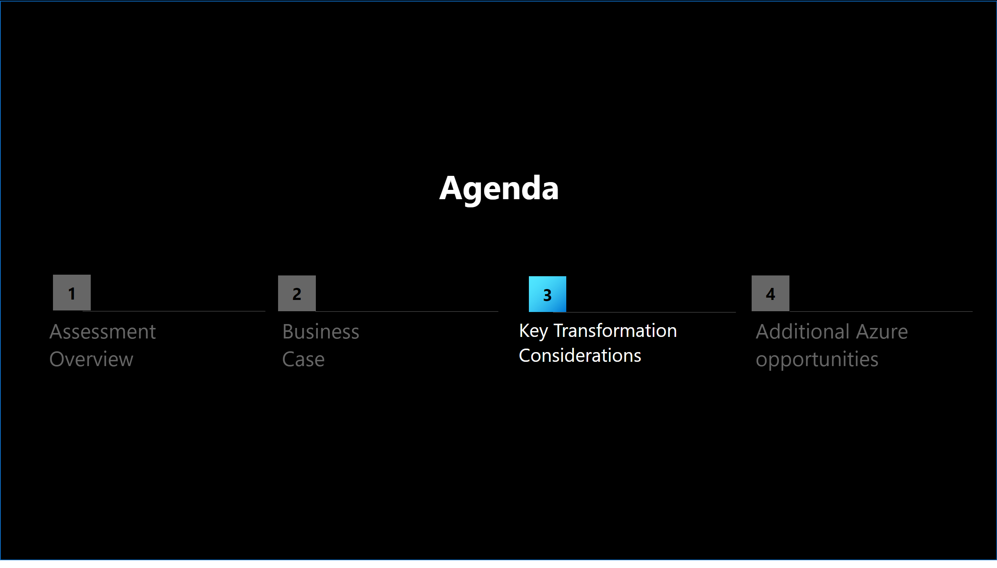
Slide 9
Notes:
shape
No alt text provided
shape
No alt text provided
shape
No alt text provided
shape
No alt text provided
textbox
No alt text provided
textbox
No alt text provided
textbox
No alt text provided
textbox
No alt text provided
textbox
No alt text provided
actionButton
No alt text provided
actionButton
No alt text provided
actionButton
No alt text provided
actionButton
No alt text provided
shape
No alt text provided

Slide 10
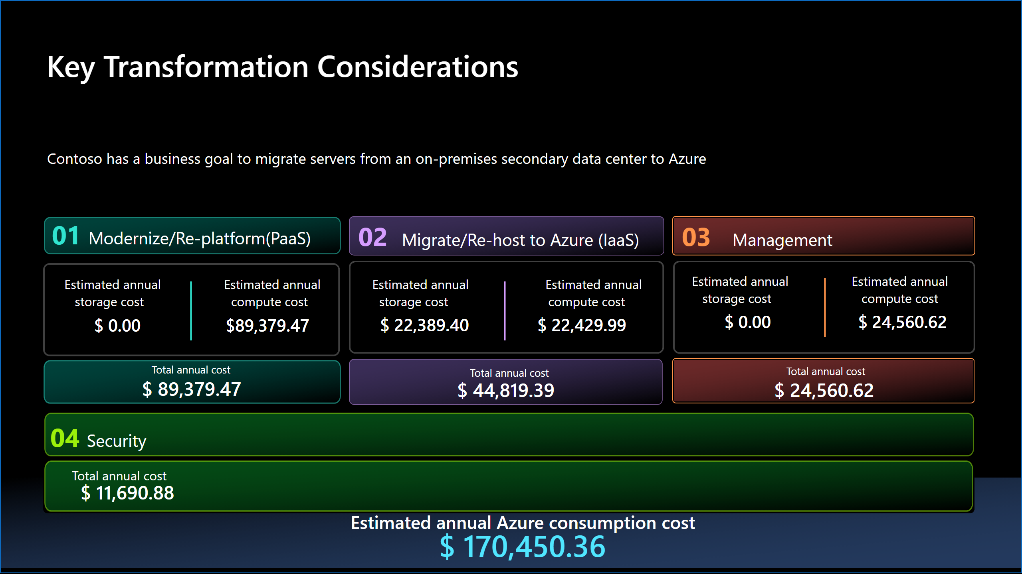
Slide 10
Notes:
Key Transformation Considerations
No alt text provided
textbox
No alt text provided
textbox
No alt text provided
textbox
No alt text provided
textbox
No alt text provided
shape
No alt text provided
card
No alt text provided
card
No alt text provided
card
No alt text provided
card
No alt text provided
card
No alt text provided
card
No alt text provided
actionButton
No alt text provided
textbox
No alt text provided
actionButton
No alt text provided
textbox
No alt text provided
card
No alt text provided
actionButton
No alt text provided
textbox
No alt text provided
shape
No alt text provided
shape
No alt text provided
actionButton
No alt text provided
card
No alt text provided
Estimated annual Azure consumption cost
No alt text provided
actionButton
No alt text provided
card
No alt text provided
textbox
No alt text provided
actionButton
No alt text provided
textbox
No alt text provided
actionButton
No alt text provided
textbox
No alt text provided
card
No alt text provided
actionButton
No alt text provided
actionButton
No alt text provided
textbox
No alt text provided
card
No alt text provided
shape
No alt text provided
shape
No alt text provided
shape
No alt text provided
textbox
No alt text provided
shape
No alt text provided

Slide 11
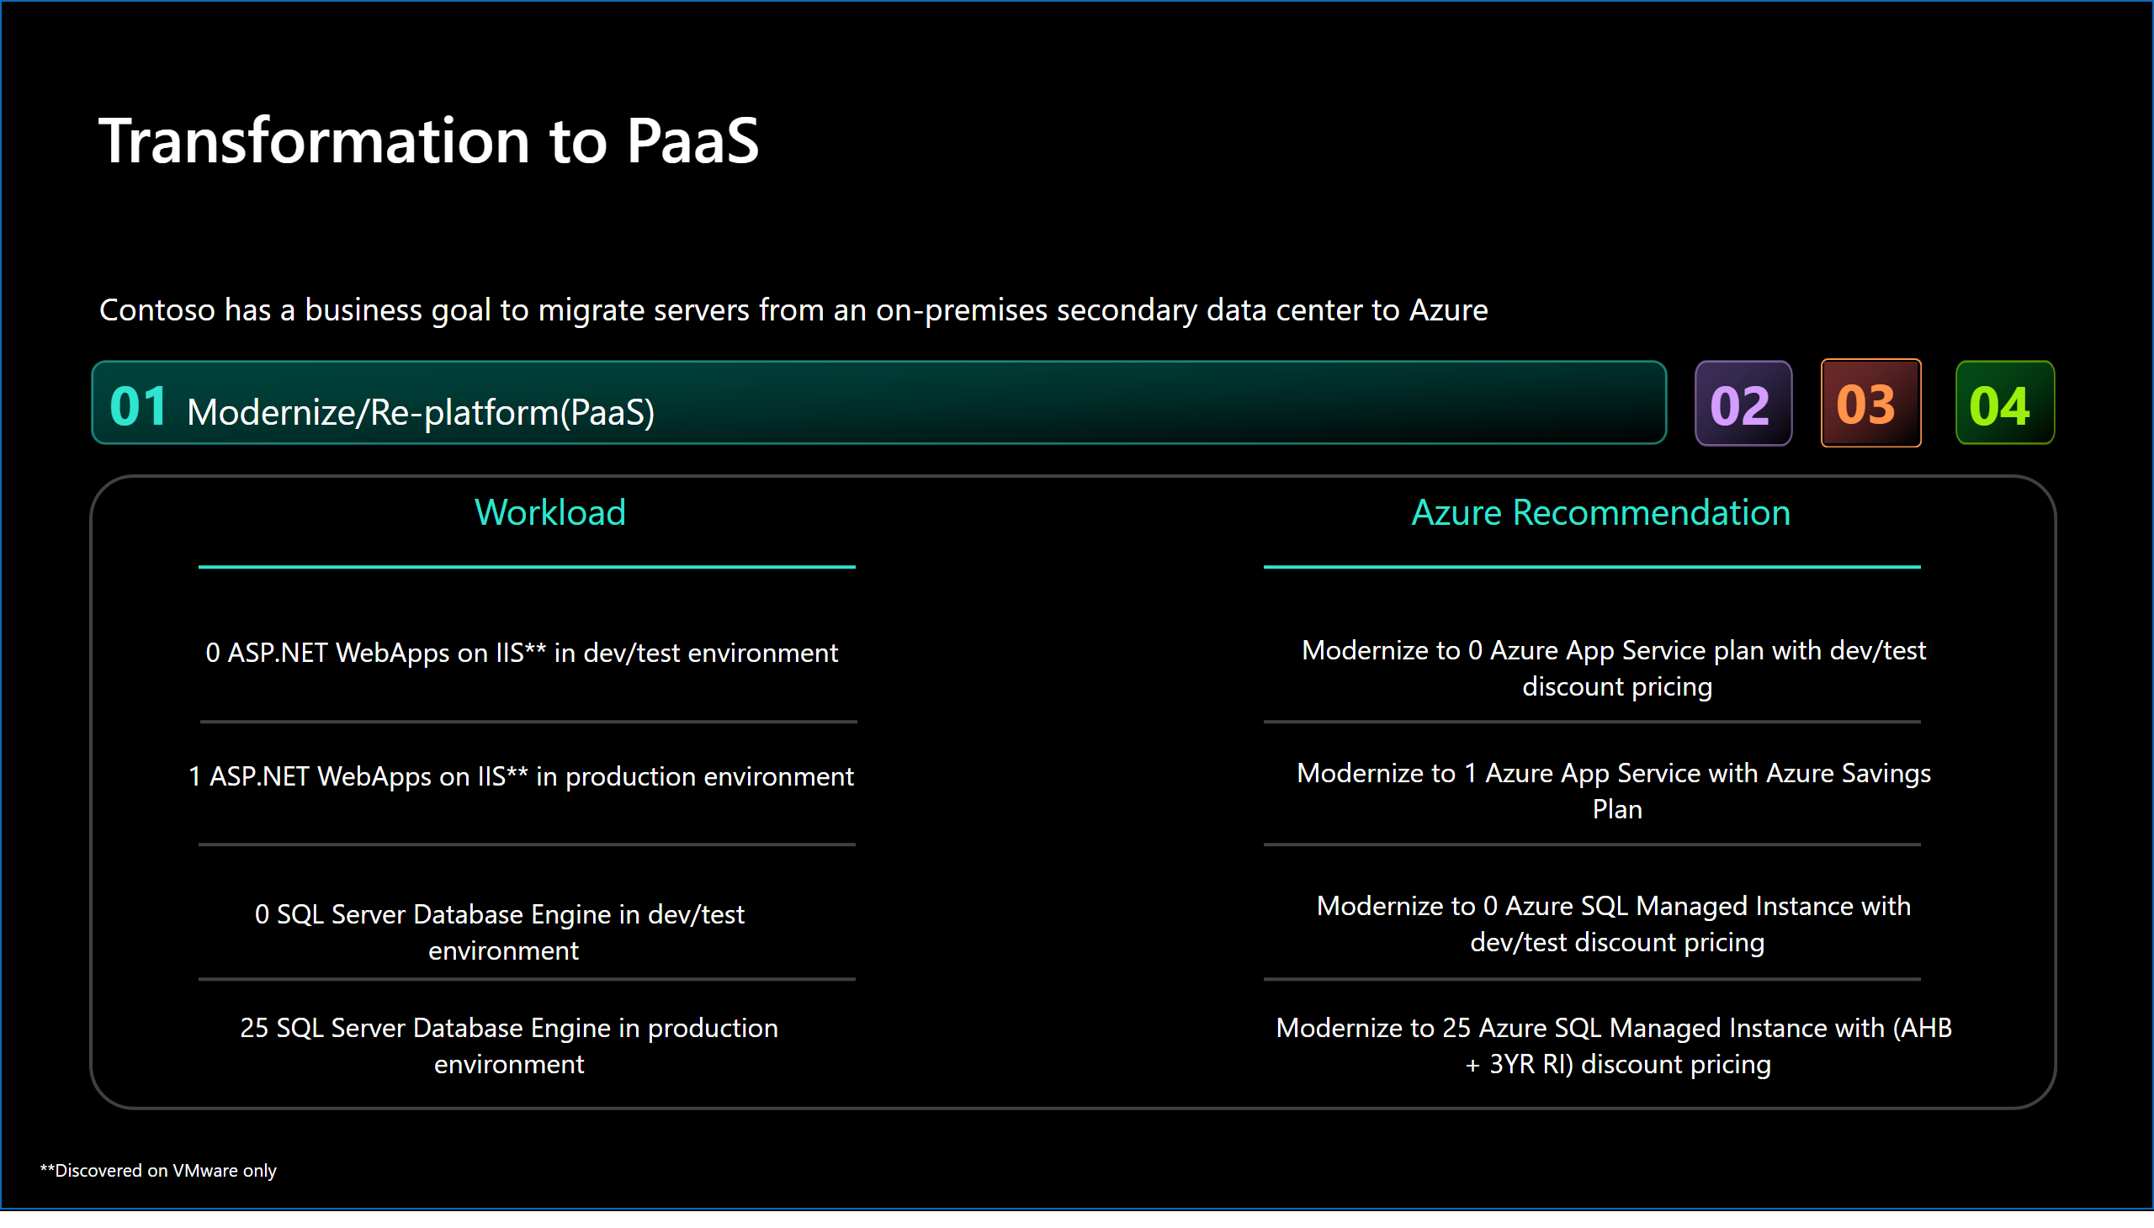
Slide 11
Notes:
Transformation to PaaS
No alt text provided
textbox
No alt text provided
textbox
No alt text provided
textbox
No alt text provided
card
No alt text provided
card
No alt text provided
card
No alt text provided
card
No alt text provided
card
No alt text provided
card
No alt text provided
card
No alt text provided
card
No alt text provided
shape
No alt text provided
shape
No alt text provided
shape
No alt text provided
textbox
No alt text provided
shape
No alt text provided
shape
No alt text provided
shape
No alt text provided
shape
No alt text provided
shape
No alt text provided
shape
No alt text provided
actionButton
No alt text provided
textbox
No alt text provided
actionButton
No alt text provided
actionButton
No alt text provided
actionButton
No alt text provided
textbox
No alt text provided
textbox
No alt text provided
textbox
No alt text provided
shape
No alt text provided

Slide 12
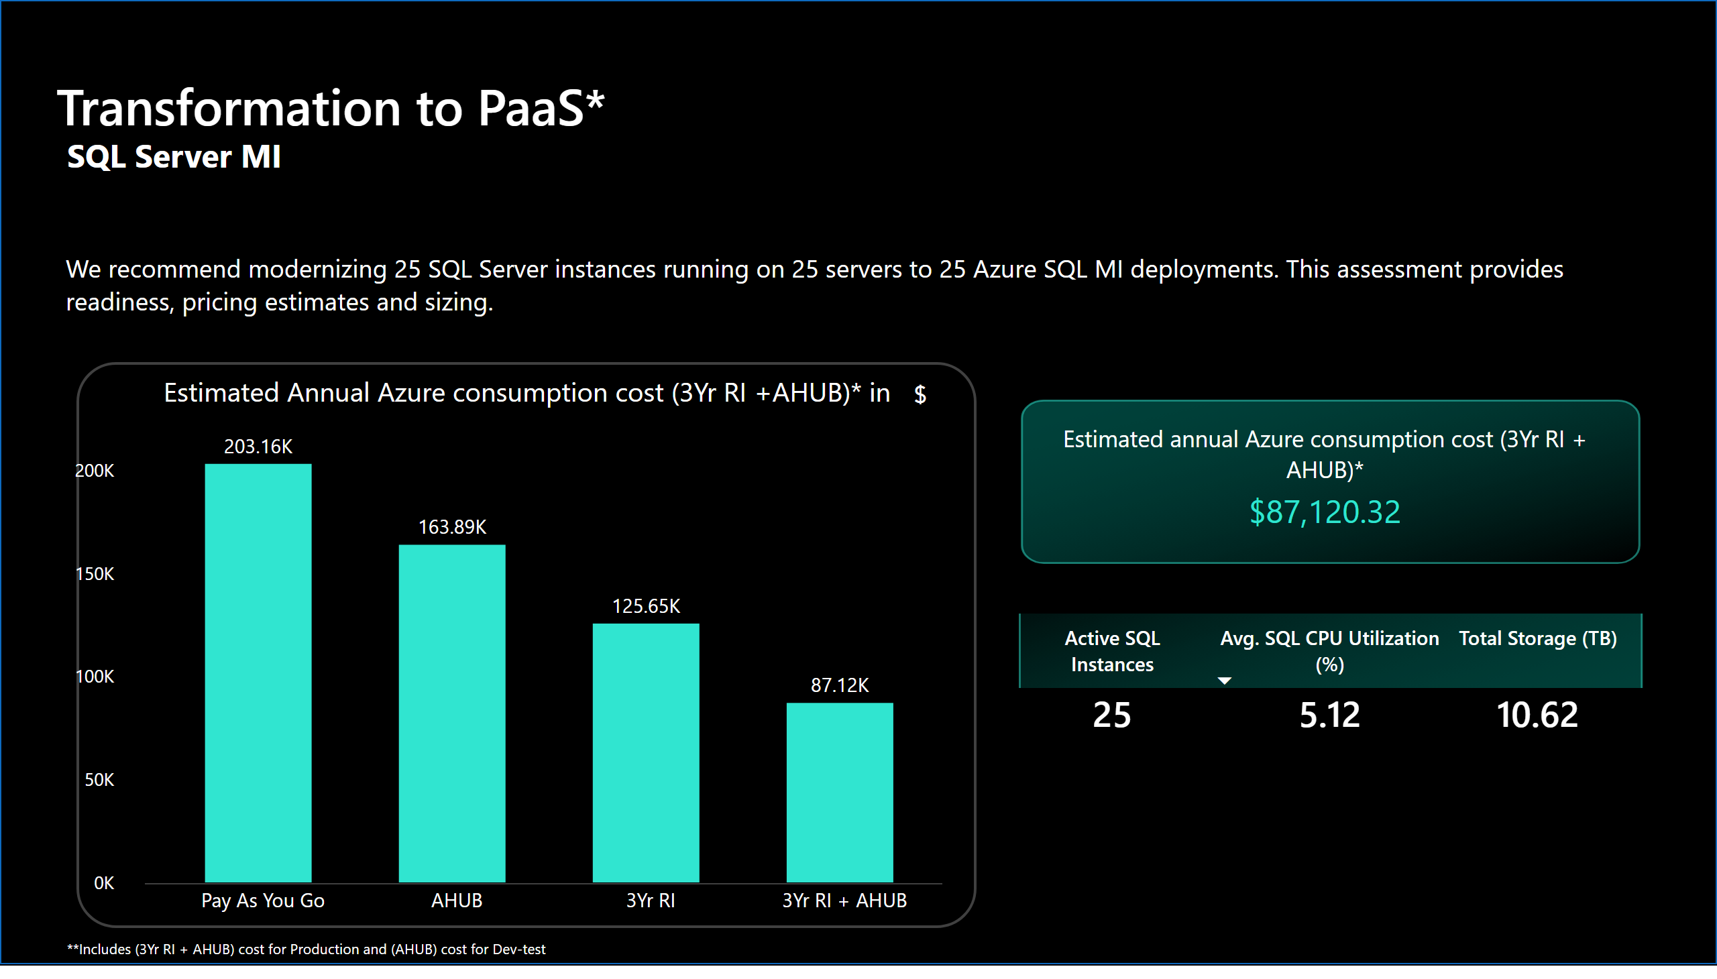
Slide 12
Notes:
Transformation to PaaS*
No alt text provided
textbox
No alt text provided
textbox
No alt text provided
card
No alt text provided
shape
No alt text provided
shape
No alt text provided
actionButton
No alt text provided
Estimated annual Azure consumption cost (3Yr RI + AHUB)*
No alt text provided
actionButton
No alt text provided
tableEx
No alt text provided
Estimated Annual Azure consumption cost (3Yr RI +AHUB)* in
No alt text provided
actionButton
No alt text provided
shape
No alt text provided

Slide 13
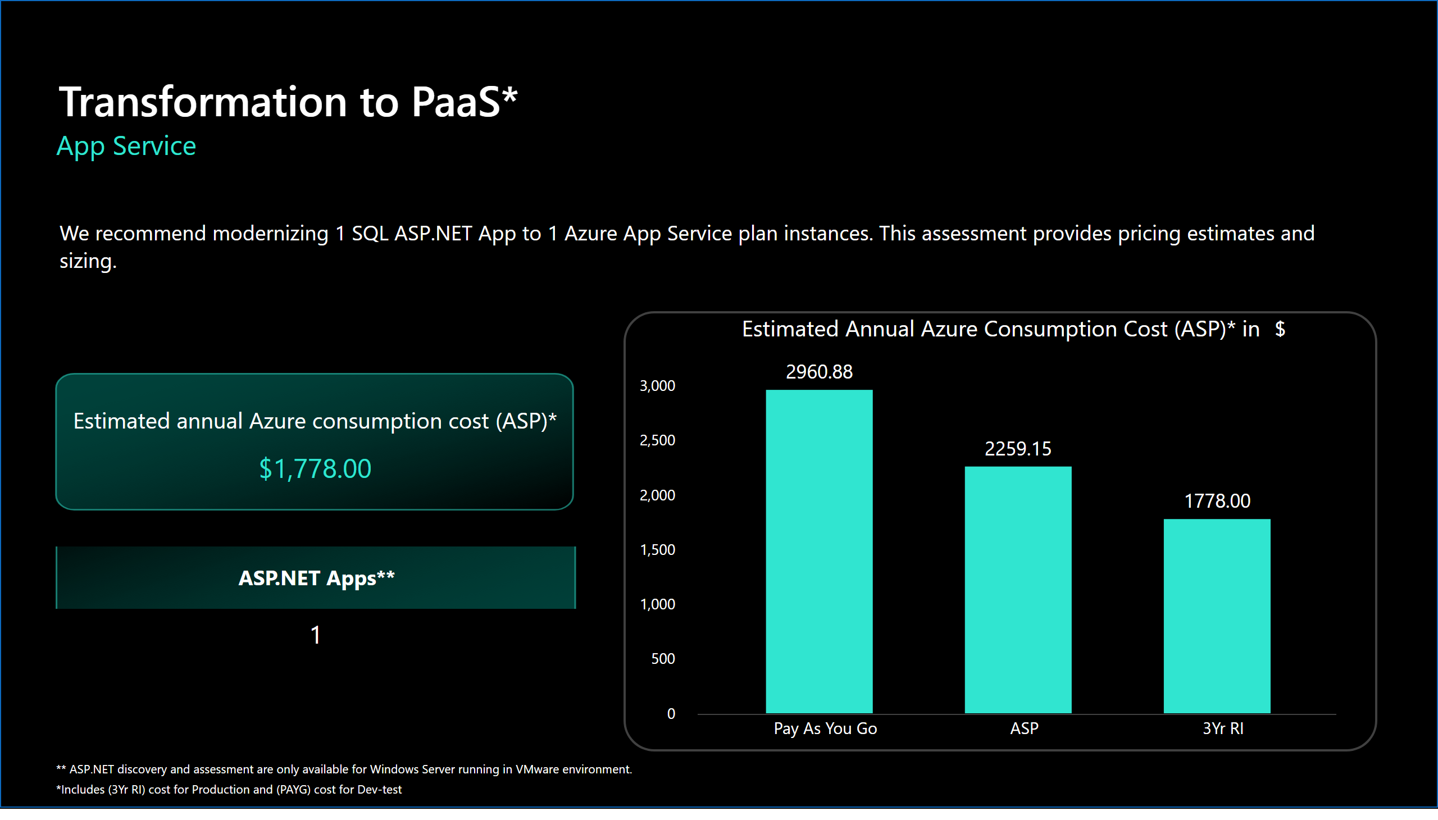
Slide 13
Notes:
textbox
No alt text provided
textbox
No alt text provided
Transformation to PaaS*
No alt text provided
card
No alt text provided
shape
No alt text provided
actionButton
No alt text provided
shape
No alt text provided
Estimated annual Azure consumption cost (ASP)*
No alt text provided
actionButton
No alt text provided
ASP.Net Apps
No alt text provided
No alt text provided
Estimated Annual Azure Consumption Cost (ASP)* in
No alt text provided
actionButton
No alt text provided
shape
No alt text provided

Slide 14
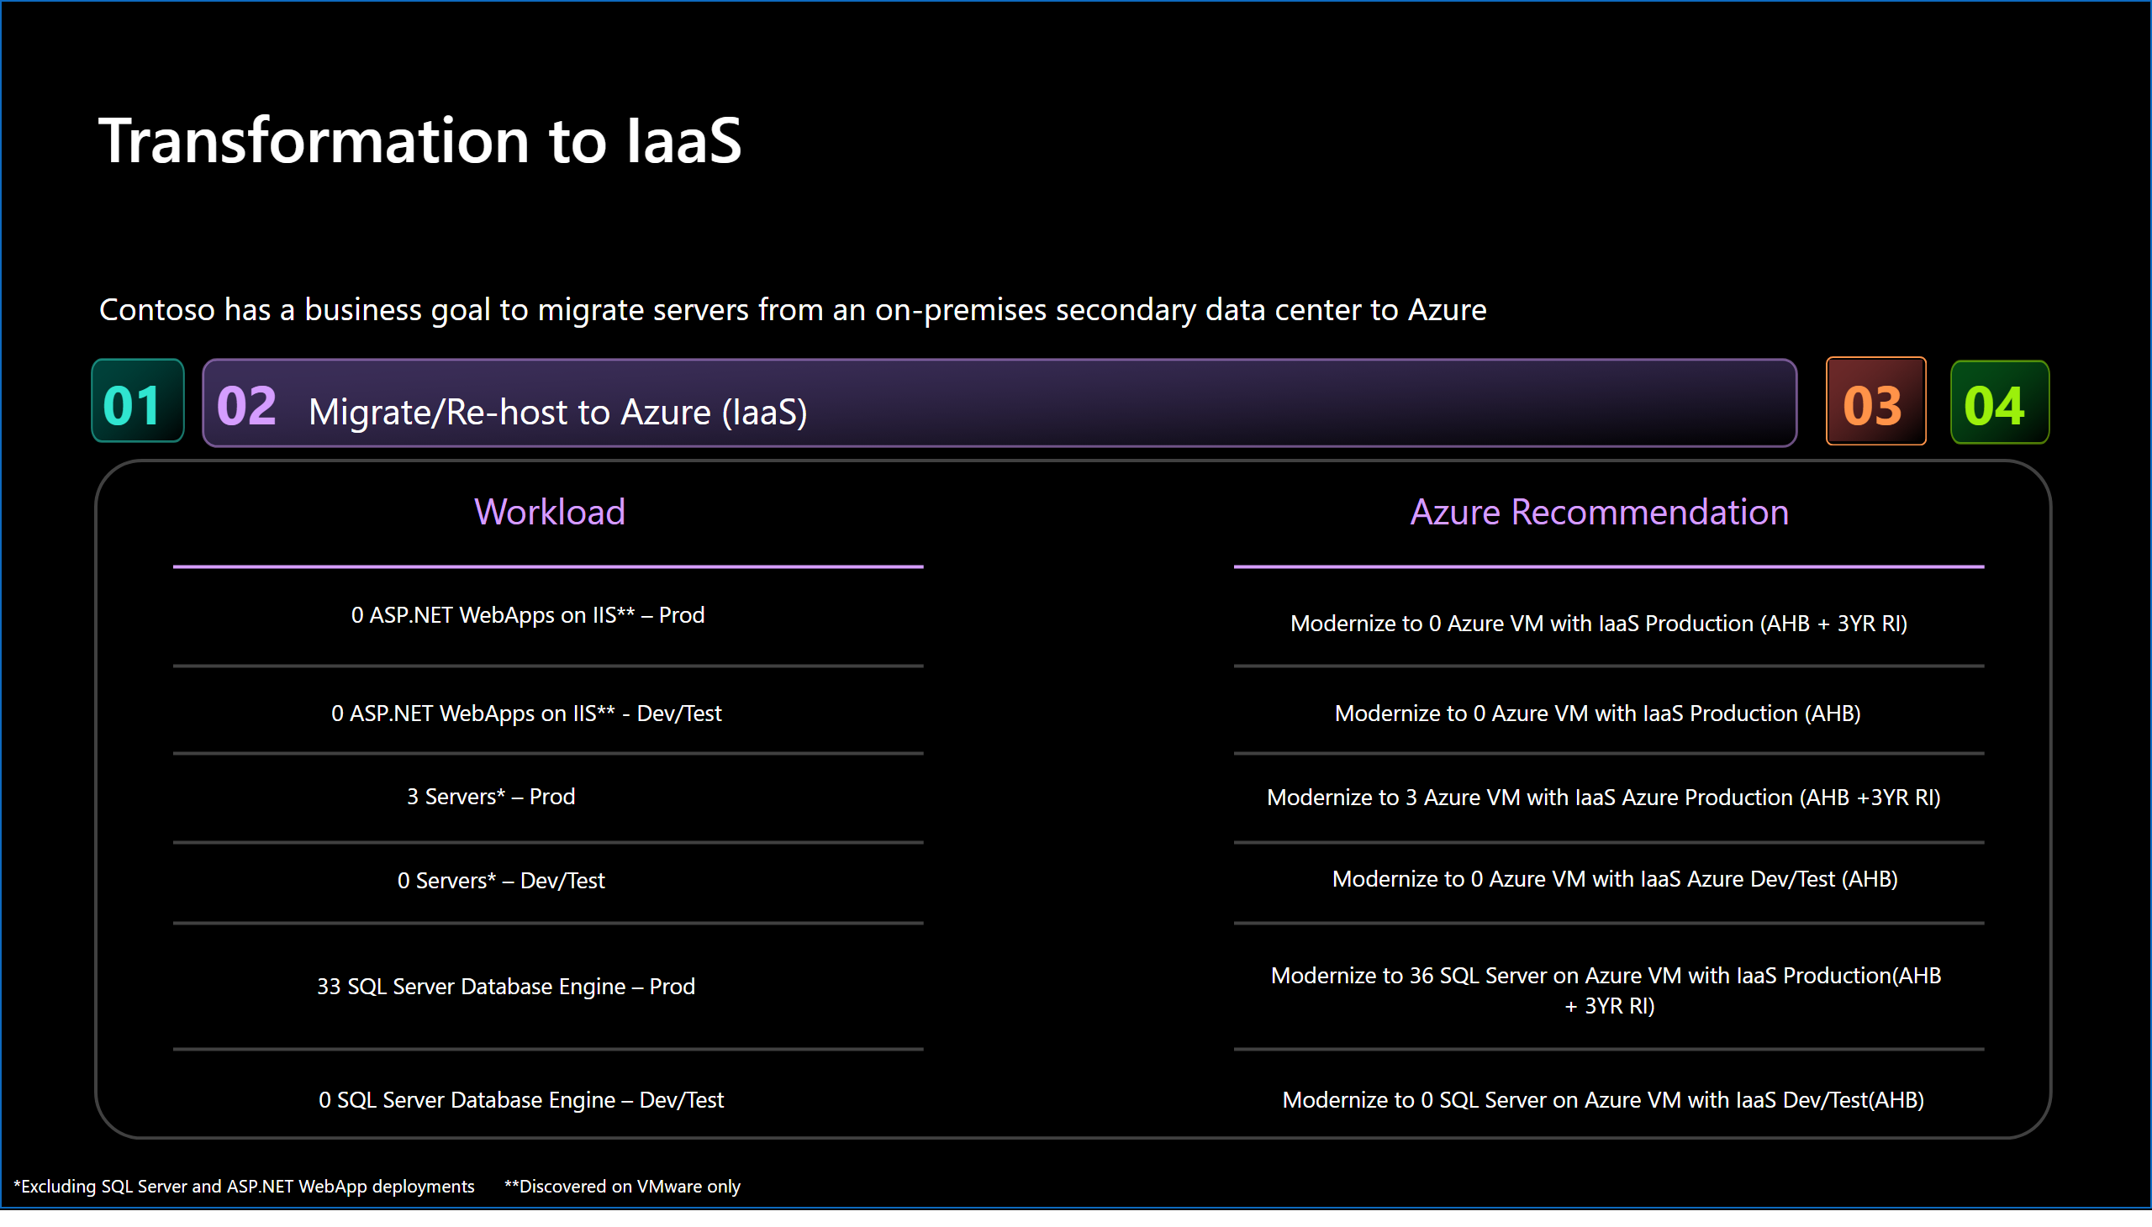
Slide 14
Notes:
Transformation to IaaS
No alt text provided
textbox
No alt text provided
textbox
No alt text provided
textbox
No alt text provided
card
No alt text provided
card
No alt text provided
card
No alt text provided
card
No alt text provided
shape
No alt text provided
shape
No alt text provided
card
No alt text provided
card
No alt text provided
card
No alt text provided
card
No alt text provided
card
No alt text provided
card
No alt text provided
card
No alt text provided
card
No alt text provided
shape
No alt text provided
textbox
No alt text provided
shape
No alt text provided
shape
No alt text provided
shape
No alt text provided
shape
No alt text provided
shape
No alt text provided
shape
No alt text provided
shape
No alt text provided
shape
No alt text provided
shape
No alt text provided
shape
No alt text provided
actionButton
No alt text provided
actionButton
No alt text provided
actionButton
No alt text provided
actionButton
No alt text provided
textbox
No alt text provided
textbox
No alt text provided
textbox
No alt text provided
textbox
No alt text provided
shape
No alt text provided

Slide 15
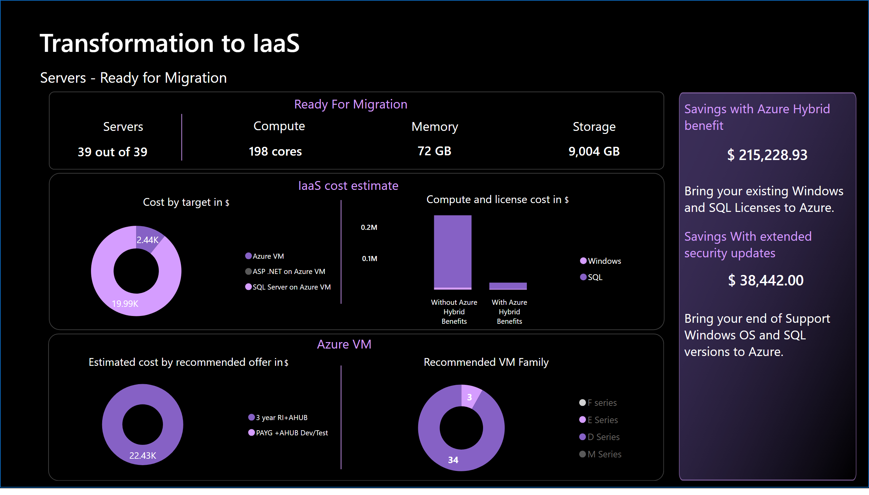
Slide 15
Notes:
Transformation to IaaS
No alt text provided
textbox
No alt text provided
textbox
No alt text provided
textbox
No alt text provided
textbox
No alt text provided
card
No alt text provided
card
No alt text provided
card
No alt text provided
textbox
No alt text provided
textbox
No alt text provided
textbox
No alt text provided
textbox
No alt text provided
shape
No alt text provided
card
No alt text provided
Recommended VM Family
No alt text provided
Cost by target in
No alt text provided
Estimated cost by recommended offer in
No alt text provided
shape
No alt text provided
shape
No alt text provided
shape
No alt text provided
shape
No alt text provided
card
No alt text provided
card
No alt text provided
shape
No alt text provided
card
No alt text provided
actionButton
No alt text provided
textbox
No alt text provided
card
No alt text provided
card
No alt text provided
Compute and license cost in
No alt text provided
shape
No alt text provided

Slide 16
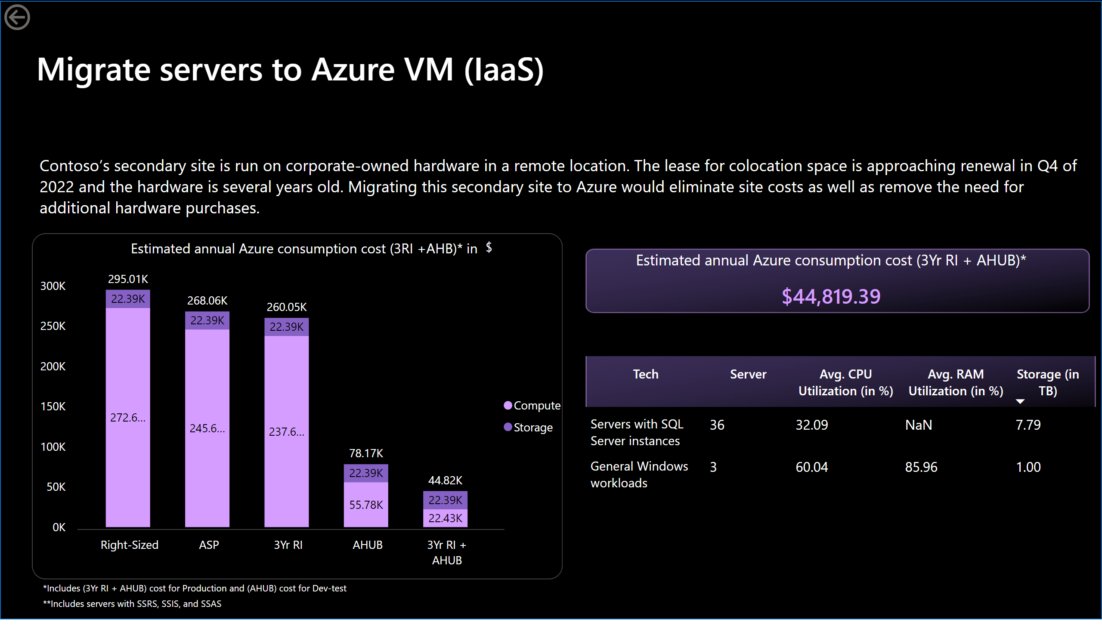
Slide 16
Notes:
actionButton
No alt text provided
*Production and Dev-test combined
No alt text provided
textbox
No alt text provided
Migrate servers to Azure VM (IaaS)
No alt text provided
Estimated annual Azure consumption cost (3RI +AHB)* in
No alt text provided
actionButton
No alt text provided
shape
No alt text provided
card
No alt text provided
actionButton
No alt text provided
Estimated annual Azure consumption cost (3Yr RI + AHUB)*
No alt text provided
shape
No alt text provided
actionButton
No alt text provided
pivotTable
No alt text provided
shape
No alt text provided

Slide 17
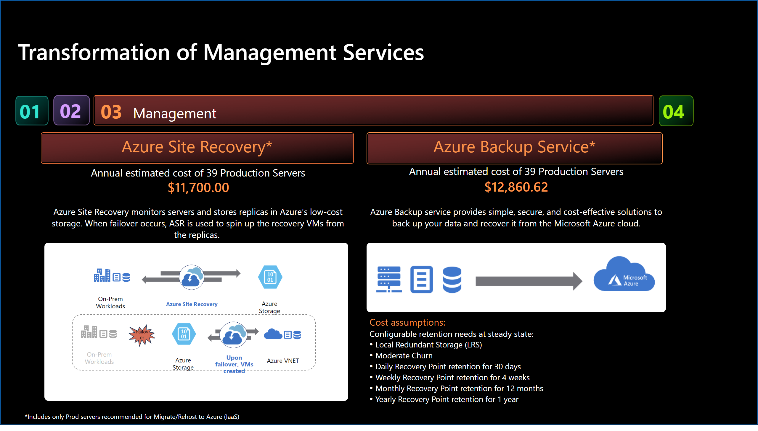
Slide 17
Notes:
Transformation of Management Services
No alt text provided
textbox
No alt text provided
image
No alt text provided
textbox
No alt text provided
card
No alt text provided
card
No alt text provided
card
No alt text provided
card
No alt text provided
textbox
No alt text provided
image
No alt text provided
textbox
No alt text provided
actionButton
No alt text provided
actionButton
No alt text provided
Azure Site Recovery*
No alt text provided
Azure Backup Service*
No alt text provided
actionButton
No alt text provided
actionButton
No alt text provided
textbox
No alt text provided
textbox
No alt text provided
actionButton
No alt text provided
actionButton
No alt text provided
textbox
No alt text provided
textbox
No alt text provided
shape
No alt text provided

Slide 18
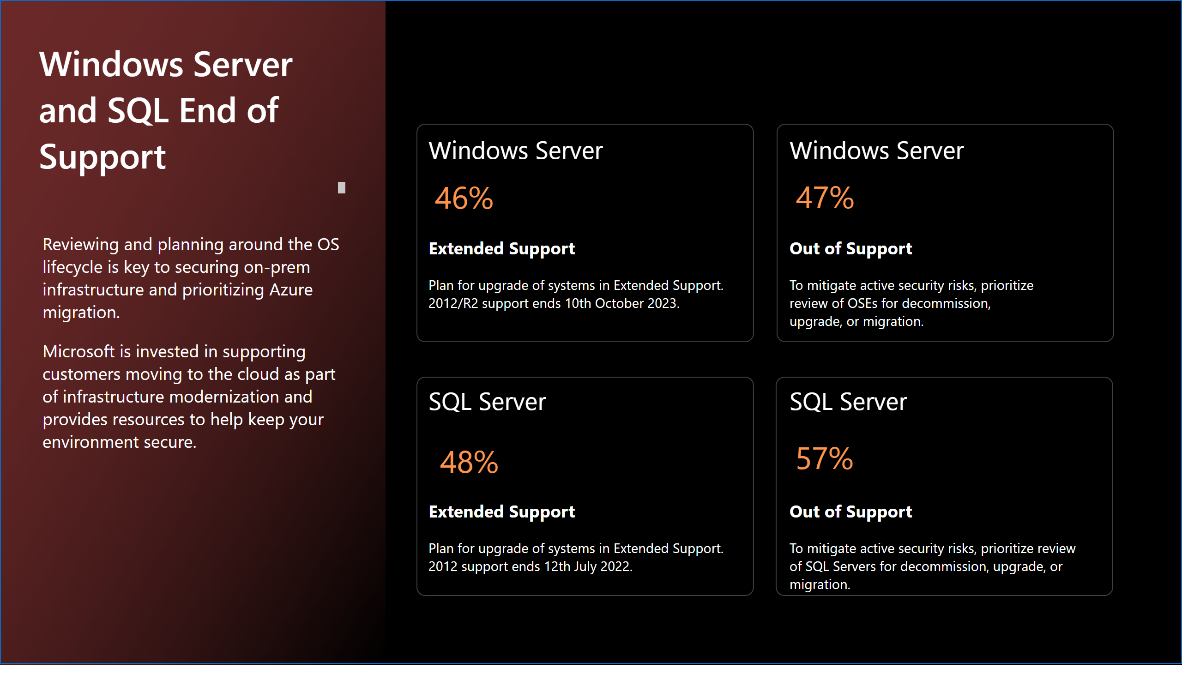
Slide 18
Notes:
Windows Server
No alt text provided
textbox
No alt text provided
textbox
No alt text provided
Windows Server
No alt text provided
card
No alt text provided
card
No alt text provided
card
No alt text provided
card
No alt text provided
shape
No alt text provided
shape
No alt text provided
shape
No alt text provided
shape
No alt text provided
actionButton
No alt text provided
Windows Server and SQL End of Support
No alt text provided
textbox
No alt text provided
shape
No alt text provided

Slide 19
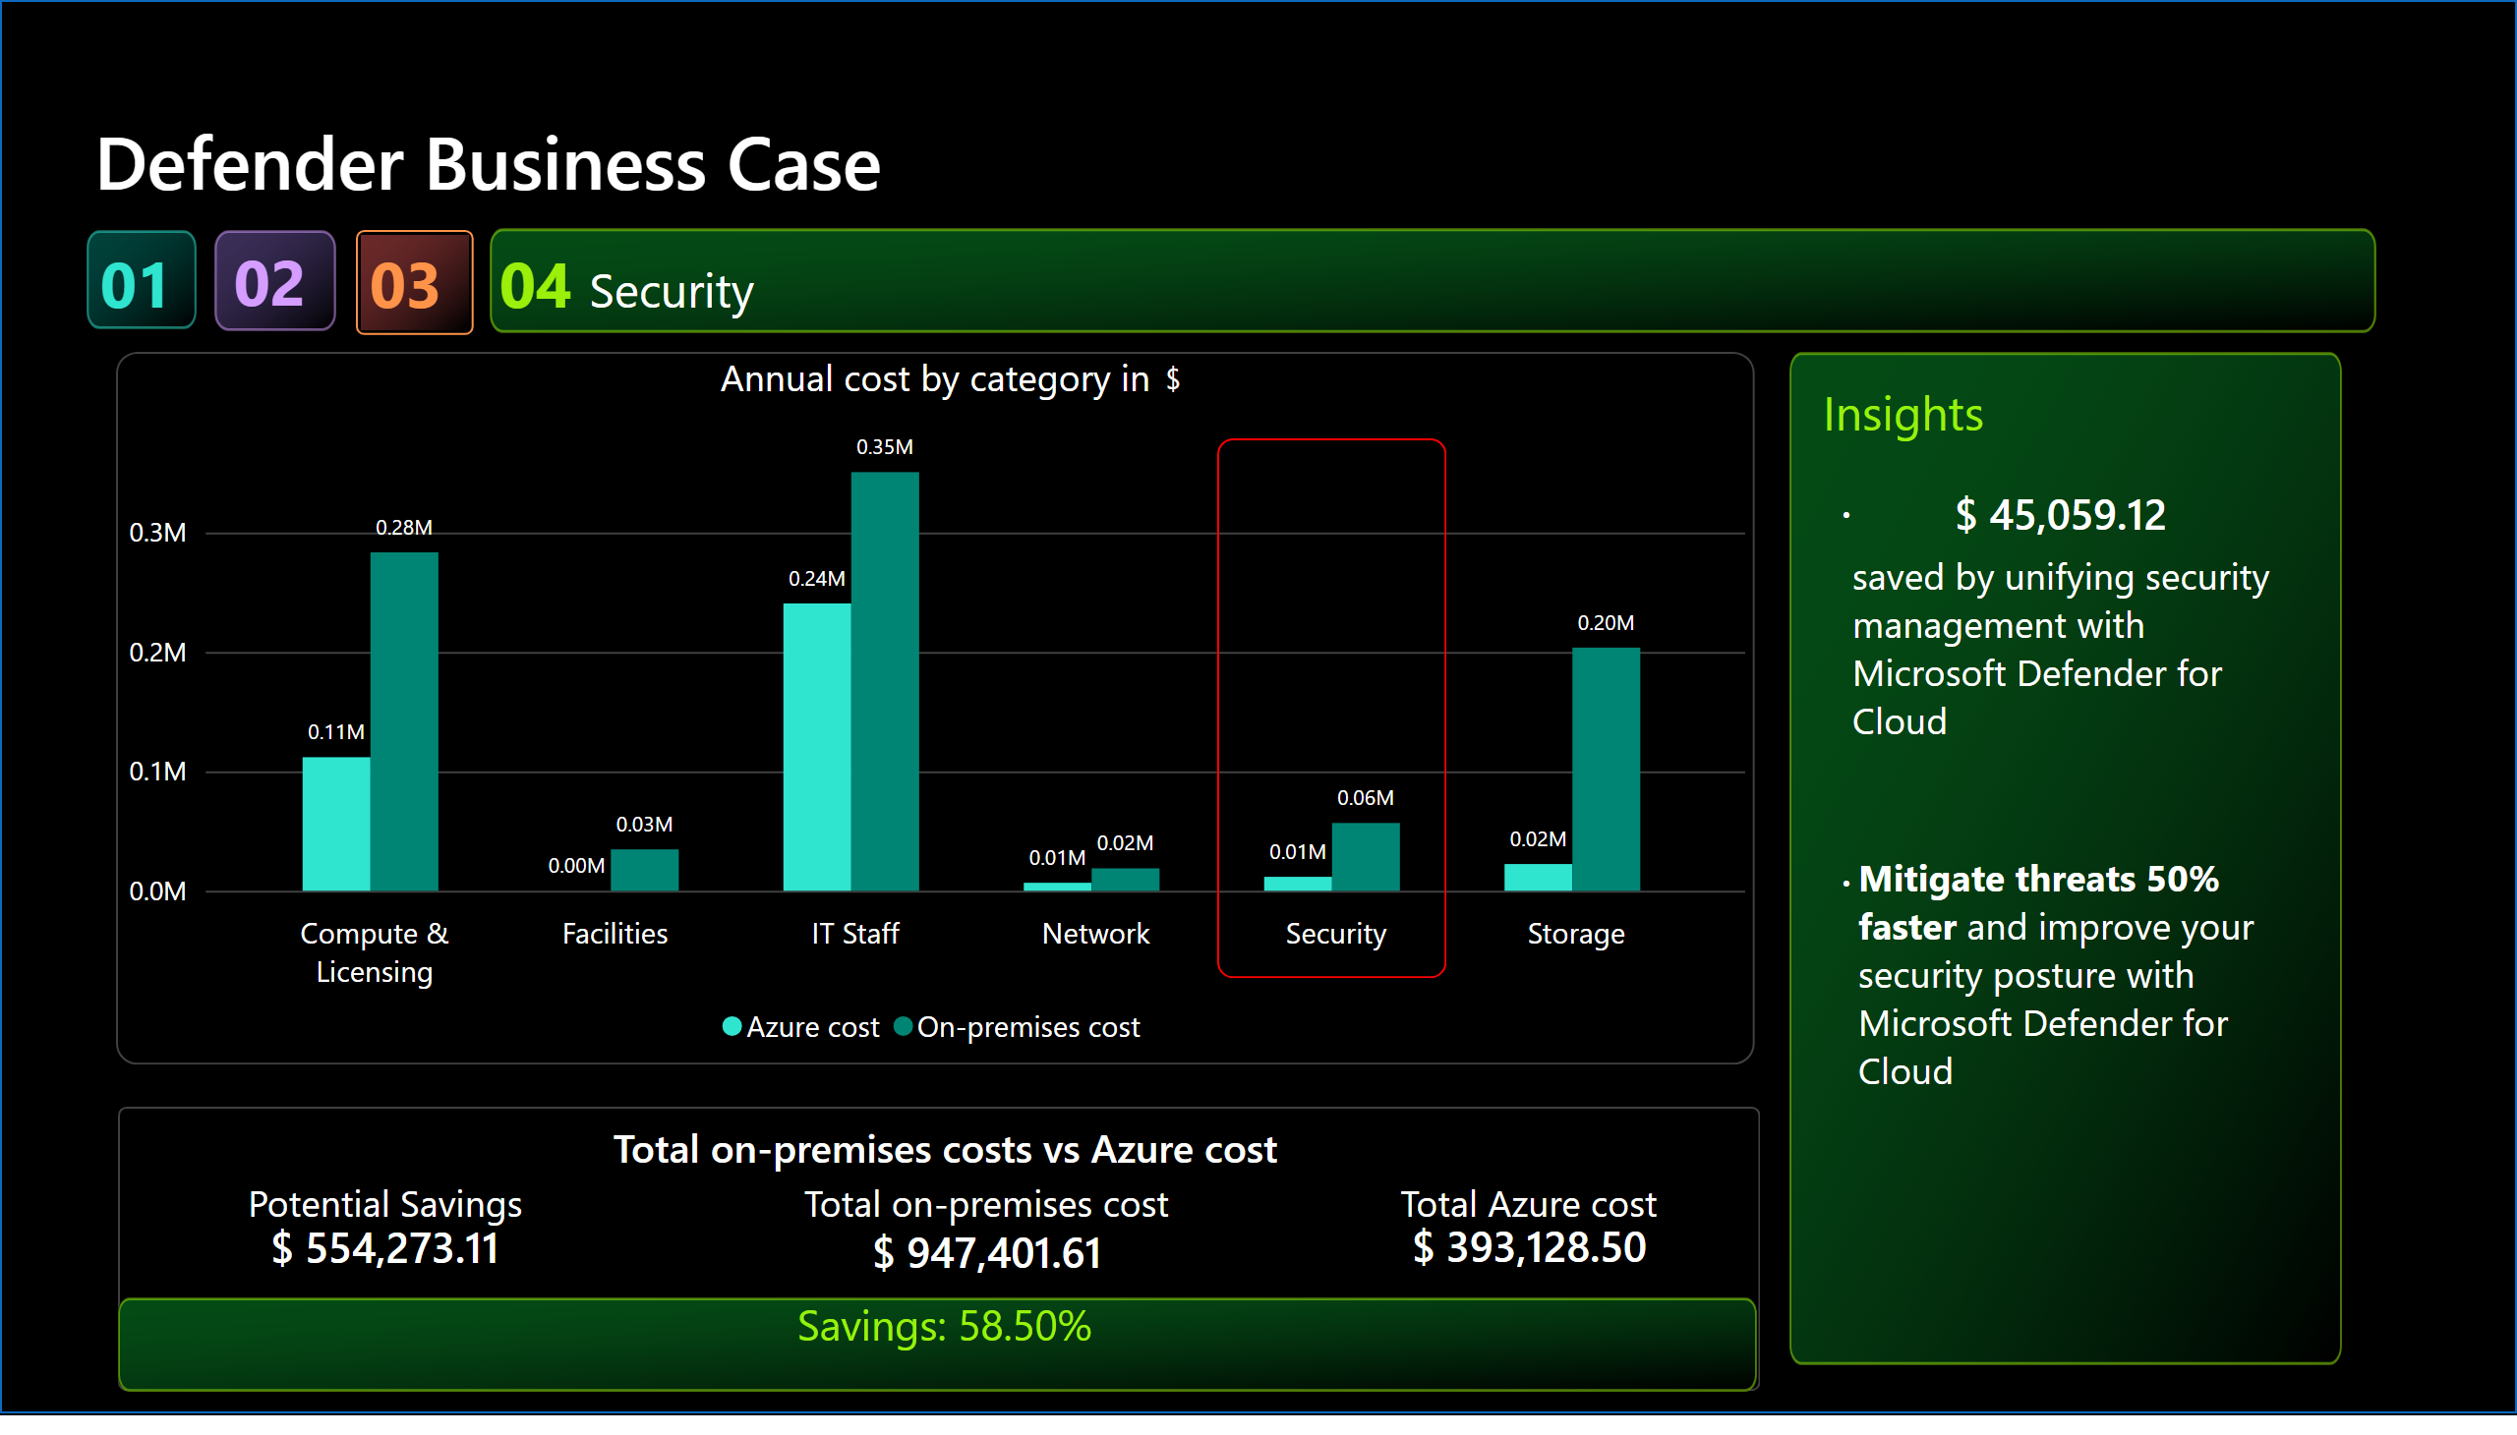
Slide 19
Notes:
Defender Business Case
No alt text provided
Annual cost by category in
No alt text provided
Total on-premises costs vs Azure cost
No alt text provided
Potential Savings
No alt text provided
Total on-premises cost
No alt text provided
Total Azure cost
No alt text provided
card
No alt text provided
card
No alt text provided
card
No alt text provided
shape
No alt text provided
shape
No alt text provided
card
No alt text provided
actionButton
No alt text provided
textbox
No alt text provided
card
No alt text provided
actionButton
No alt text provided
card
No alt text provided
shape
No alt text provided
actionButton
No alt text provided
actionButton
No alt text provided
textbox
No alt text provided
actionButton
No alt text provided
textbox
No alt text provided
textbox
No alt text provided
actionButton
No alt text provided
textbox
No alt text provided
textbox
No alt text provided
shape
No alt text provided

Slide 20
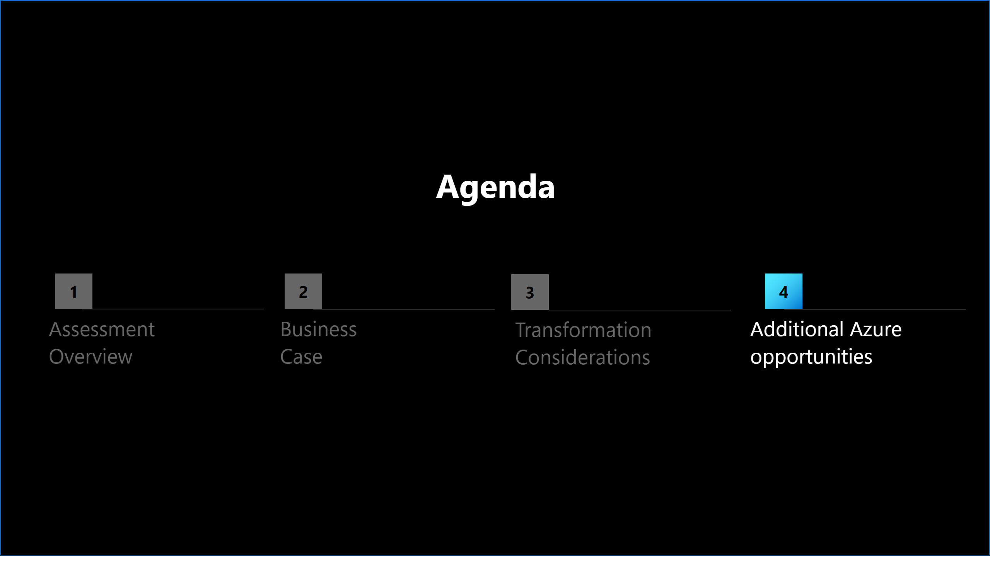
Slide 20
Notes:
shape
No alt text provided
shape
No alt text provided
shape
No alt text provided
shape
No alt text provided
textbox
No alt text provided
textbox
No alt text provided
textbox
No alt text provided
textbox
No alt text provided
textbox
No alt text provided
actionButton
No alt text provided
actionButton
No alt text provided
actionButton
No alt text provided
actionButton
No alt text provided
shape
No alt text provided

Slide 21
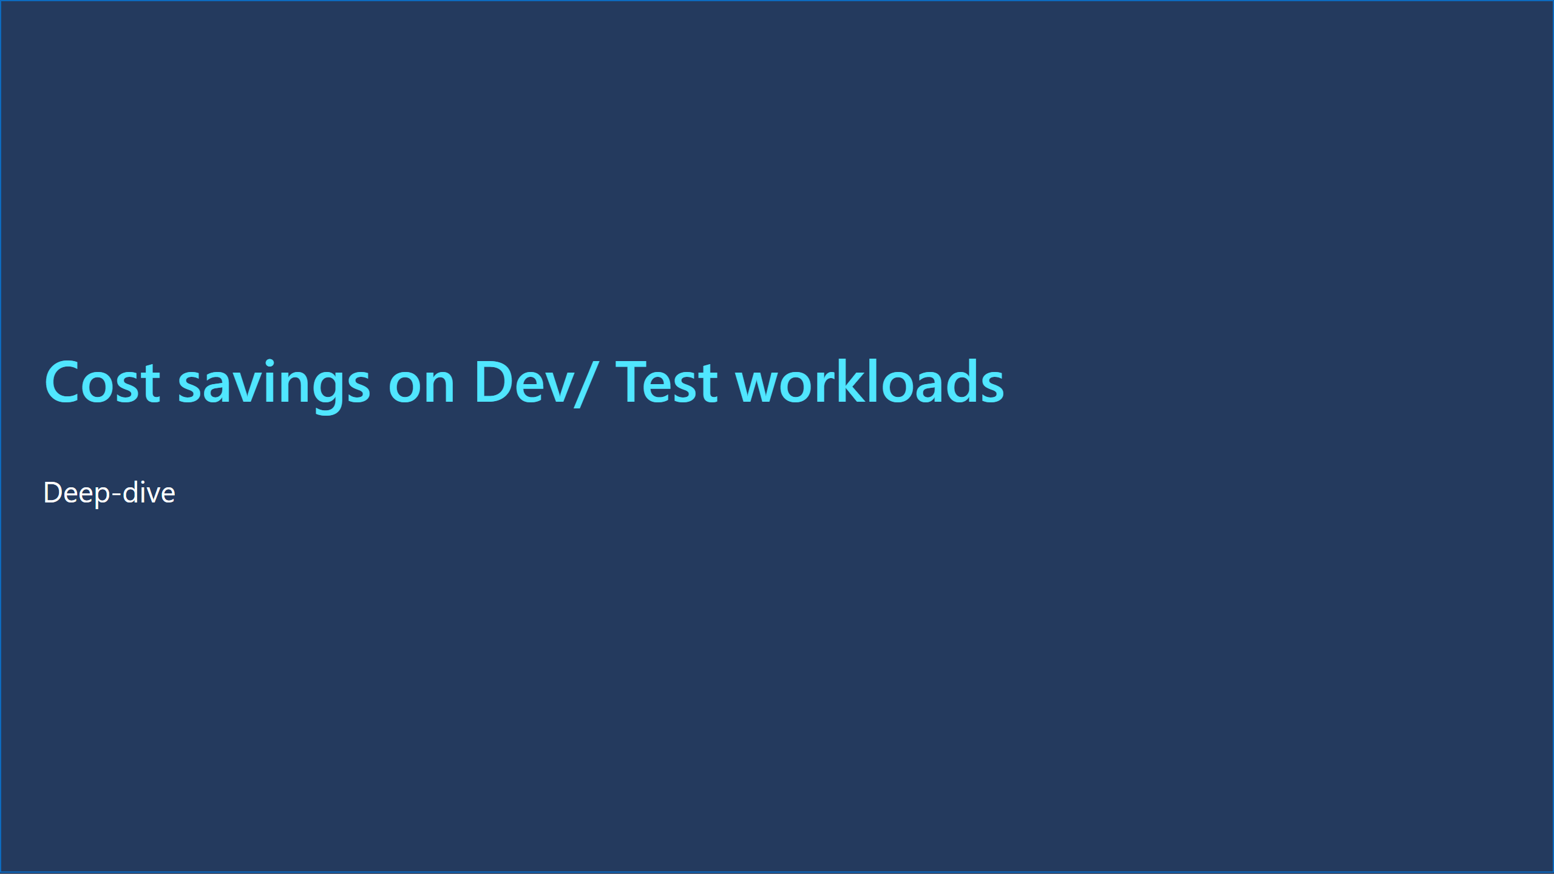
Slide 21
Notes:
Deep-dive
No alt text provided
Cost savings on Dev/ Test workloads
No alt text provided
shape
No alt text provided

Slide 22
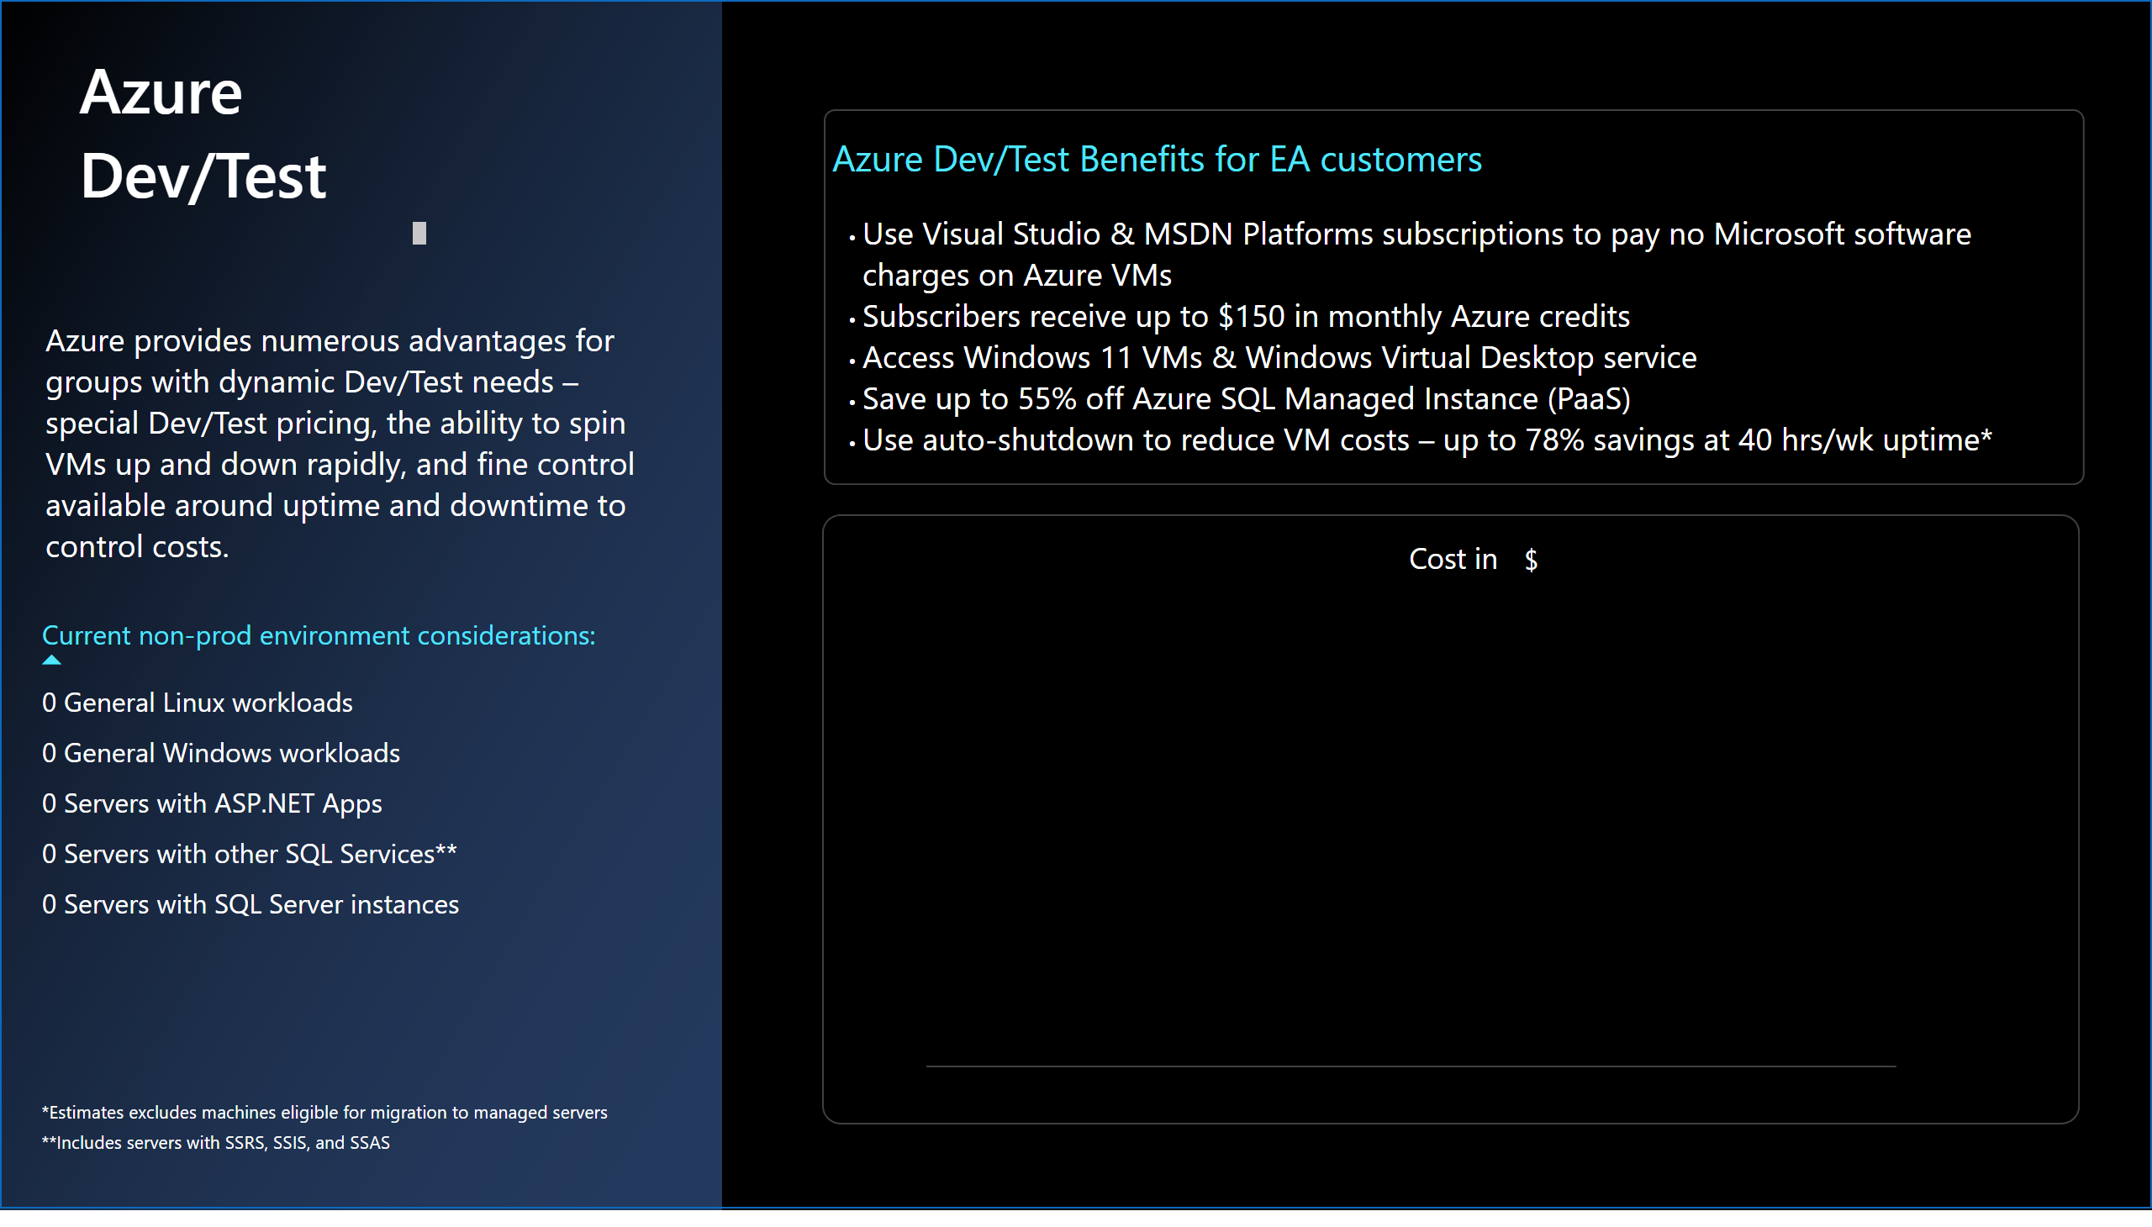
Slide 22
Notes:
textbox
No alt text provided
Cost in
No alt text provided
actionButton
No alt text provided
Azure Dev/Test
No alt text provided
textbox
No alt text provided
tableEx
No alt text provided
textbox
No alt text provided
card
No alt text provided
shape
No alt text provided
shape
No alt text provided
shape
No alt text provided
shape
No alt text provided

Slide 23
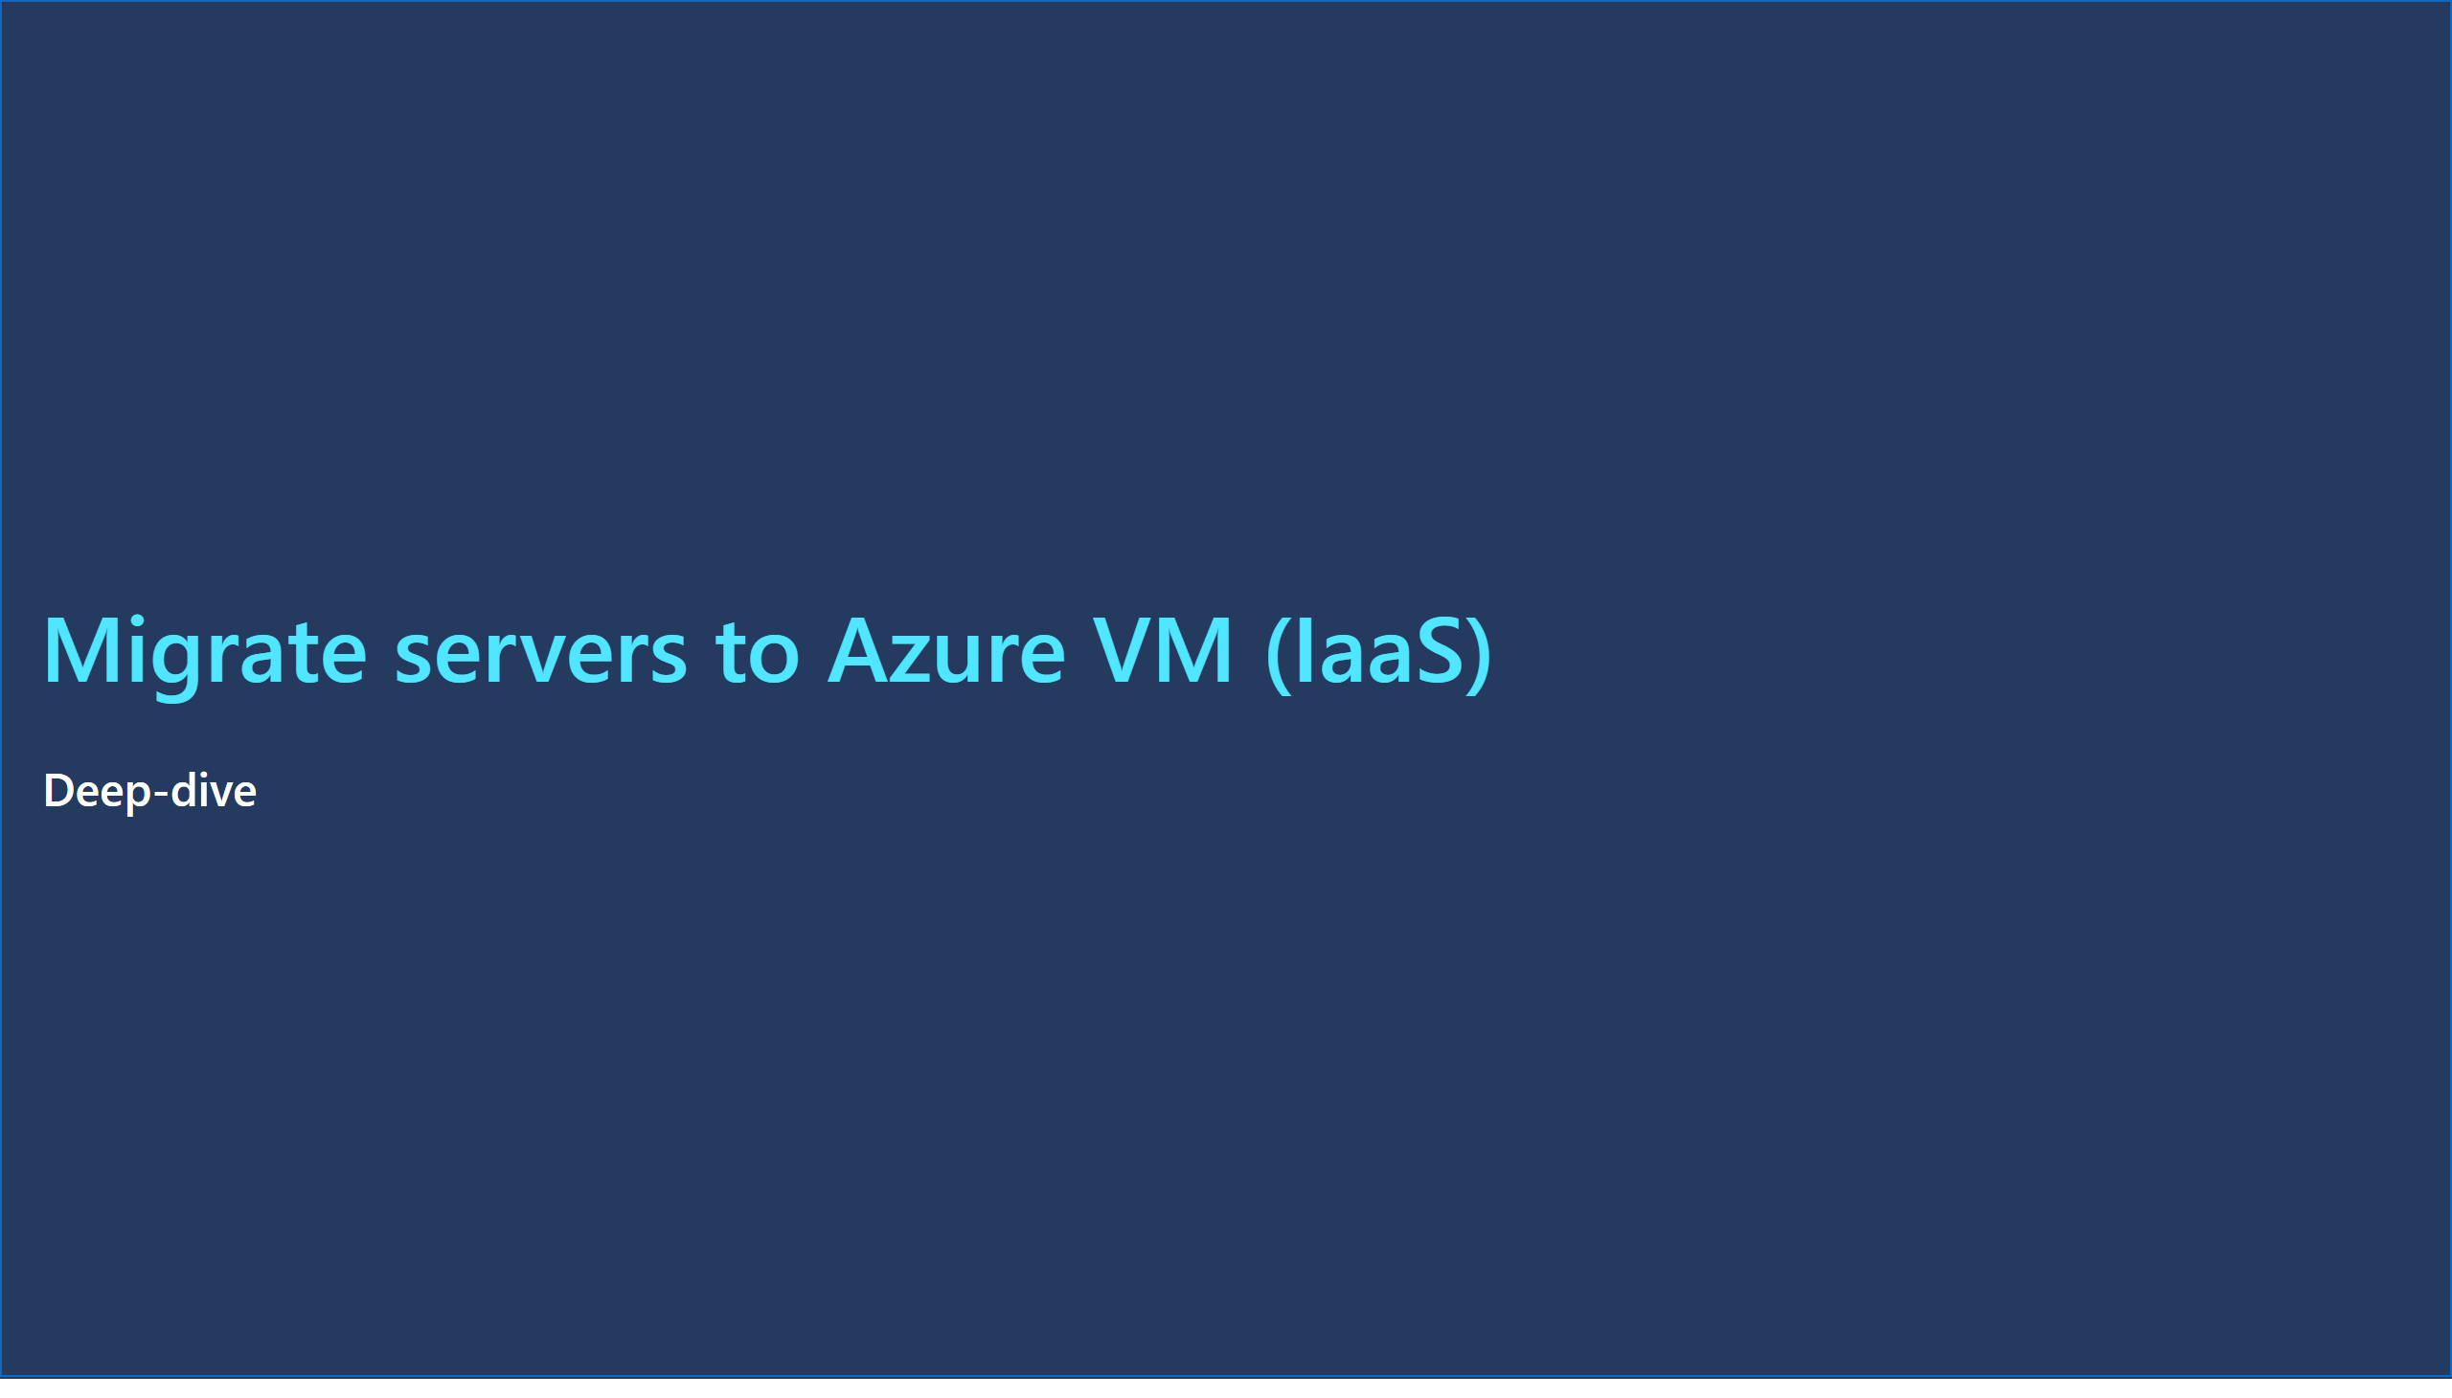
Slide 23
Notes:
Migrate servers to Azure VM (IaaS)
No alt text provided
Deep-dive
No alt text provided
shape
No alt text provided

Slide 24
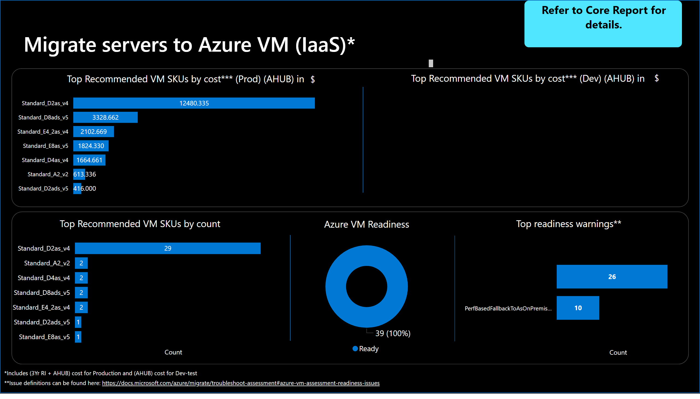
Slide 24
Notes:
textbox
No alt text provided
Azure VM Readiness
No alt text provided
Migrate servers to Azure VM (IaaS)*
No alt text provided
Refer to Core Report for details.
No alt text provided
card
No alt text provided
card
No alt text provided
shape
No alt text provided
shape
No alt text provided
shape
No alt text provided
shape
No alt text provided
shape
No alt text provided
Top Recommended VM SKUs by count
No alt text provided
Top readiness warnings**
No alt text provided
Top Recommended VM SKUs by cost*** (Prod) (AHUB) in
No alt text provided
Top Recommended VM SKUs by cost*** (Dev) (AHUB) in
No alt text provided
shape
No alt text provided

Slide 25
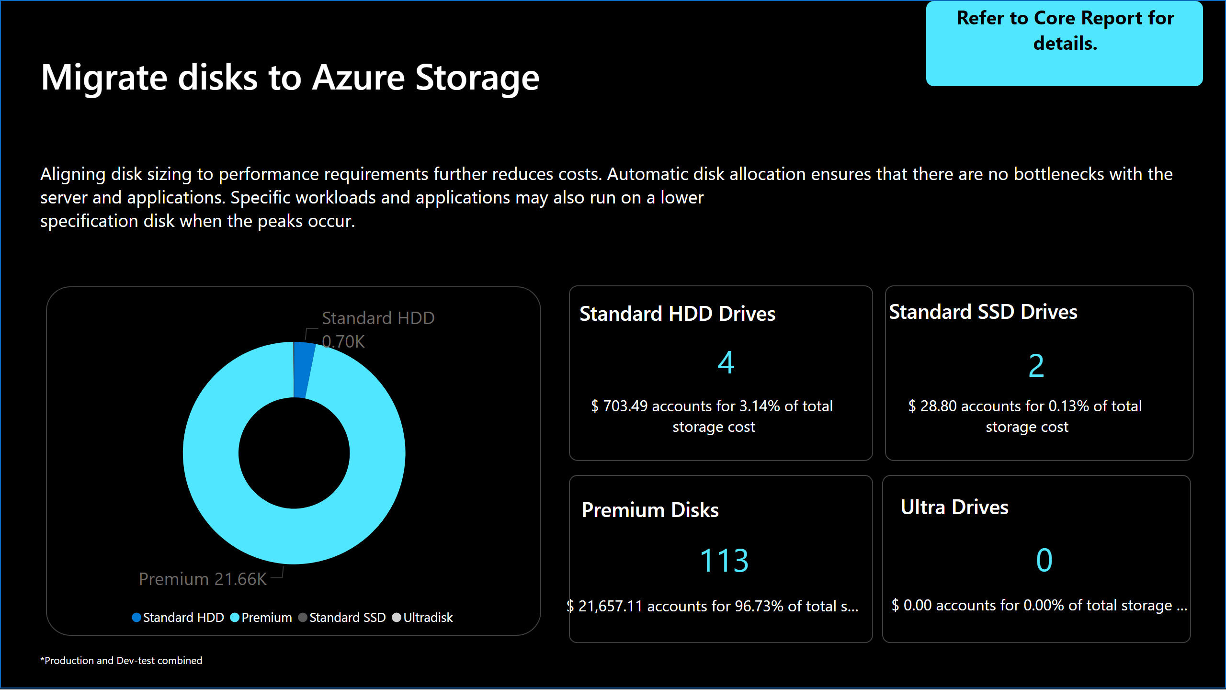
Slide 25
Notes:
Estimated annual storage cost
No alt text provided
textbox
No alt text provided
Migrate disks to Azure Storage​
No alt text provided
textbox
No alt text provided
card
No alt text provided
card
No alt text provided
card
No alt text provided
card
No alt text provided
card
No alt text provided
Premium Disks
No alt text provided
Refer to Core Report for details.
No alt text provided
shape
No alt text provided
card
No alt text provided
Standard HDD Drives
No alt text provided
card
No alt text provided
Standard SSD Drives
No alt text provided
shape
No alt text provided
shape
No alt text provided
card
No alt text provided
Ultra Drives
No alt text provided
shape
No alt text provided
shape
No alt text provided
shape
No alt text provided

Slide 26

Slide 26
Notes:
Modernize to PaaS
No alt text provided
Deep-dive
No alt text provided
shape
No alt text provided

Slide 27
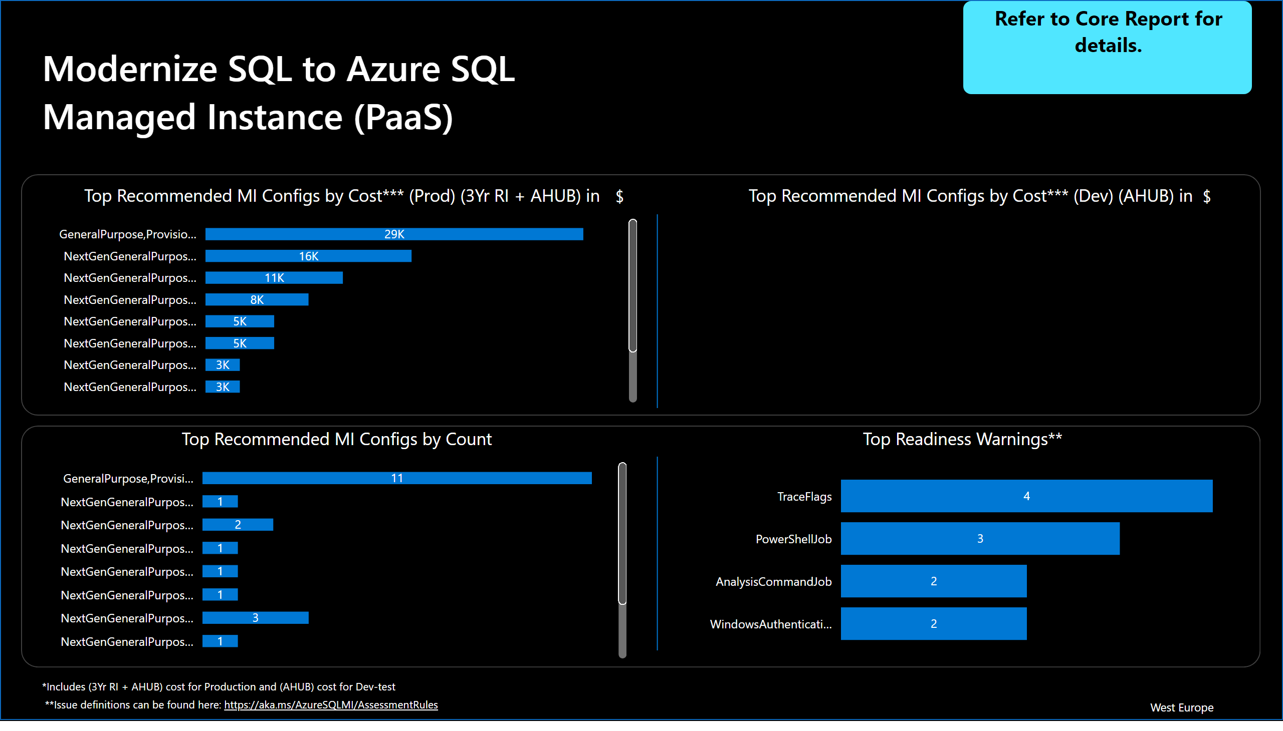
Slide 27
Notes:
Modernize SQL to Azure SQL Managed Instance (PaaS)
No alt text provided
textbox
No alt text provided
card
No alt text provided
Refer to Core Report for details.
No alt text provided
card
No alt text provided
card
No alt text provided
shape
No alt text provided
shape
No alt text provided
shape
No alt text provided
shape
No alt text provided
Top Recommended MI Configs by Count
No alt text provided
Top Readiness Warnings**
No alt text provided
Top Recommended MI Configs by Cost*** (Prod) (3Yr RI + AHUB) in
No alt text provided
Top Recommended MI Configs by Cost*** (Dev) (AHUB) in
No alt text provided
shape
No alt text provided

Slide 28
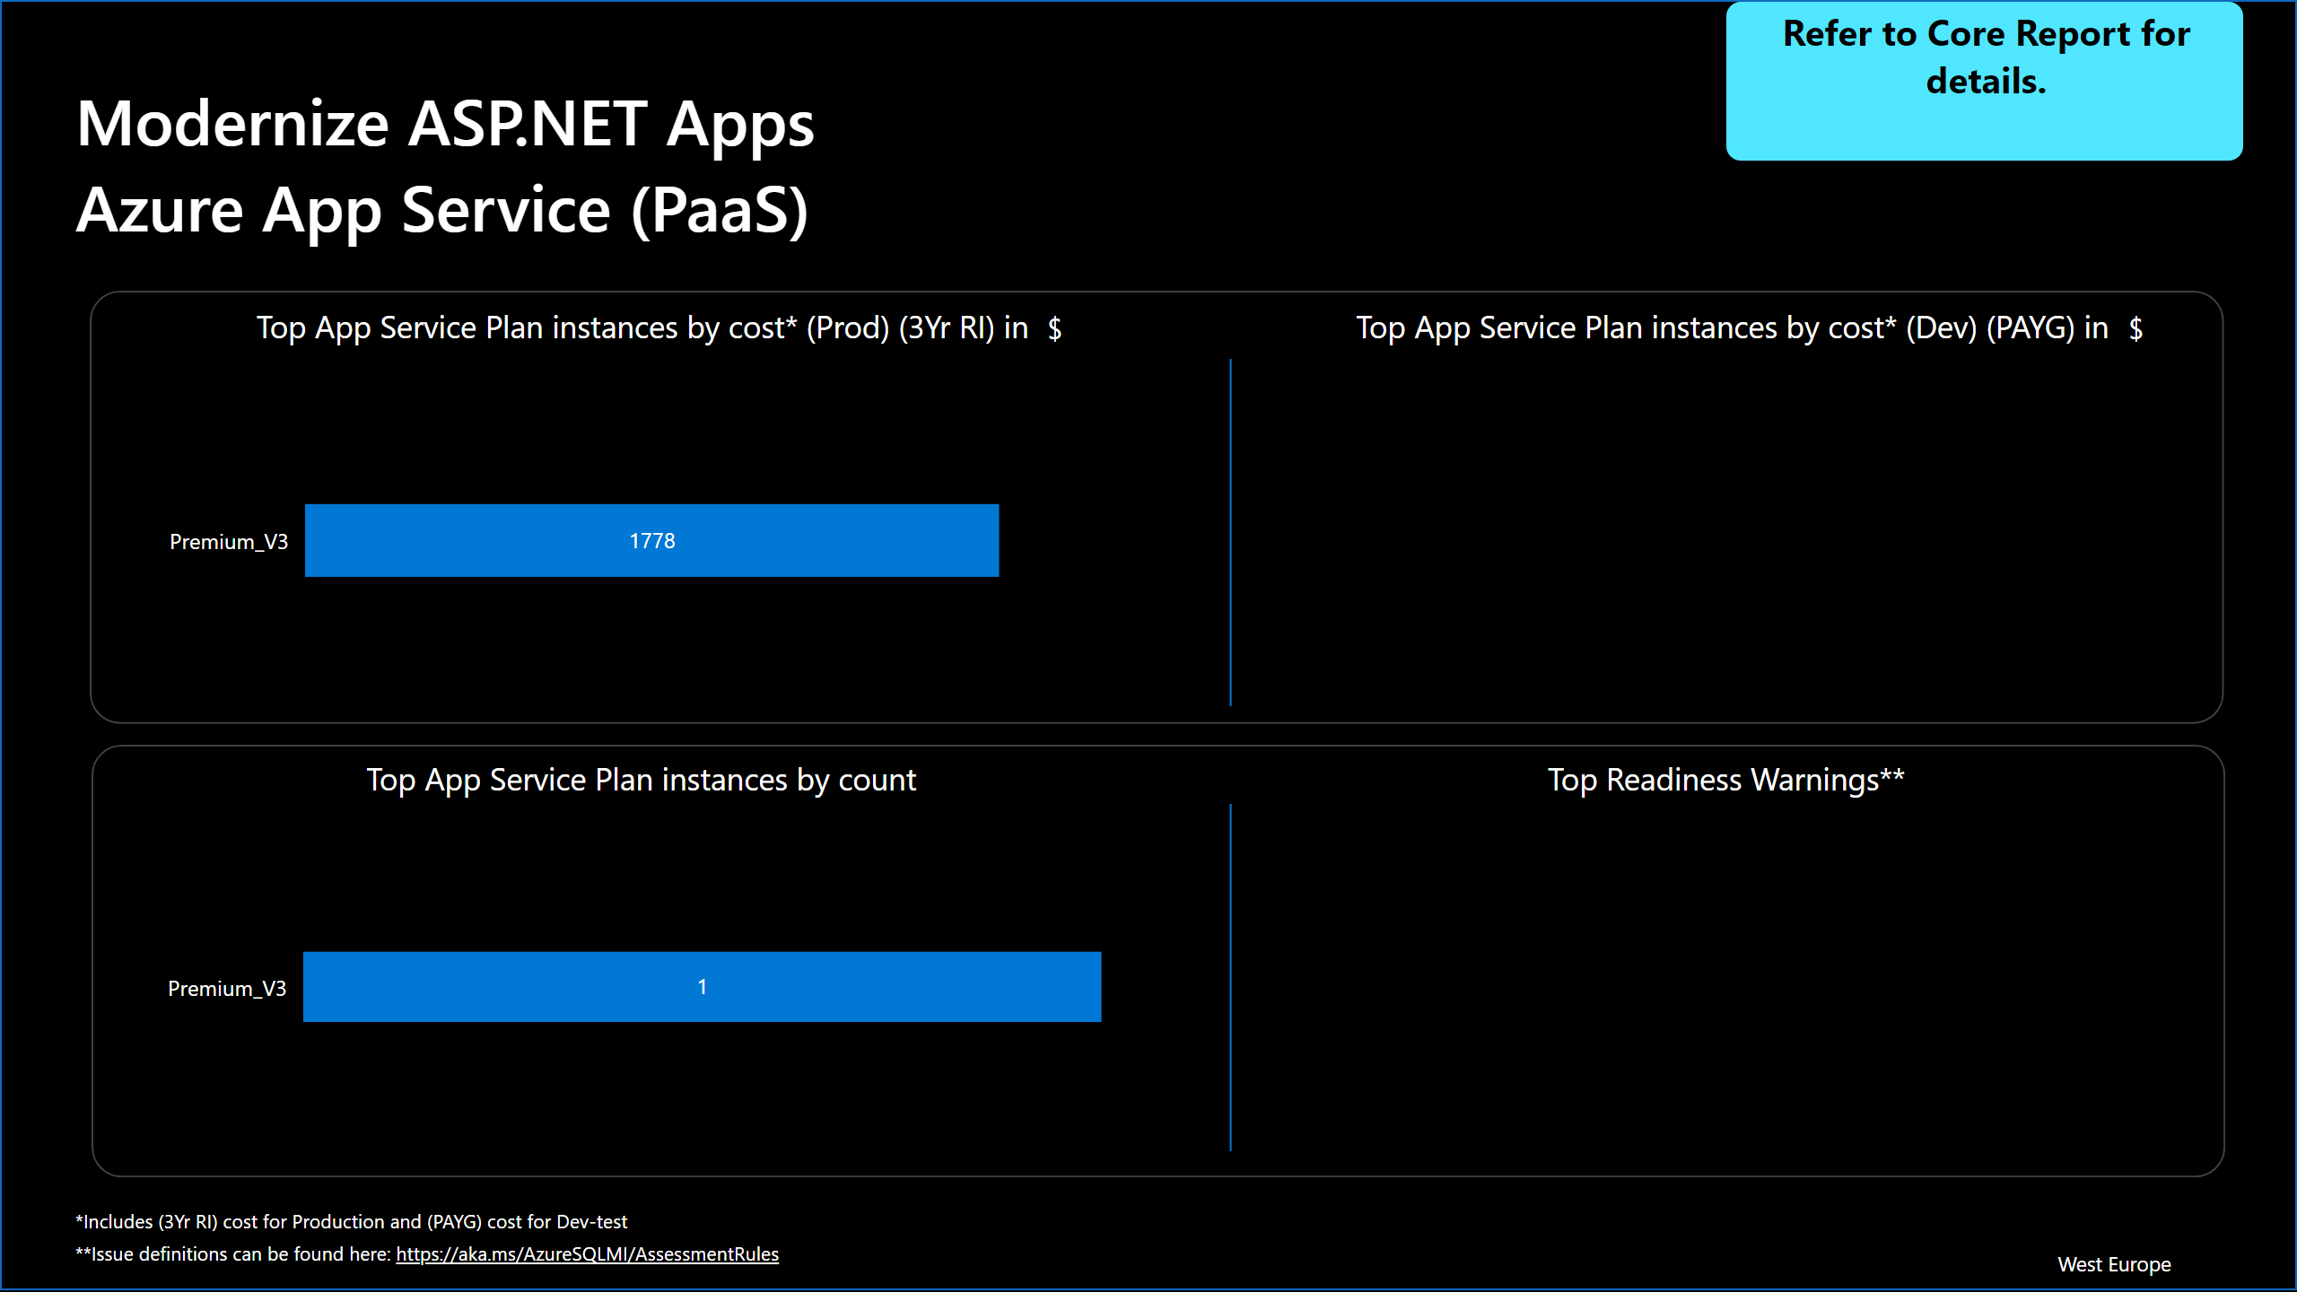
Slide 28
Notes:
Modernize ASP.NET Apps Azure App Service (PaaS)
No alt text provided
textbox
No alt text provided
card
No alt text provided
Refer to Core Report for details.
No alt text provided
shape
No alt text provided
shape
No alt text provided
card
No alt text provided
card
No alt text provided
shape
No alt text provided
shape
No alt text provided
Top App Service Plan instances by count
No alt text provided
Top Readiness Warnings**
No alt text provided
Top App Service Plan instances by cost* (Prod) (3Yr RI) in
No alt text provided
Top App Service Plan instances by cost* (Dev) (PAYG) in
No alt text provided
shape
No alt text provided

Slide 29

Slide 29
Notes:
Additional Azure Opportunities
No alt text provided
shape
No alt text provided

Slide 30
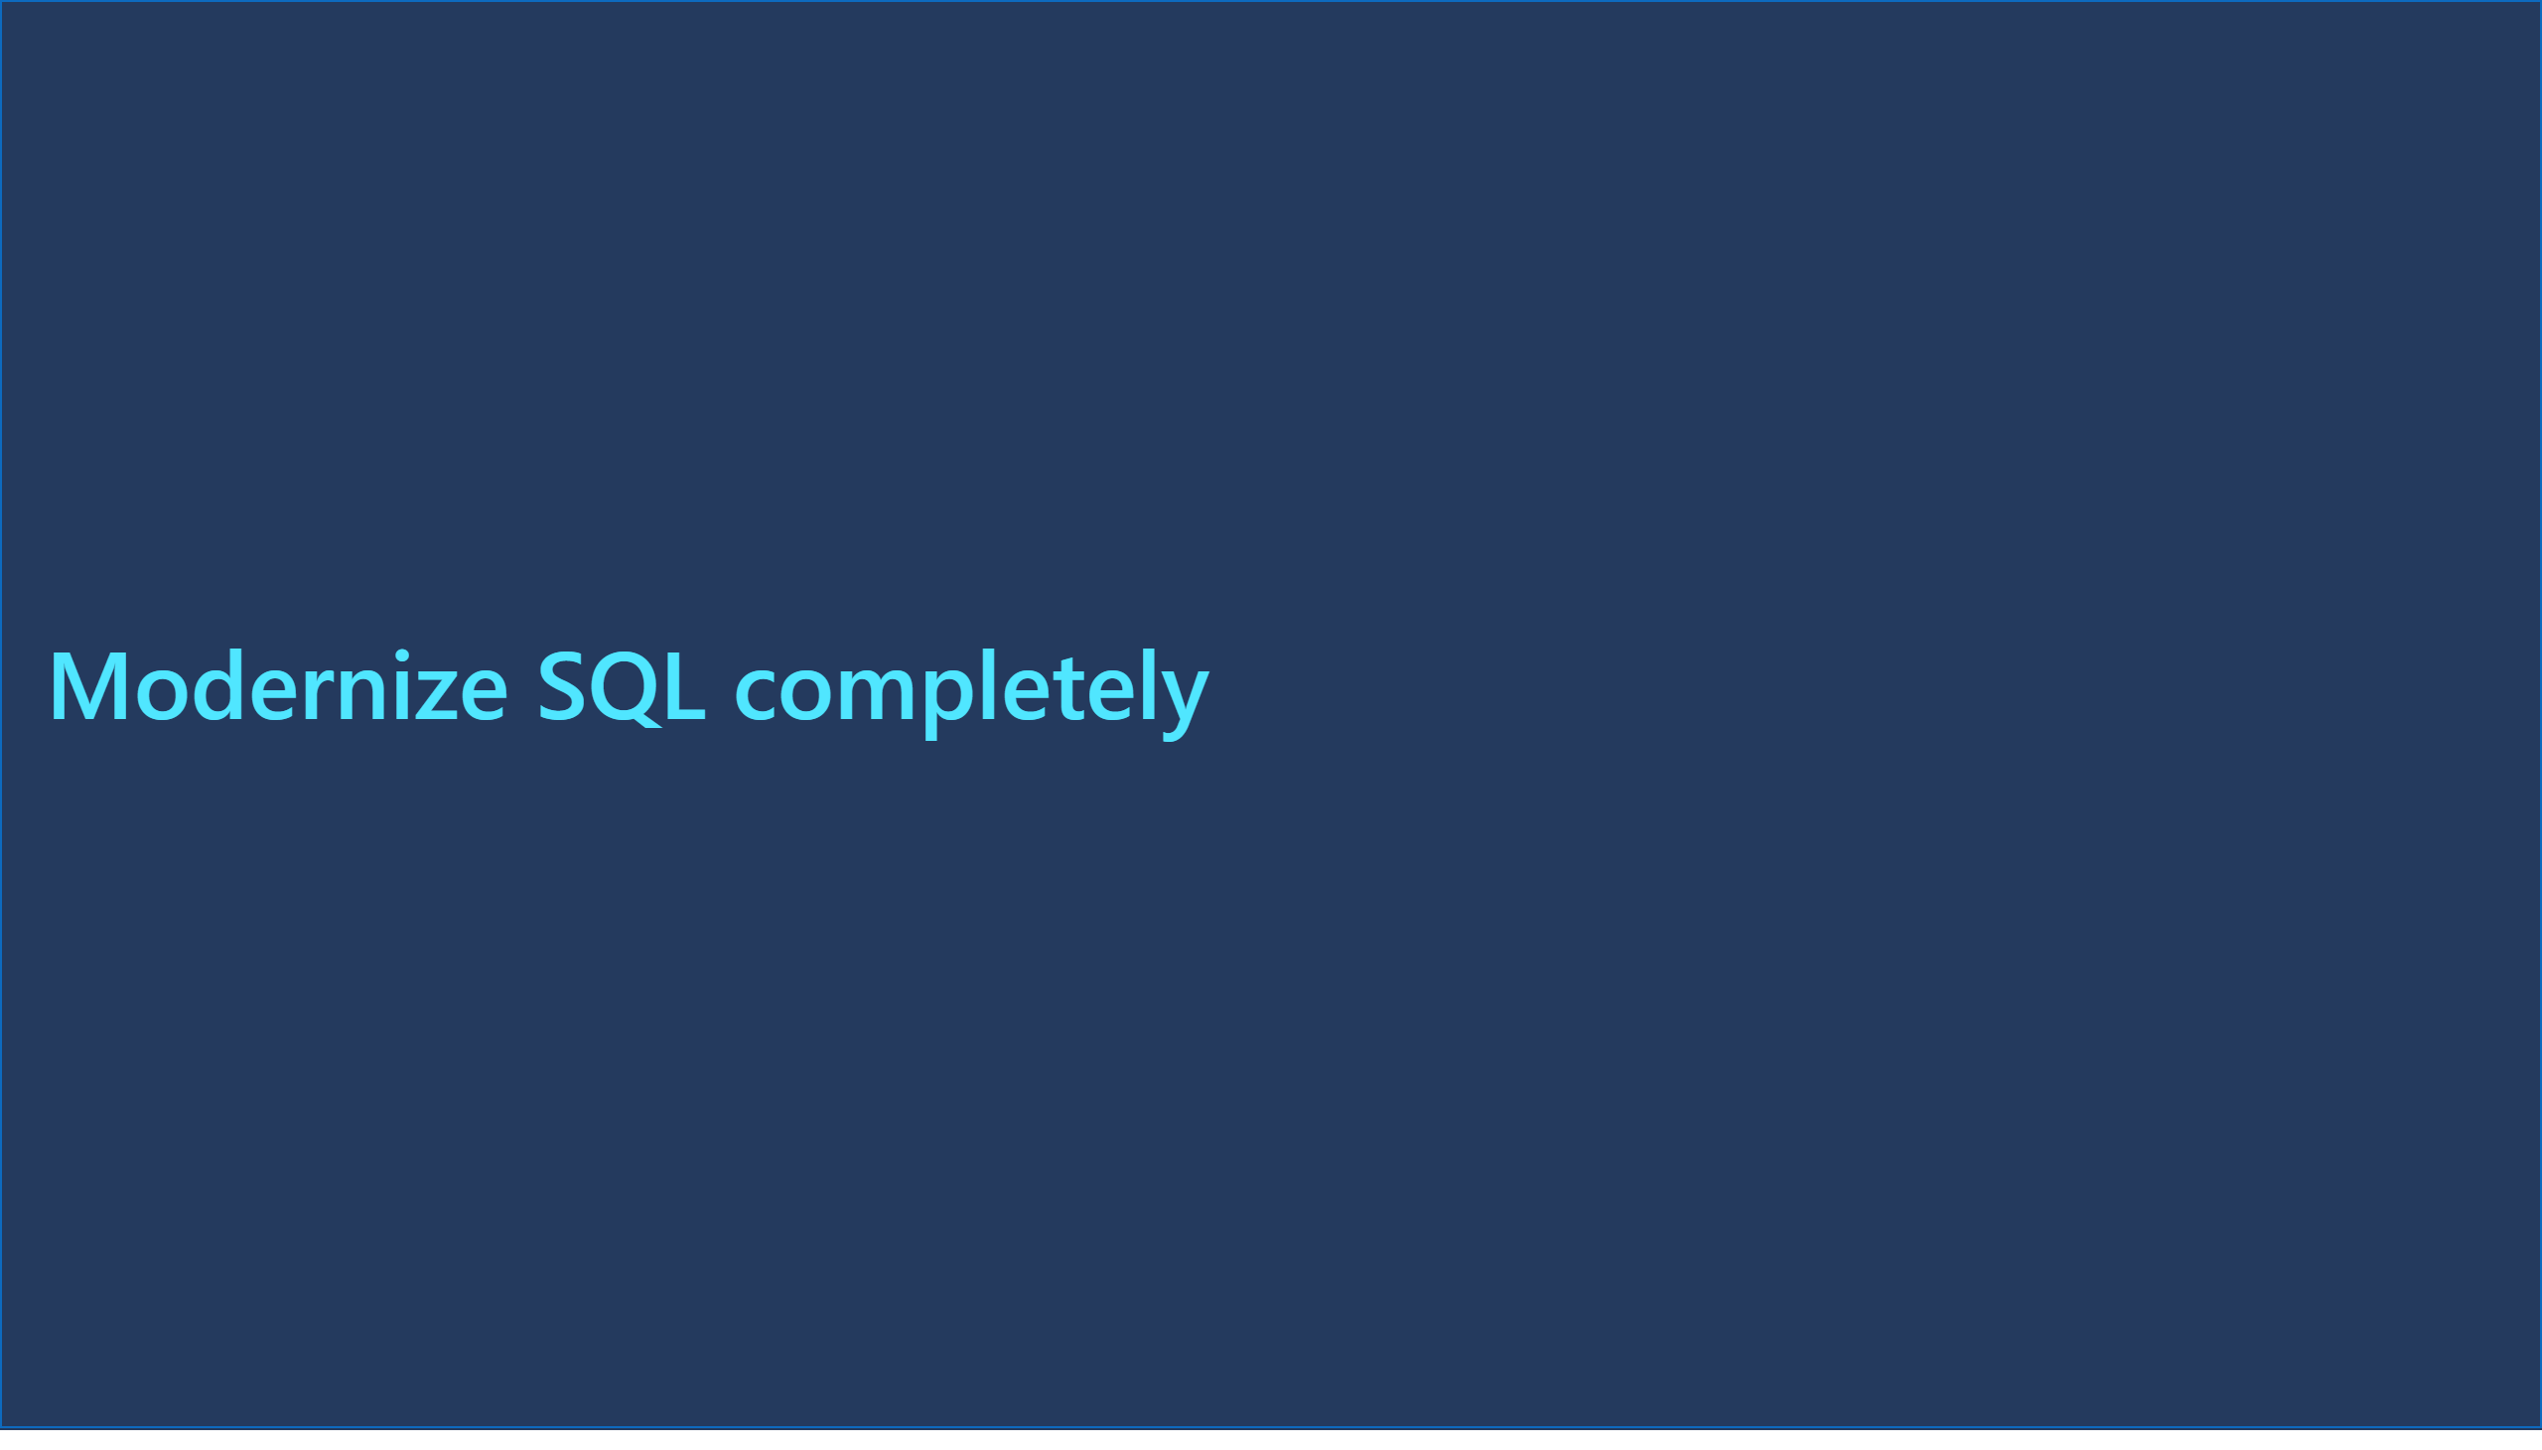
Slide 30
Notes:
Modernize SQL completely
No alt text provided
shape
No alt text provided

Slide 31
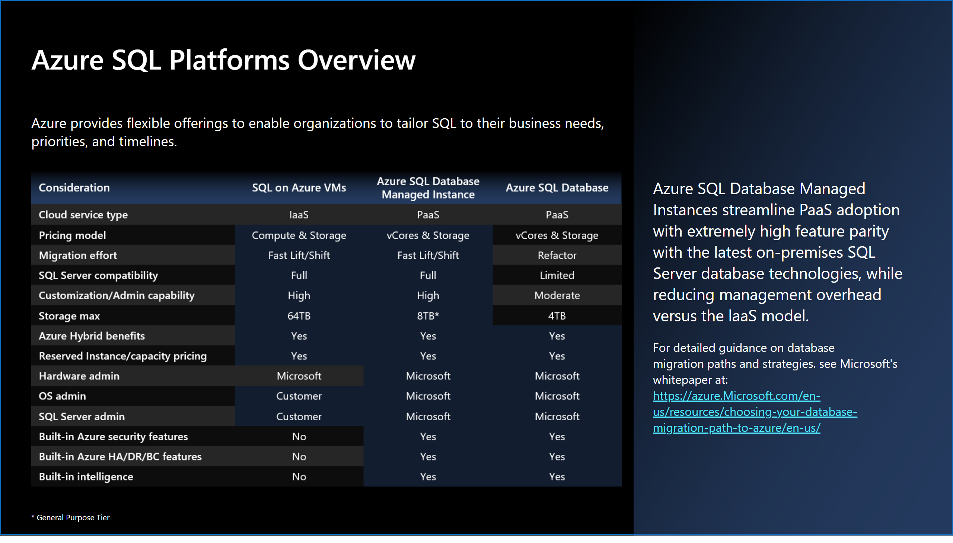
Slide 31
Notes:
Azure SQL Platforms Overview
No alt text provided
textbox
No alt text provided
textbox
No alt text provided
image
No alt text provided
actionButton
No alt text provided
textbox
No alt text provided
shape
No alt text provided

Slide 32
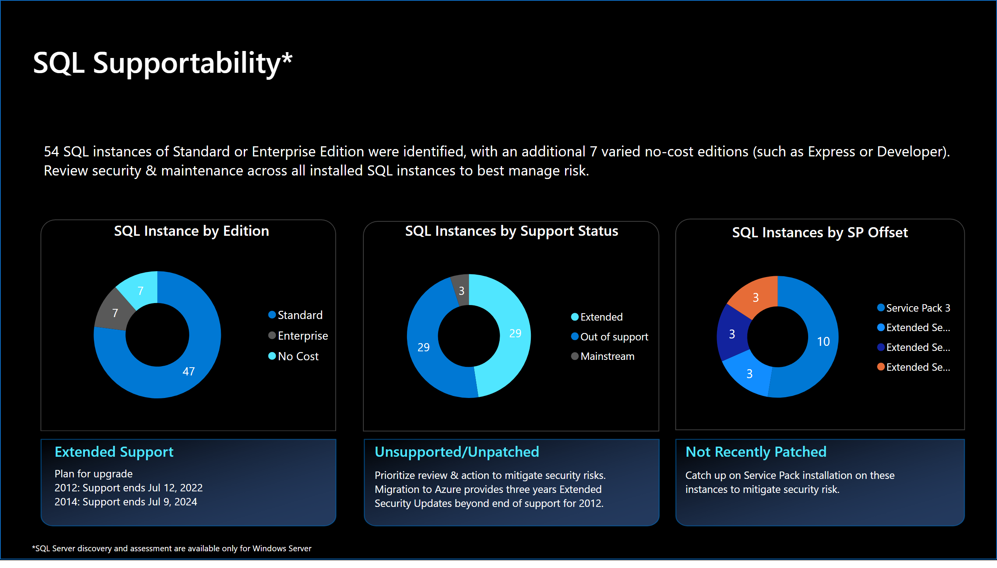
Slide 32
Notes:
SQL Instance by Edition
No alt text provided
SQL Instances by Support Status
No alt text provided
SQL Instances by SP Offset
No alt text provided
SQL Supportability*
No alt text provided
textbox
No alt text provided
textbox
No alt text provided
actionButton
No alt text provided
actionButton
No alt text provided
actionButton
No alt text provided
textbox
No alt text provided
Extended Support
No alt text provided
Unsupported/Unpatched
No alt text provided
textbox
No alt text provided
Not Recently Patched
No alt text provided
textbox
No alt text provided
shape
No alt text provided
shape
No alt text provided
shape
No alt text provided
actionButton
No alt text provided
shape
No alt text provided

Slide 33
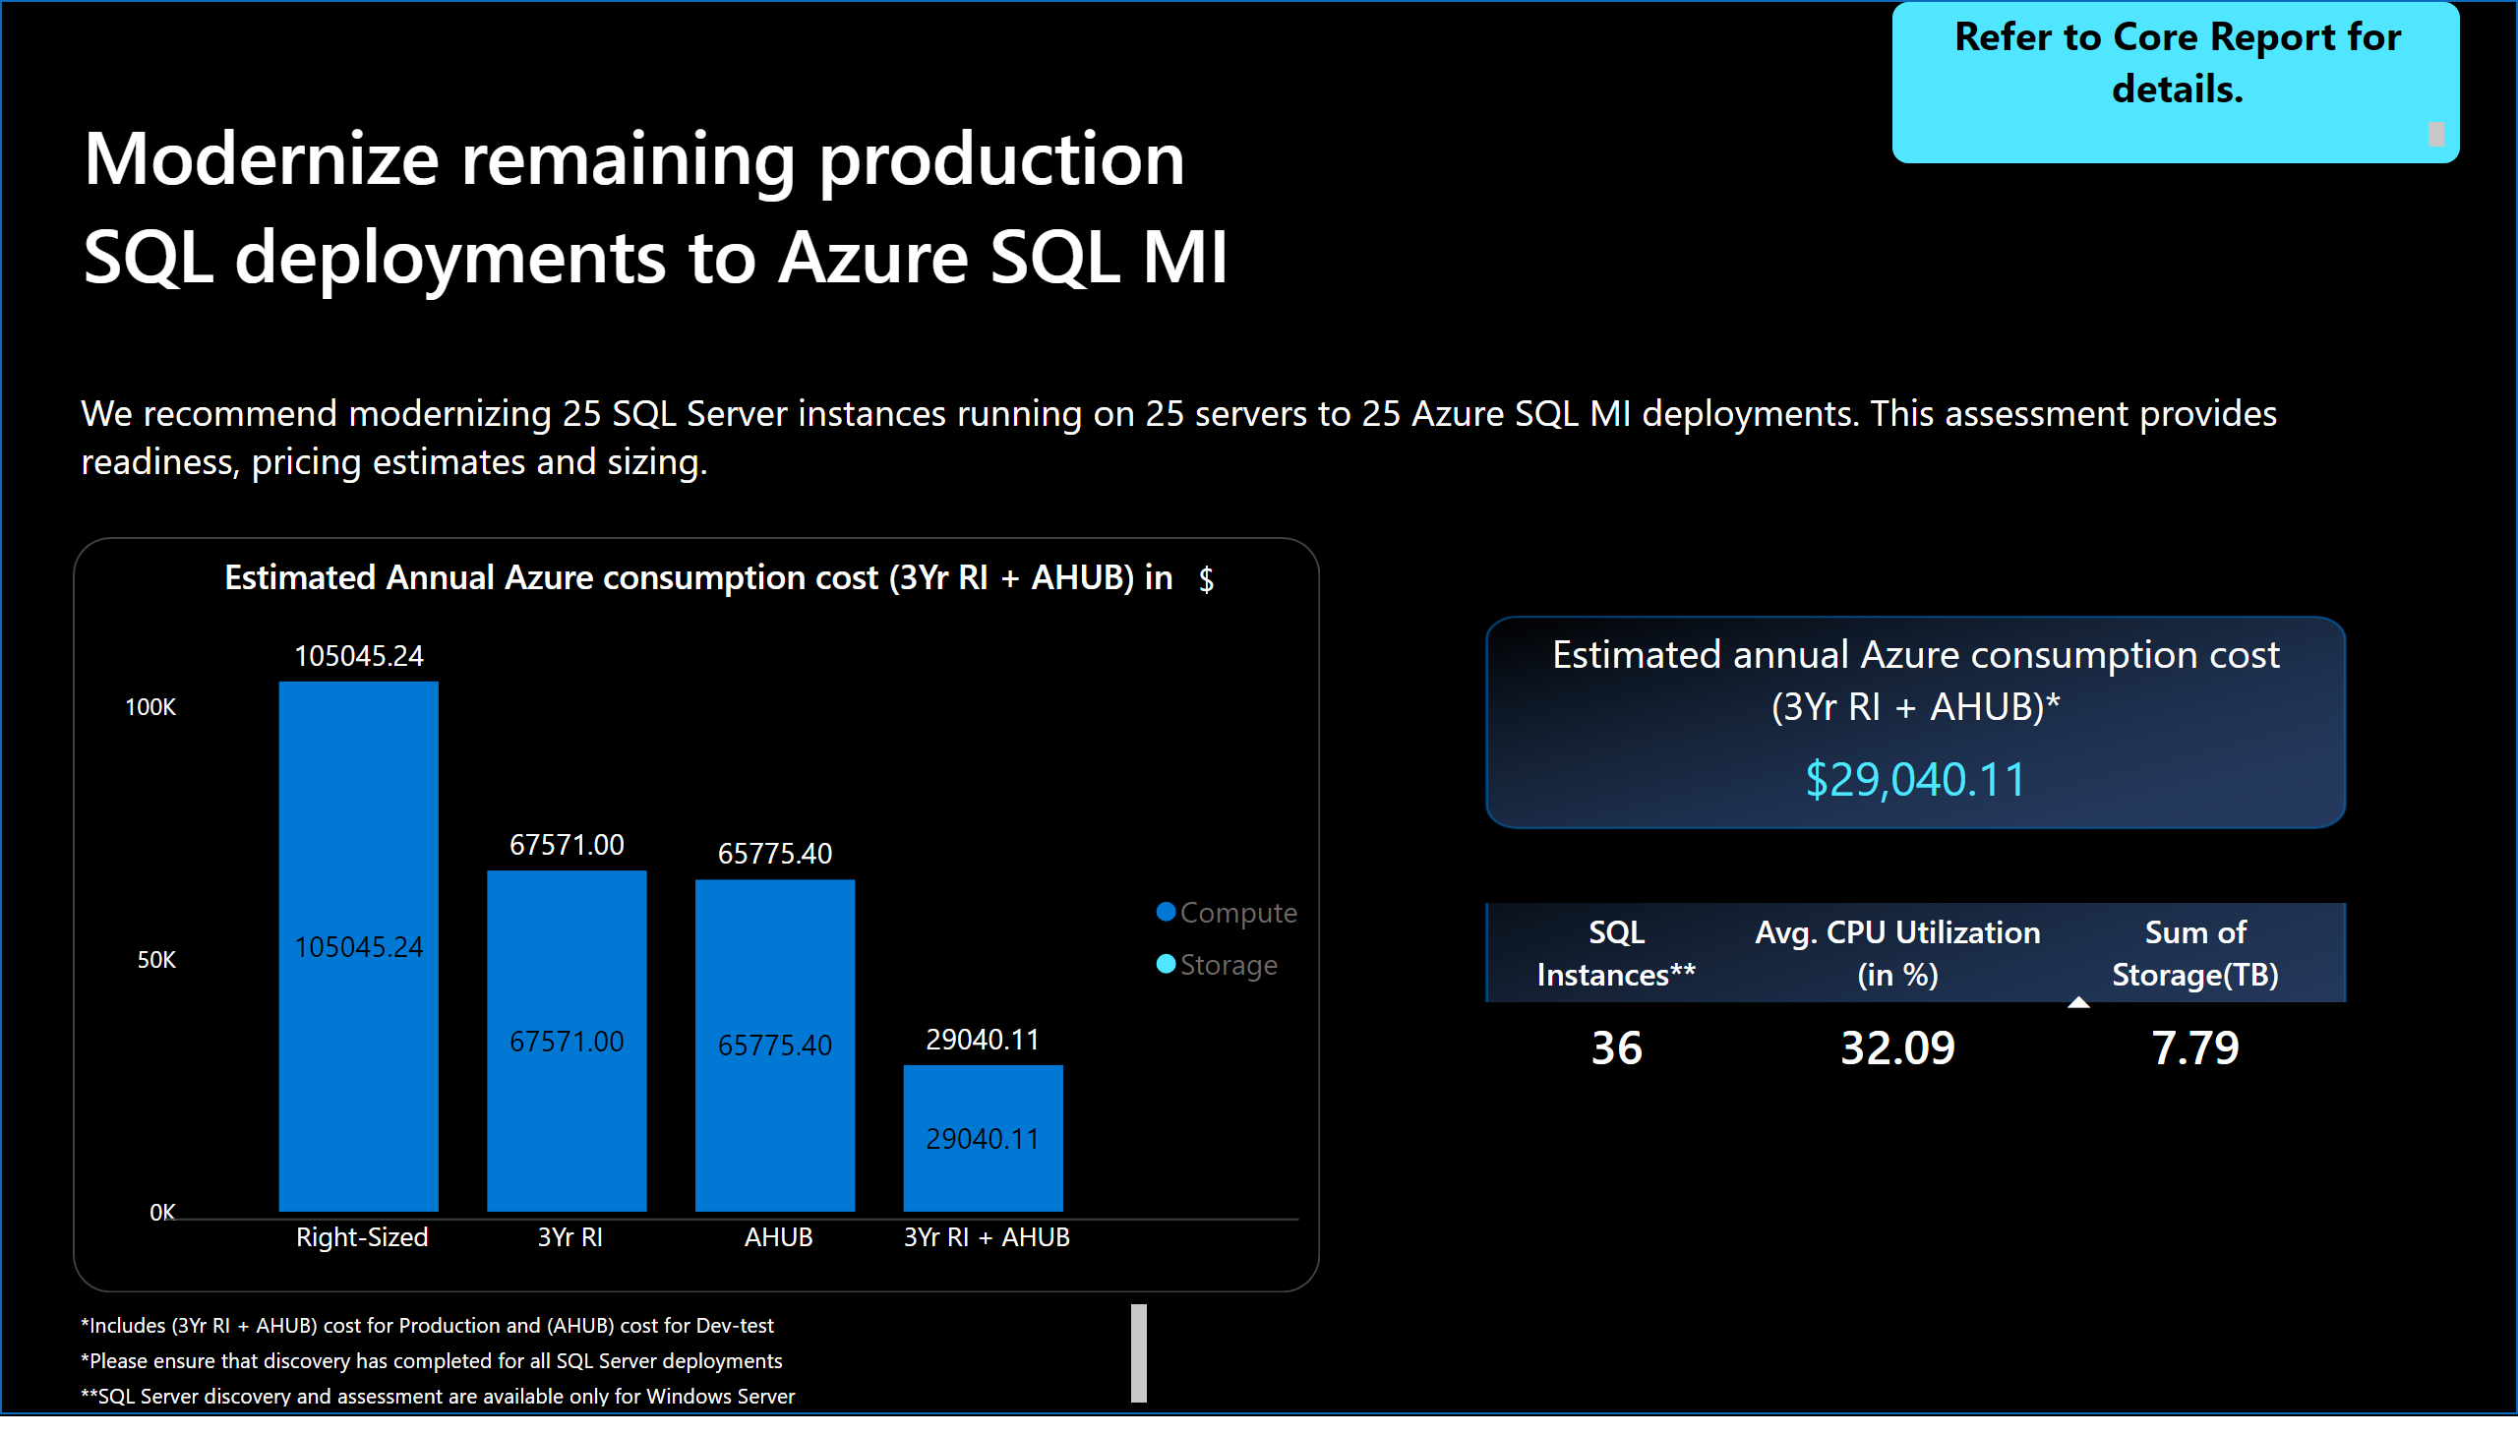
Slide 33
Notes:
Modernize remaining production SQL deployments to Azure SQL MI
No alt text provided
textbox
No alt text provided
Estimated Annual Azure consumption cost (3Yr RI + AHUB) in
No alt text provided
textbox
No alt text provided
Refer to Core Report for details.
No alt text provided
actionButton
No alt text provided
Estimated annual Azure consumption cost (3Yr RI + AHUB)*
No alt text provided
actionButton
No alt text provided
tableEx
No alt text provided
shape
No alt text provided
shape
No alt text provided
card
No alt text provided
actionButton
No alt text provided
shape
No alt text provided

Slide 34
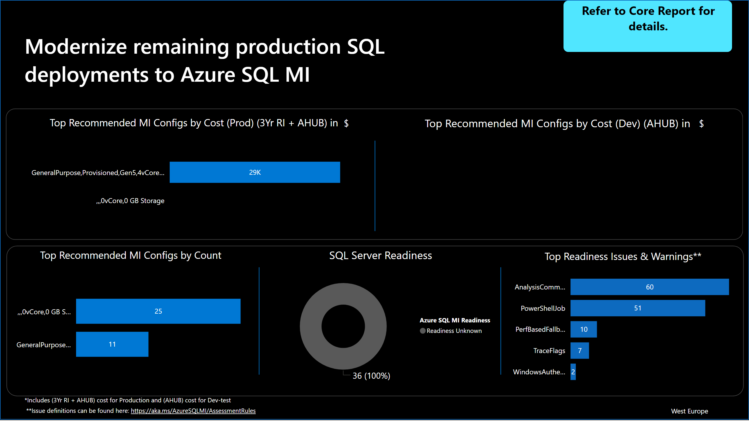
Slide 34
Notes:
Modernize remaining production SQL deployments to Azure SQL MI
No alt text provided
textbox
No alt text provided
card
No alt text provided
Refer to Core Report for details.
No alt text provided
shape
No alt text provided
shape
No alt text provided
shape
No alt text provided
shape
No alt text provided
card
No alt text provided
card
No alt text provided
shape
No alt text provided
Top Recommended MI Configs by Cost (Prod) (3Yr RI + AHUB) in
No alt text provided
Top Recommended MI Configs by Cost (Dev) (AHUB) in
No alt text provided
Top Recommended MI Configs by Count
No alt text provided
SQL Server Readiness
No alt text provided
Top Readiness Issues & Warnings**
No alt text provided
shape
No alt text provided

Slide 35
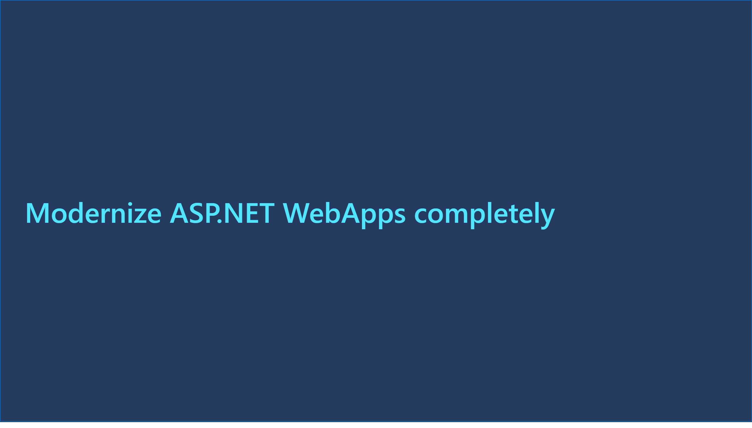
Slide 35
Notes:
Modernize ASP.NET WebApps completely​
No alt text provided
shape
No alt text provided

Slide 36
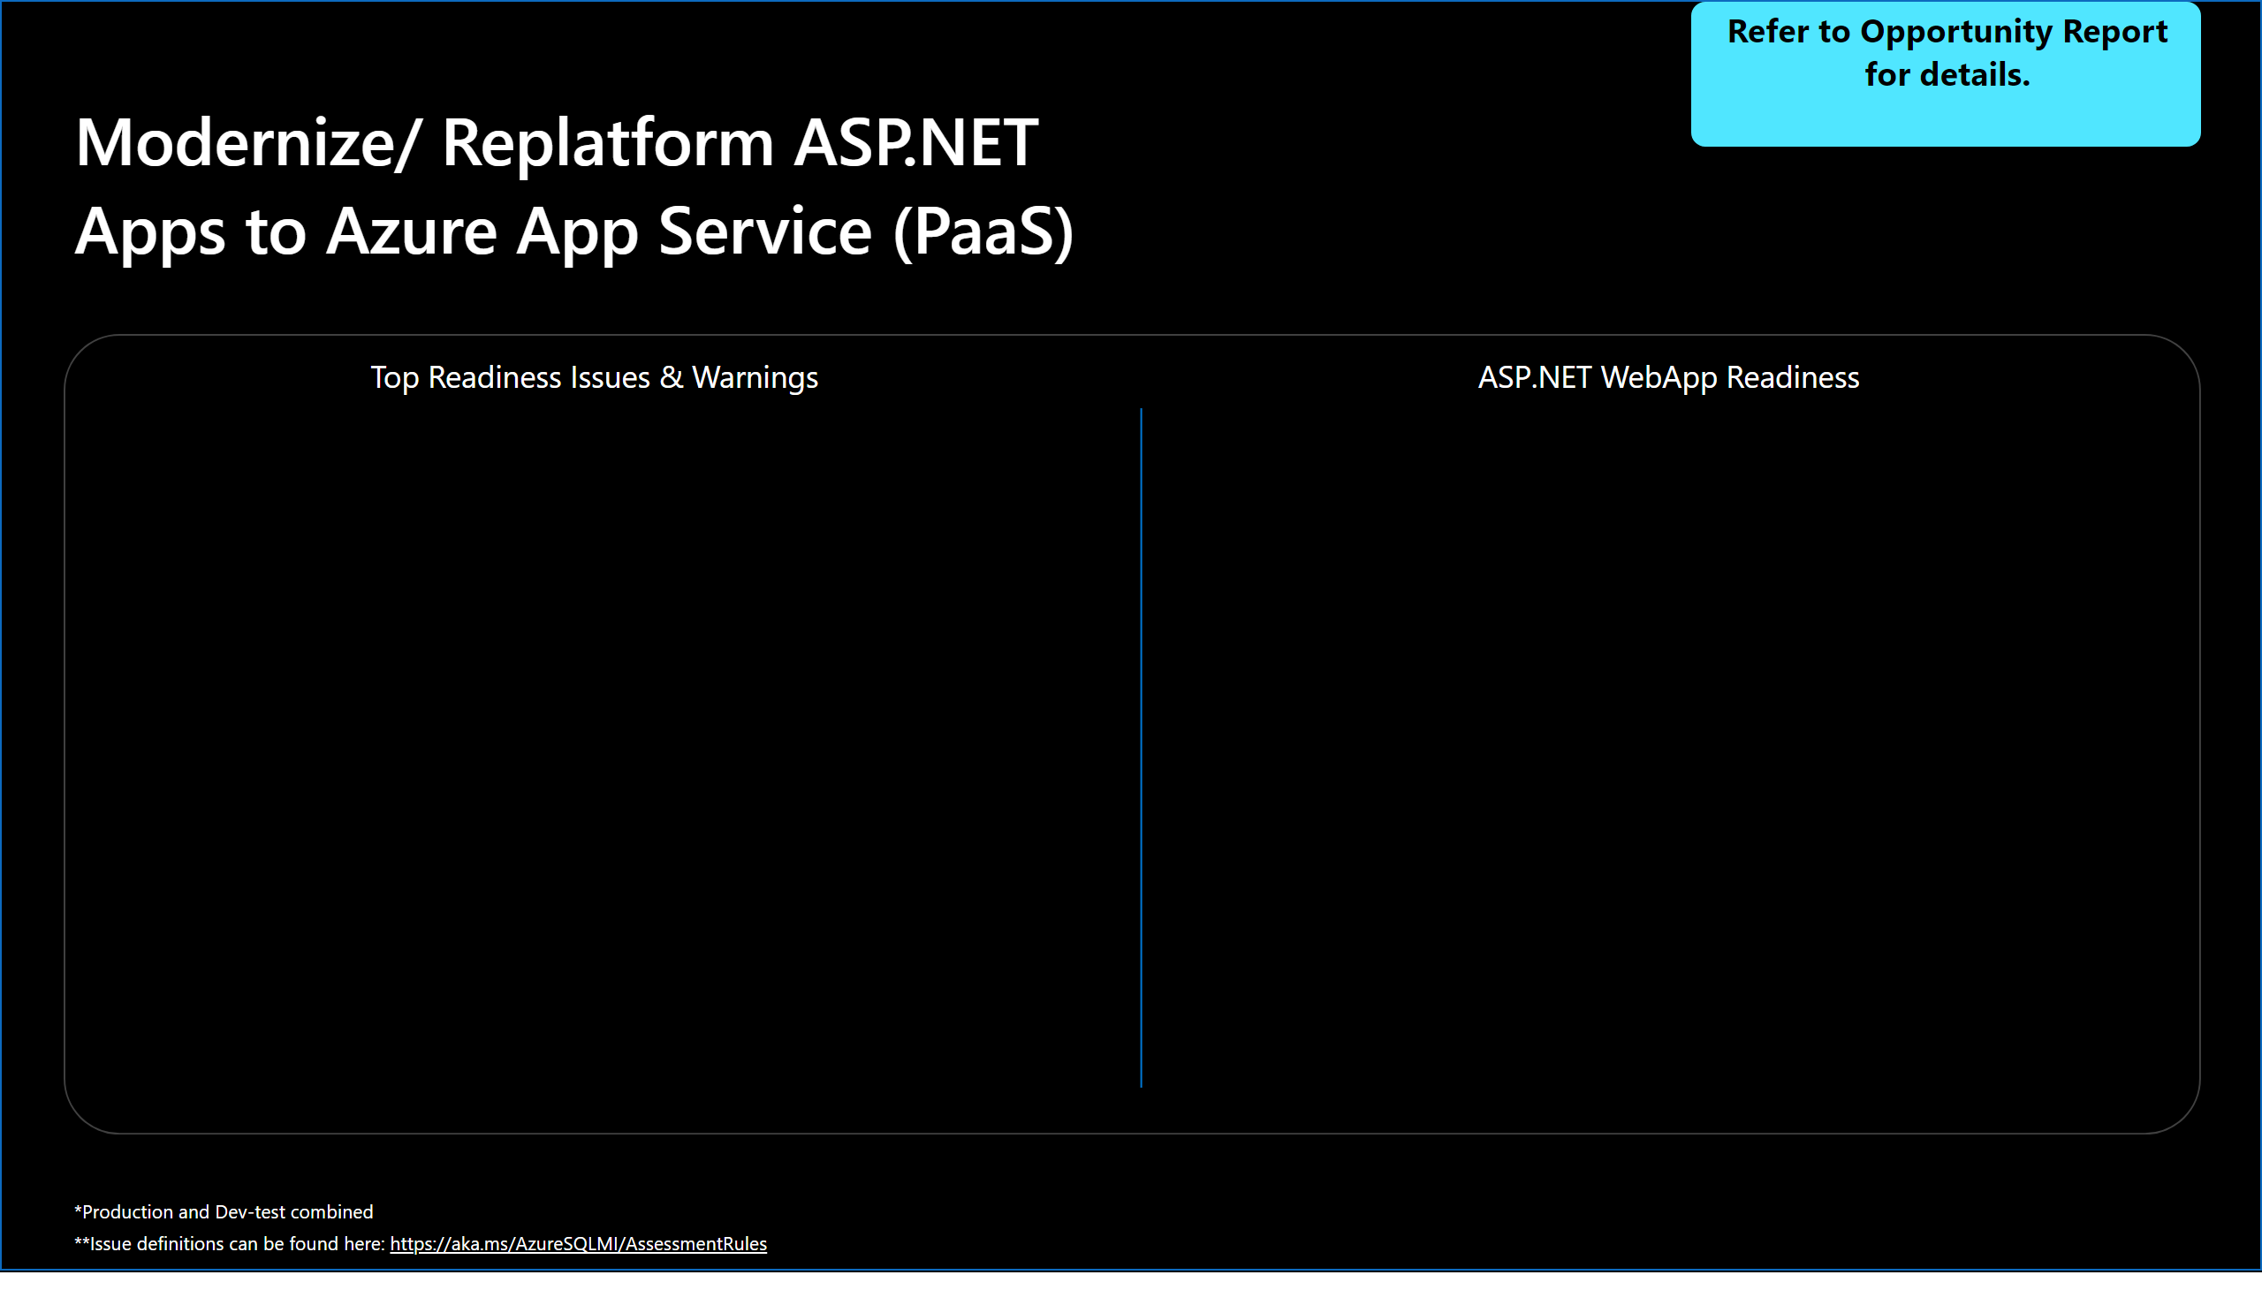
Slide 36
Notes:
Modernize/ Replatform ASP.NET Apps to Azure App Service (PaaS)
No alt text provided
textbox
No alt text provided
Refer to Opportunity Report for details.
No alt text provided
shape
No alt text provided
shape
No alt text provided
Top Readiness Issues & Warnings
No alt text provided
ASP.NET WebApp Readiness
No alt text provided
shape
No alt text provided

Slide 37
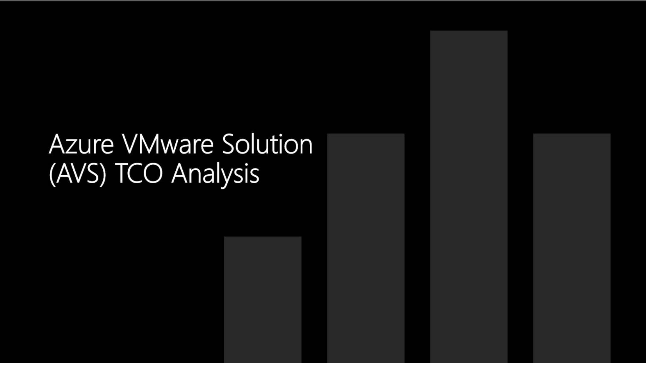
Slide 37
Notes:
image
No alt text provided

Slide 38
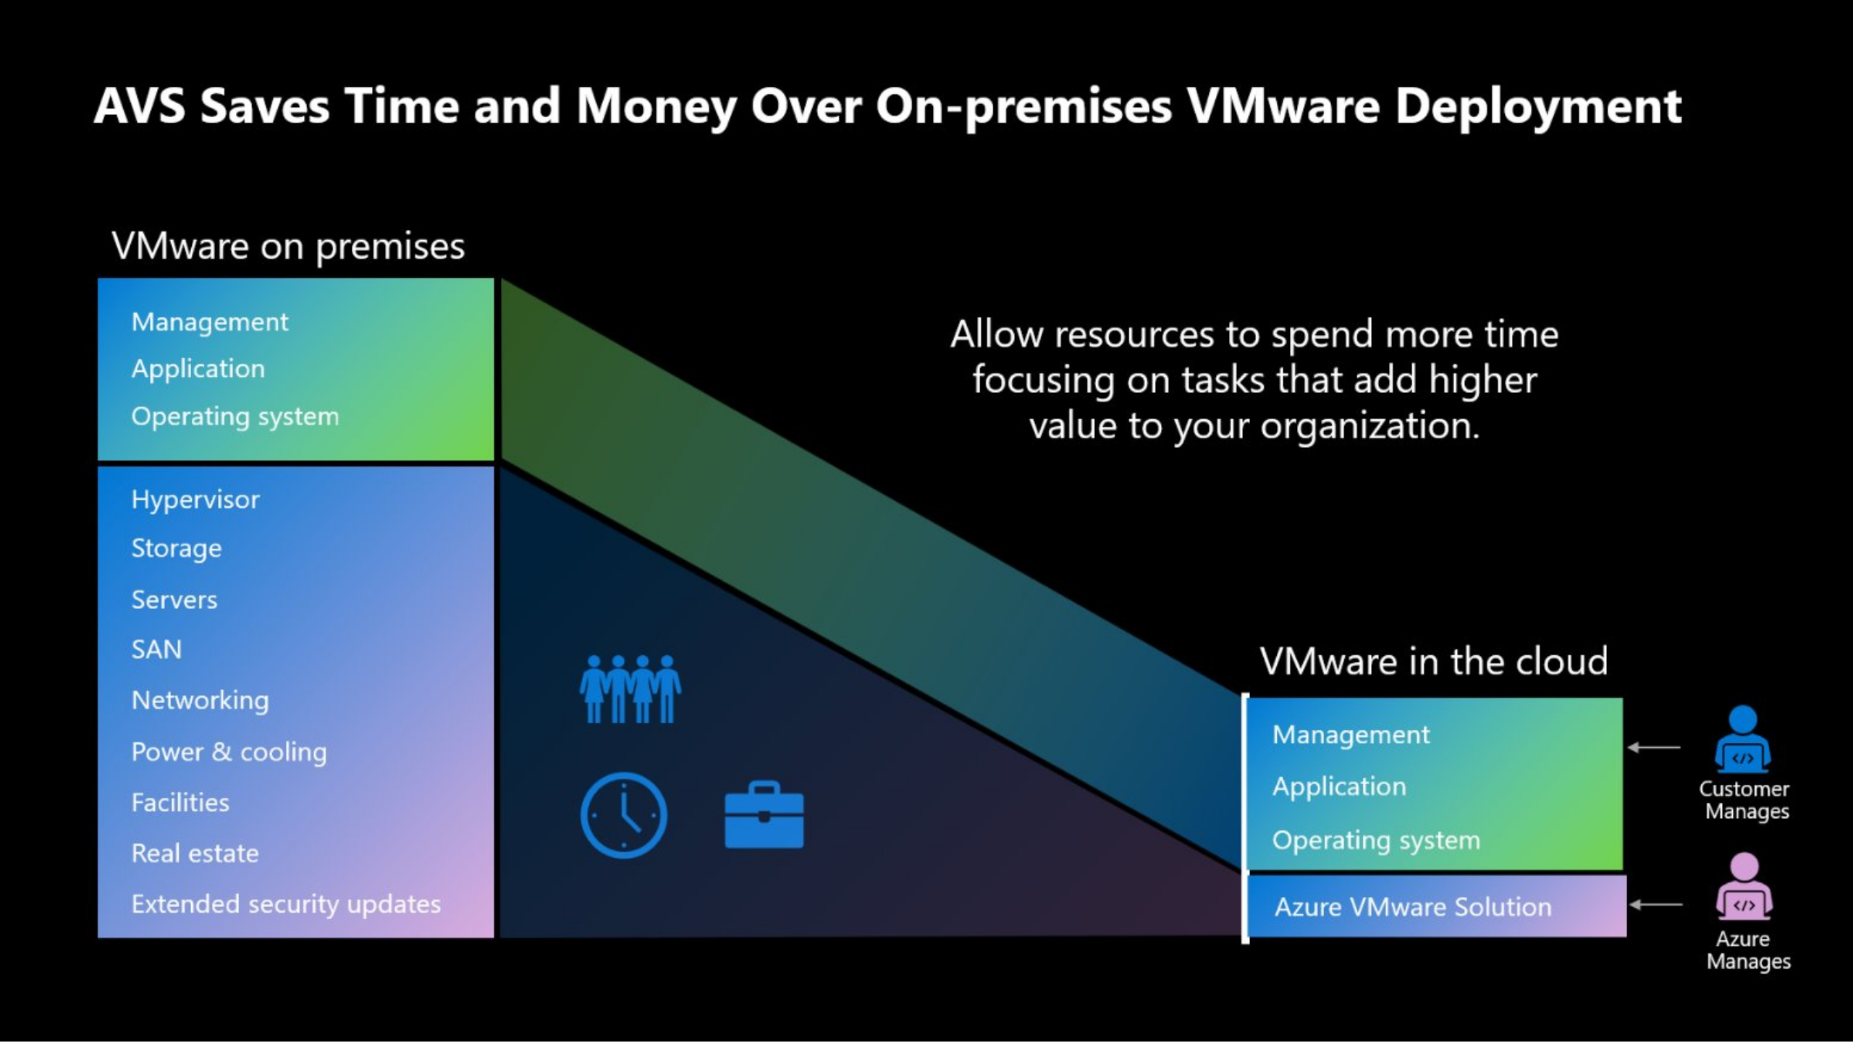
Slide 38
Notes:
image
No alt text provided

Slide 39
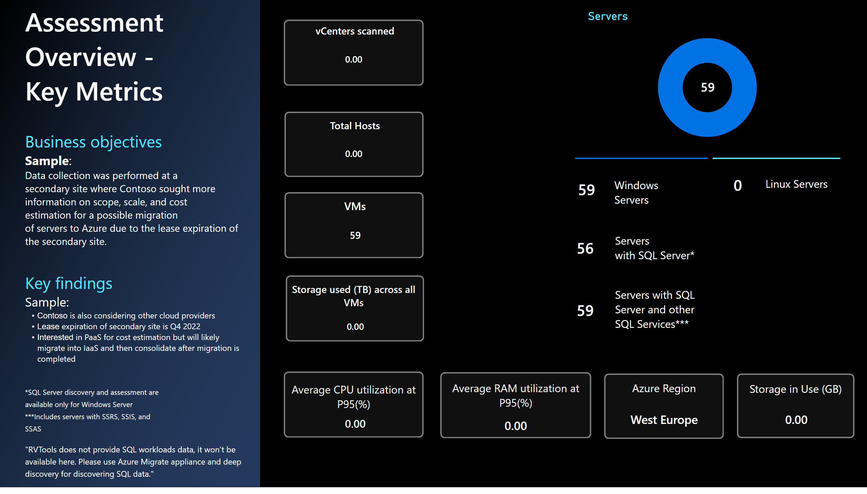
Slide 39
Notes:
card
No alt text provided
card
No alt text provided
card
No alt text provided
card
No alt text provided
card
No alt text provided
actionButton
No alt text provided
card
No alt text provided
Servers
No alt text provided
card
No alt text provided
card
No alt text provided
actionButton
No alt text provided
Assessment Overview - Key Metrics
No alt text provided
textbox
No alt text provided
textbox
No alt text provided
textbox
No alt text provided
shape
No alt text provided
shape
No alt text provided
textbox
No alt text provided
textbox
No alt text provided
textbox
No alt text provided
textbox
No alt text provided
textbox
No alt text provided
textbox
No alt text provided
Storage used (TB) across all VMs
No alt text provided
shape
No alt text provided
shape
No alt text provided
shape
No alt text provided
shape
No alt text provided
vCenters scanned
No alt text provided
card
No alt text provided
card
No alt text provided
card
No alt text provided
shape
No alt text provided
Total Hosts
No alt text provided
VMs
No alt text provided
textbox
No alt text provided
card
No alt text provided
shape
No alt text provided
shape
No alt text provided
shape
No alt text provided
textbox
No alt text provided
card
No alt text provided
textbox
No alt text provided

Slide 40
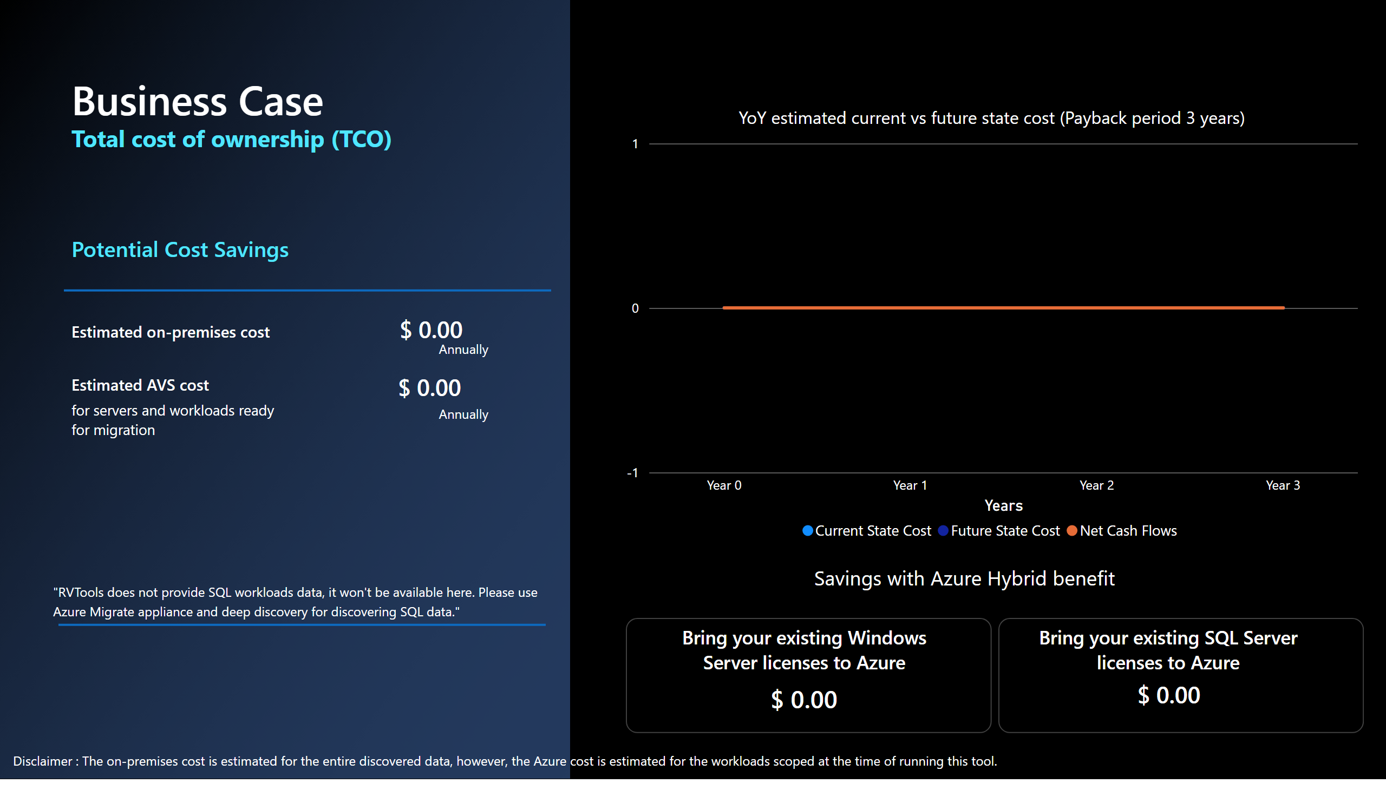
Slide 40
Notes:
Estimated on-premises cost​
No alt text provided
YoY estimated current vs future state cost (Payback period 3 years)
No alt text provided
Bring your existing Windows Server licenses to Azure
No alt text provided
Bring your existing SQL Server licenses to Azure
No alt text provided
shape
No alt text provided
shape
No alt text provided
card
No alt text provided
card
No alt text provided
actionButton
No alt text provided
card
No alt text provided
card
No alt text provided
Estimated on-premises cost​
No alt text provided
Estimated AVS cost​
No alt text provided
Potential Cost Savings
No alt text provided
shape
No alt text provided
shape
No alt text provided
Business Case
No alt text provided
textbox
No alt text provided
card
No alt text provided
card
No alt text provided
textbox
No alt text provided
Annually
No alt text provided
Annually
No alt text provided
card
No alt text provided
textbox
No alt text provided

Slide 41
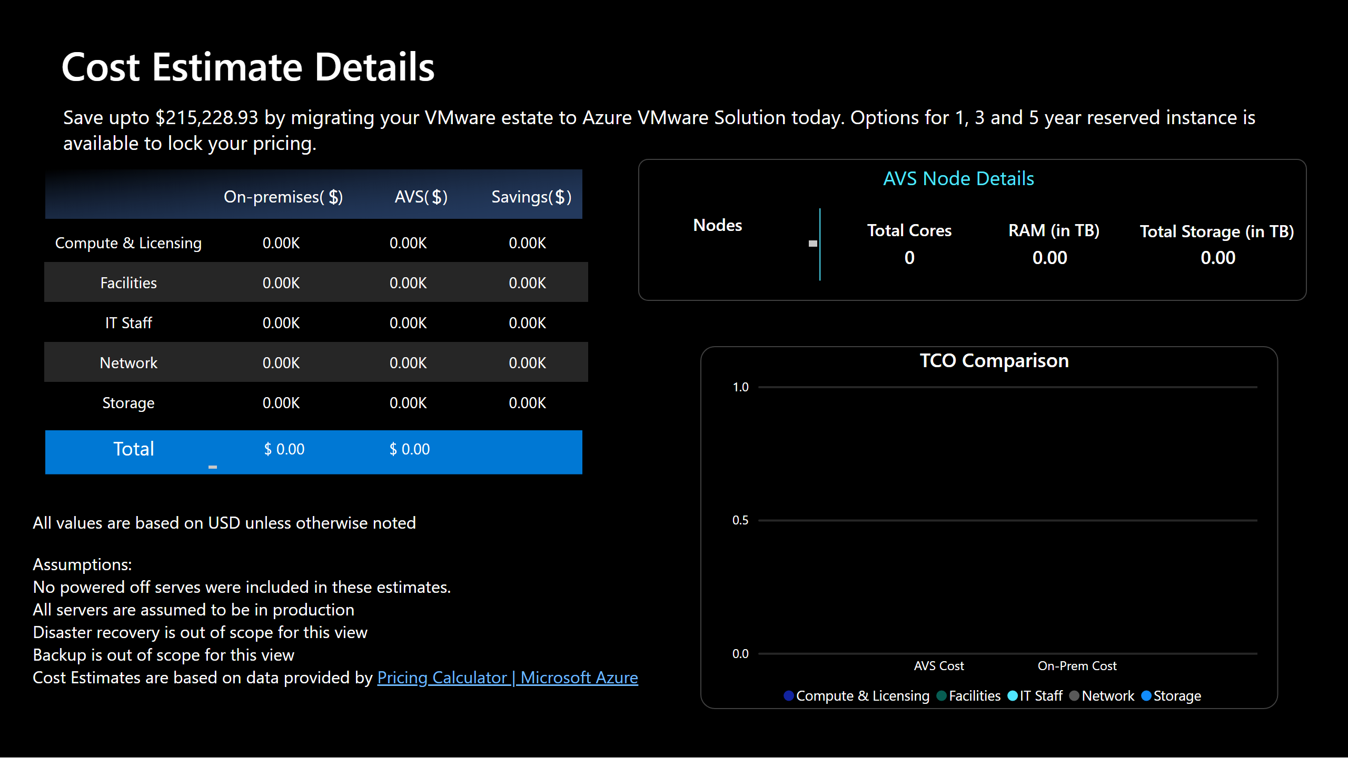
Slide 41
Notes:
Cost Estimate Details
No alt text provided
shape
No alt text provided
Total
No alt text provided
card
No alt text provided
card
No alt text provided
card
No alt text provided
tableEx
No alt text provided
actionButton
No alt text provided
textbox
No alt text provided
card
No alt text provided
card
No alt text provided
card
No alt text provided
actionButton
No alt text provided
textbox
No alt text provided
shape
No alt text provided
TCO Comparison
No alt text provided
RAM (in TB)
No alt text provided
card
No alt text provided
card
No alt text provided
card
No alt text provided
textbox
No alt text provided
Total Storage (in TB)
No alt text provided
Total Cores
No alt text provided
Nodes
No alt text provided
shape
No alt text provided
shape
No alt text provided
card
No alt text provided

Slide 42
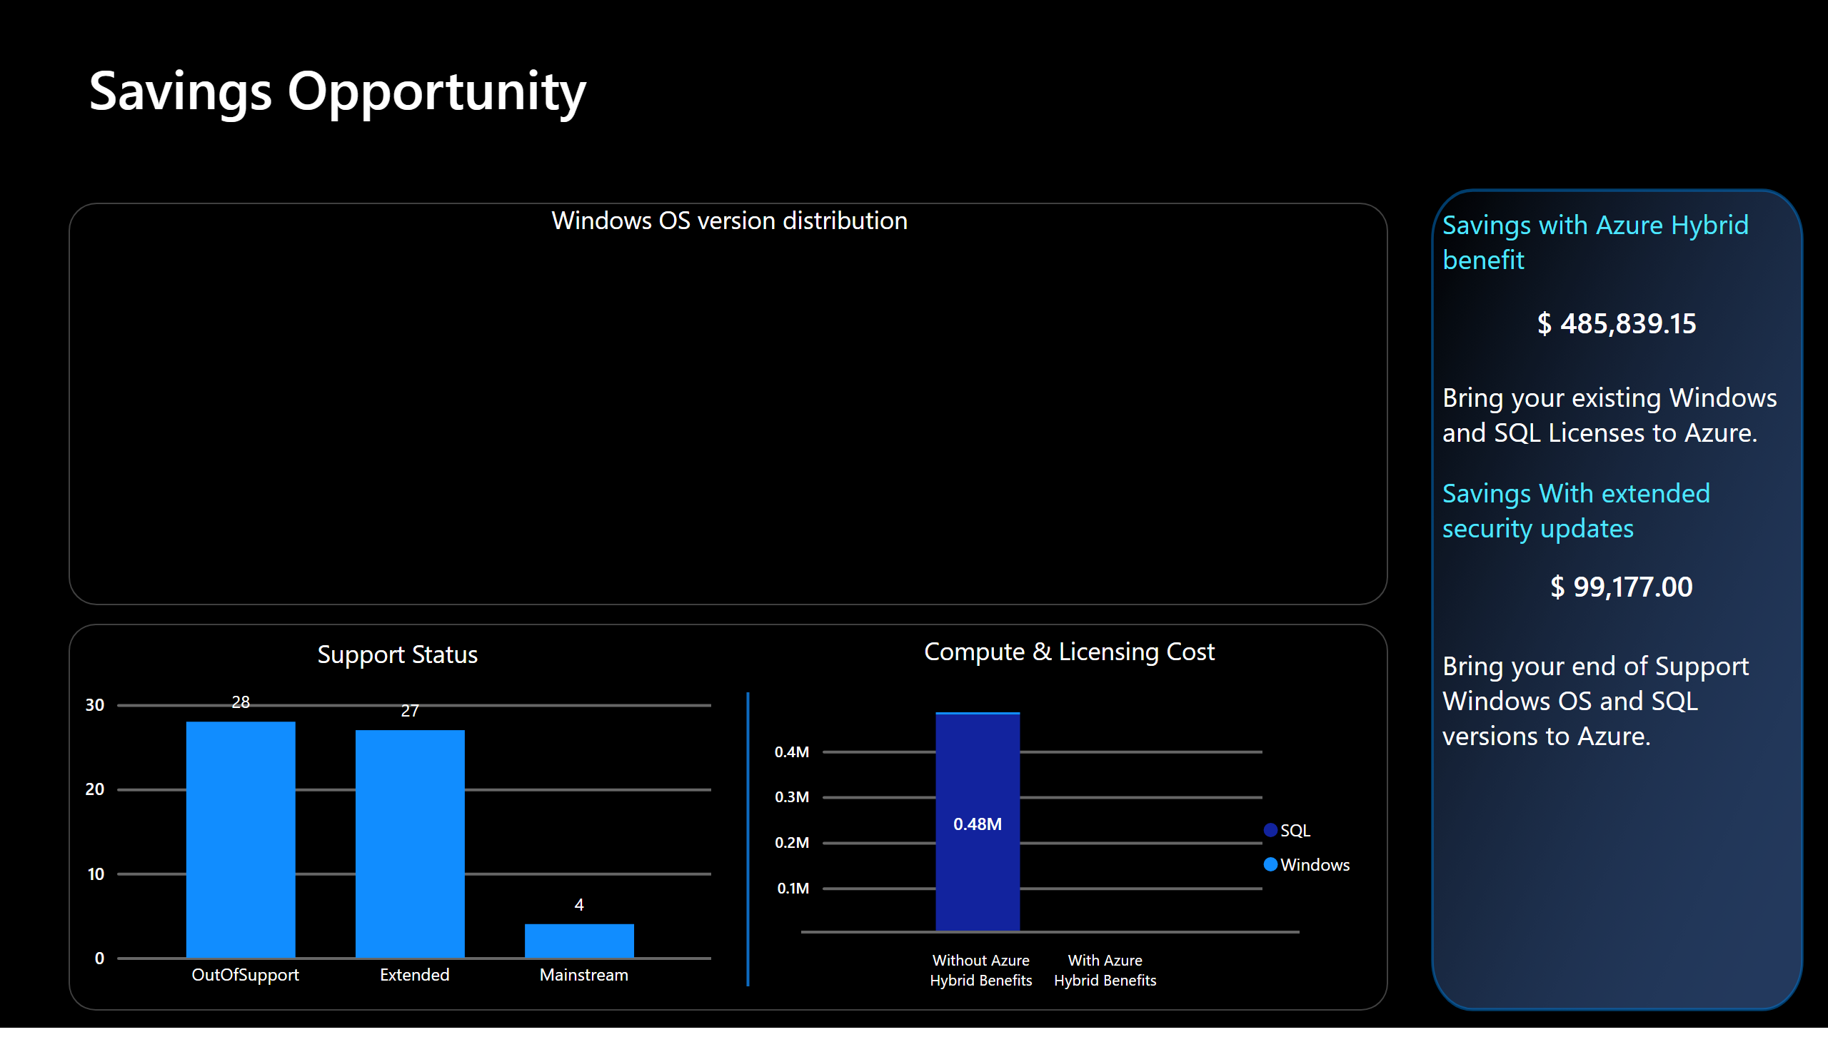
Slide 42
Notes:
Savings Opportunity
No alt text provided
Compute & Licensing Cost
No alt text provided
shape
No alt text provided
shape
No alt text provided
actionButton
No alt text provided
textbox
No alt text provided
shape
No alt text provided
Savings with AHUB:
No alt text provided
Savings with AHUB:
No alt text provided
Compute and license cost
No alt text provided
Windows OS version distribution
No alt text provided
Support Status
No alt text provided
Windows OS version distribution
No alt text provided
shape
No alt text provided

Slide 43
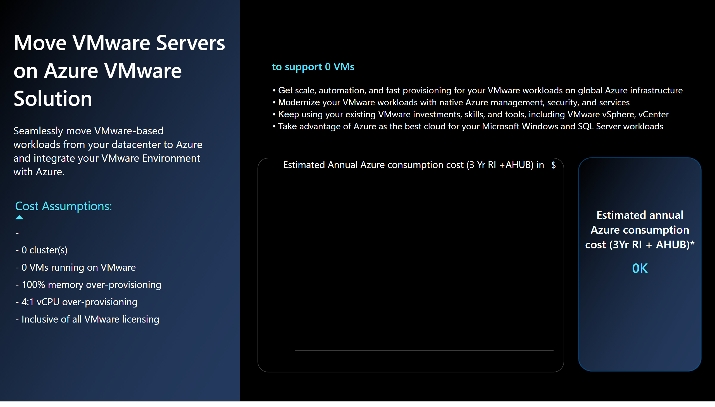
Slide 43
Notes:
Estimated Annual Azure consumption cost (3 Yr RI +AHUB) in
No alt text provided
actionButton
No alt text provided
tableEx
No alt text provided
actionButton
No alt text provided
Seamlessly move VMware-based workloads from your datacenter to Azure and integrate your VMware Environment with Azure.
No alt text provided
Move VMware Servers on Azure VMware Solution
No alt text provided
tableEx
No alt text provided
textbox
No alt text provided
card
No alt text provided
actionButton
No alt text provided
Estimated annual Azure consumption cost (3Yr RI + AHUB)*
No alt text provided
shape
No alt text provided
shape
No alt text provided
actionButton
No alt text provided

Slide 44
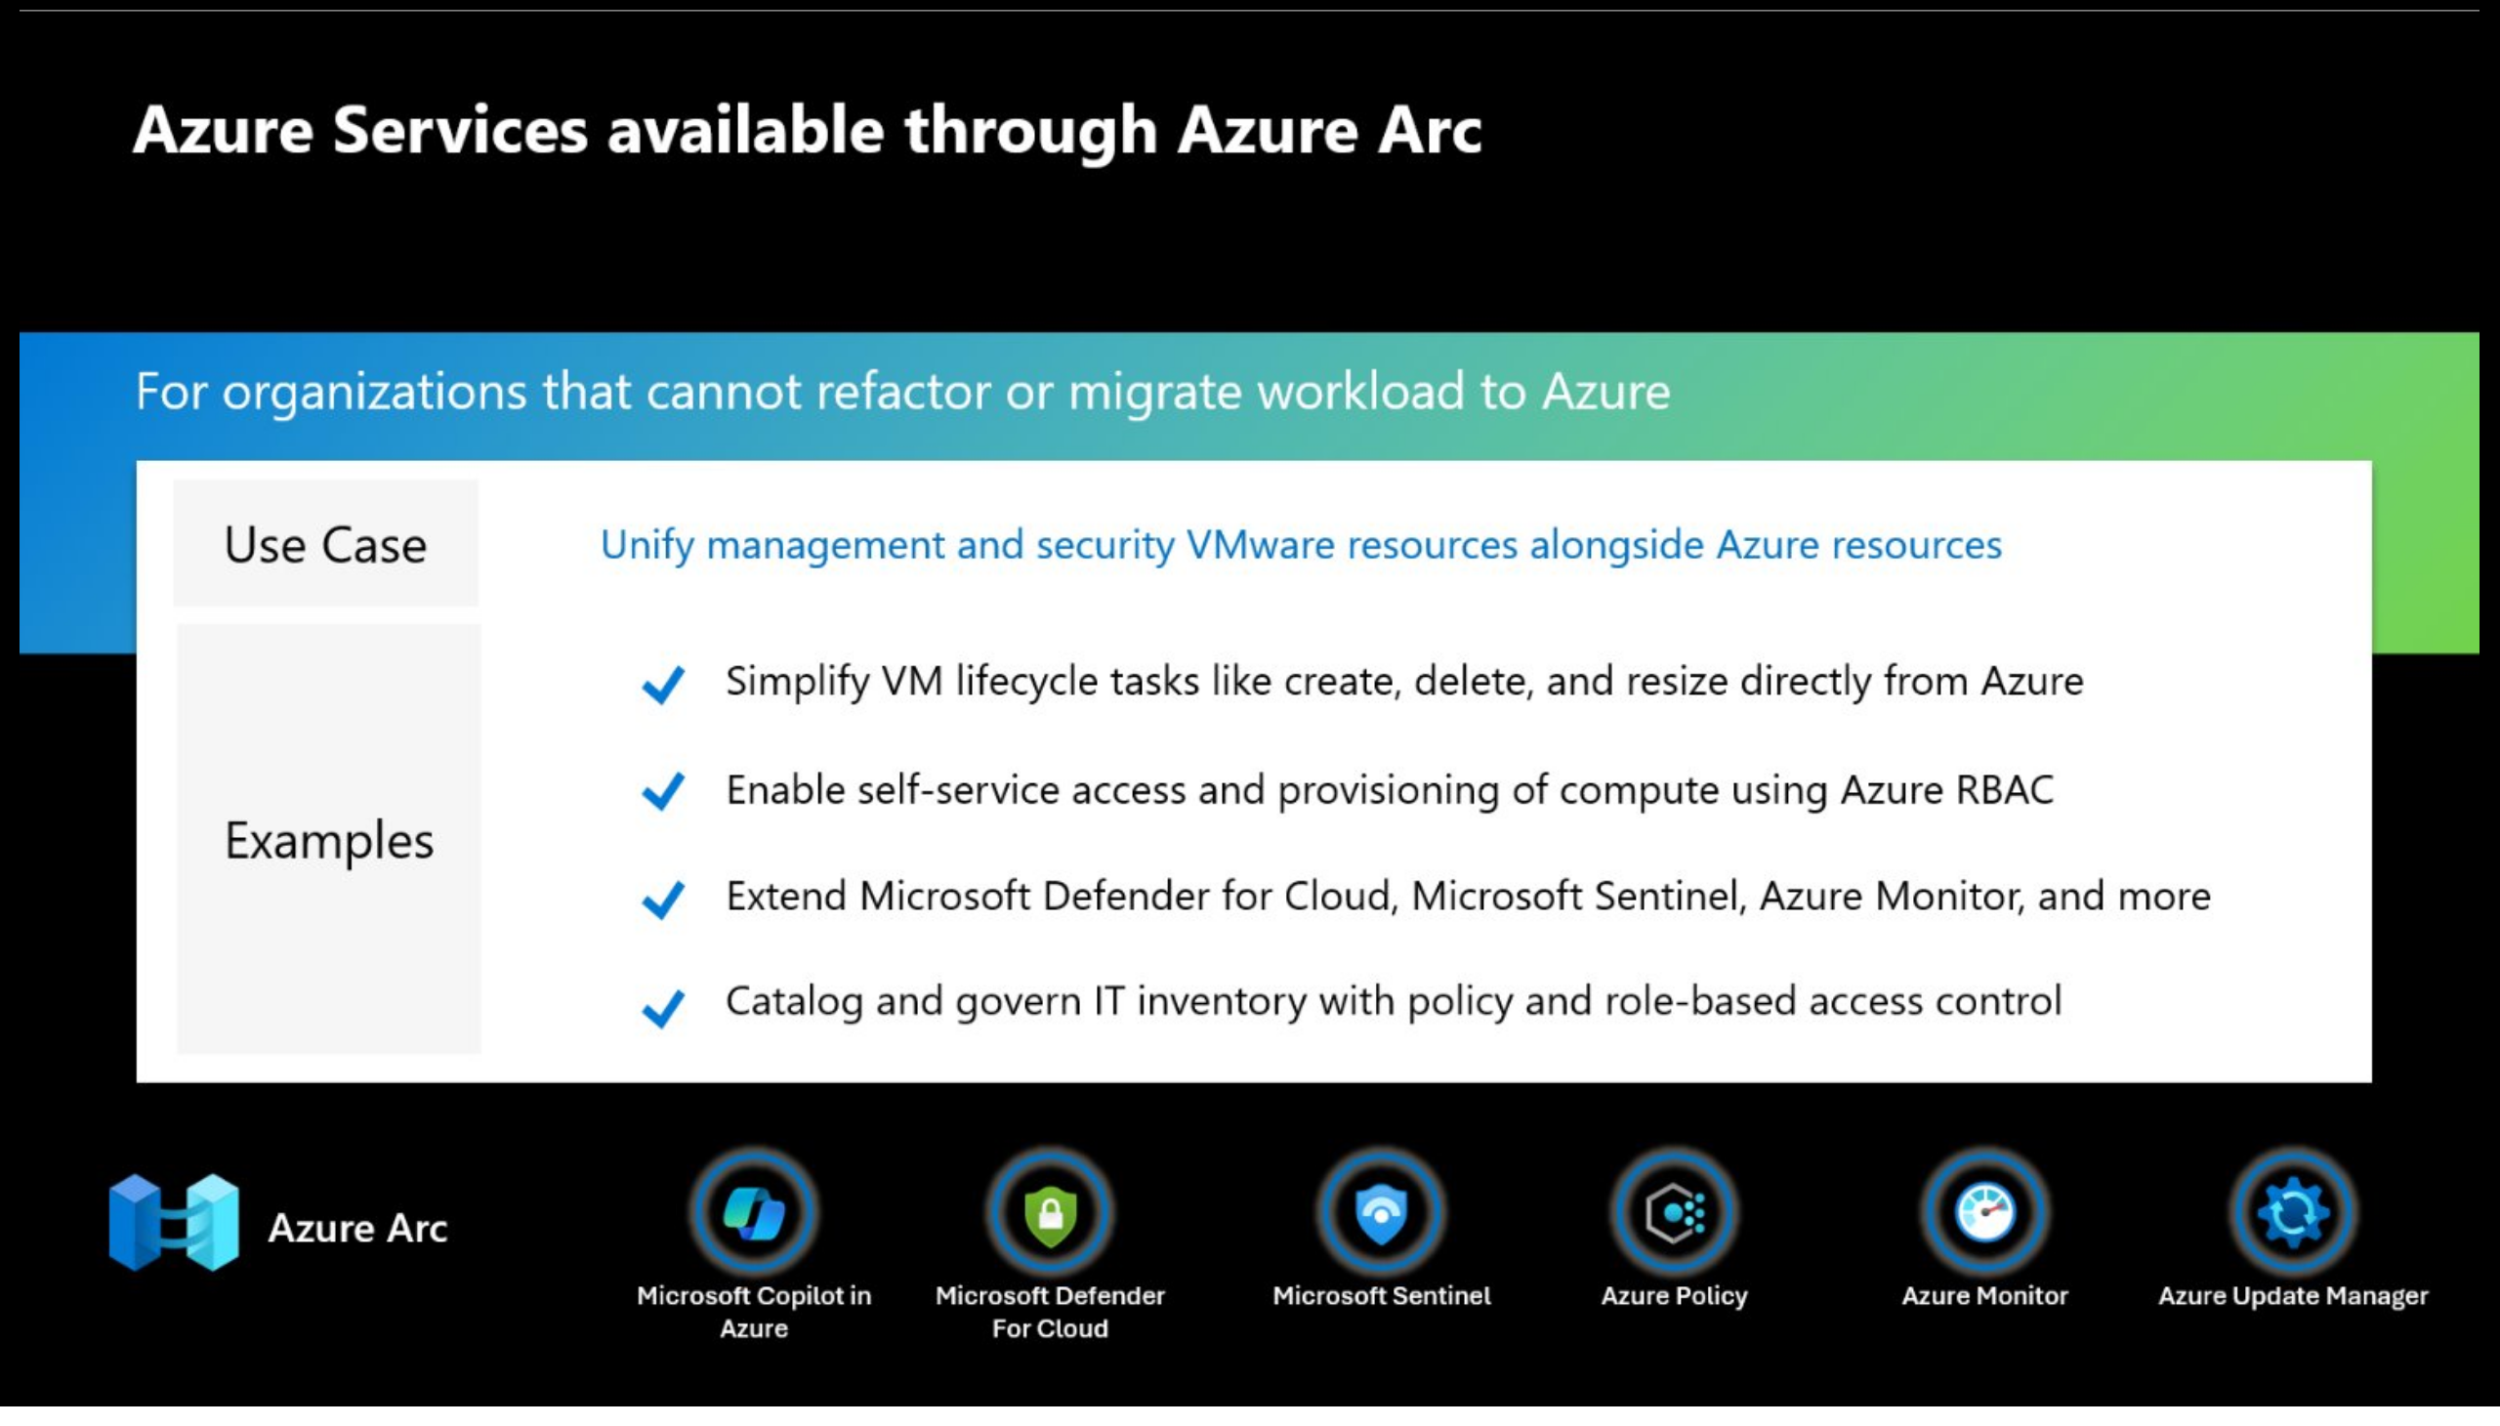
Slide 44
Notes:
image
No alt text provided
shape
No alt text provided

Slide 45
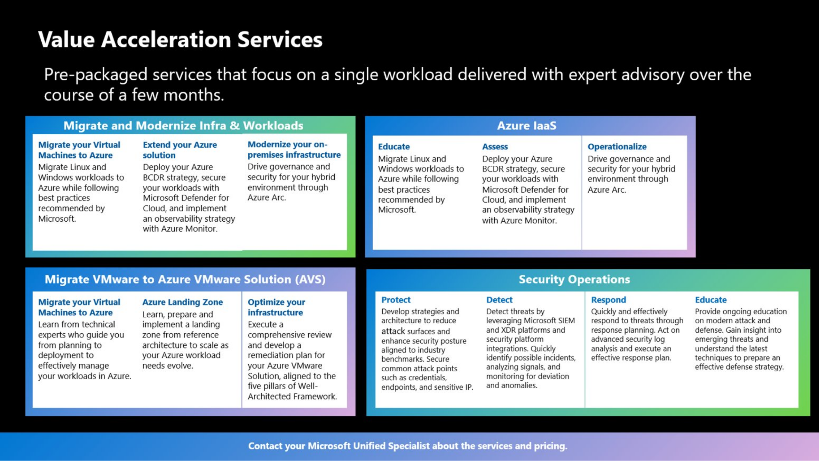
Slide 45
Notes:
image
No alt text provided

Slide 46
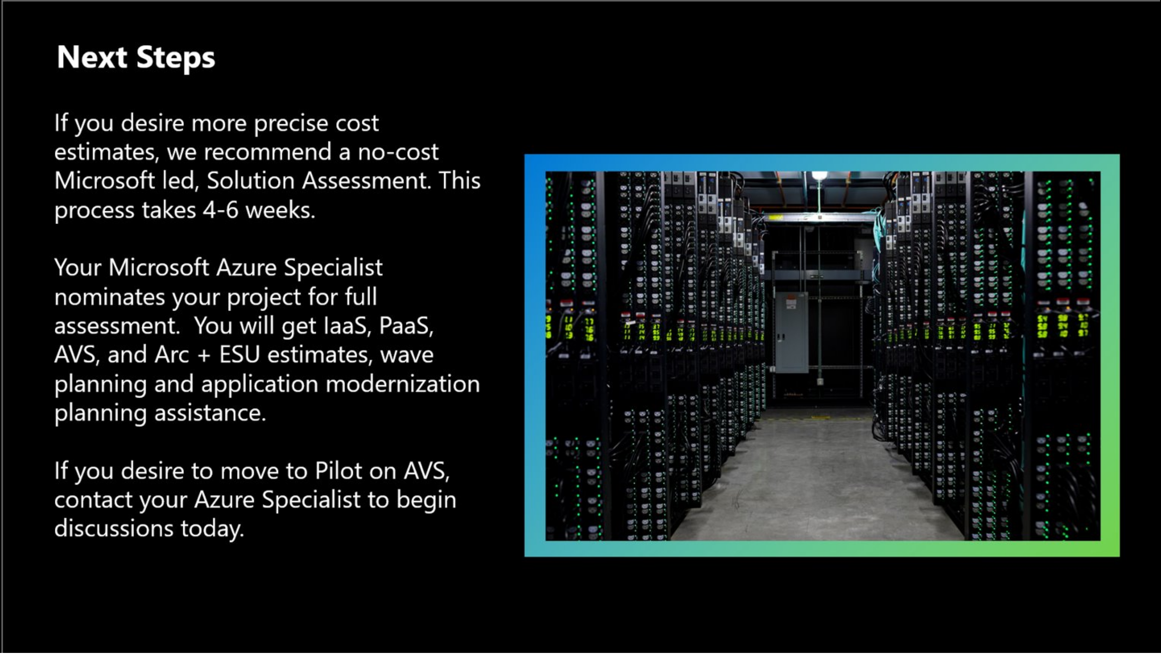
Slide 46
Notes:
image
No alt text provided

Slide 47
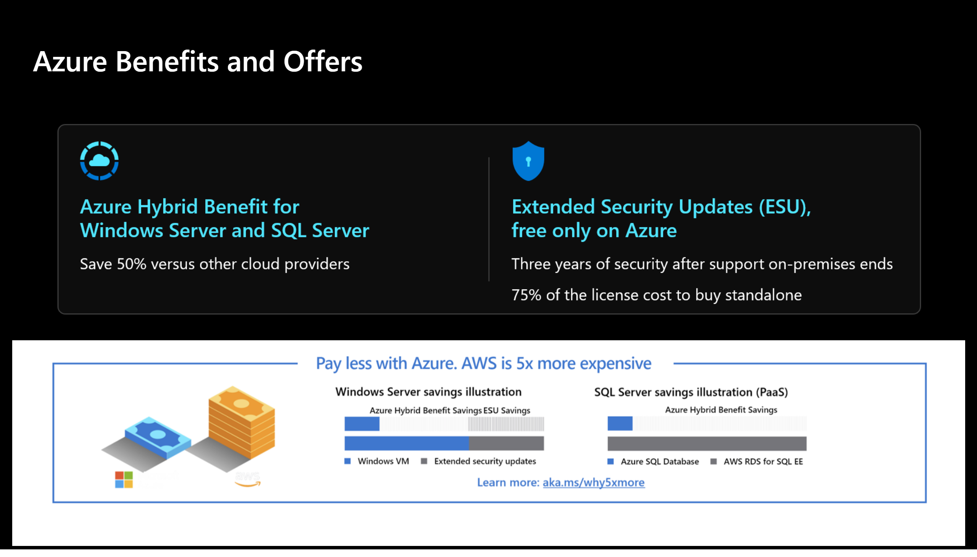
Slide 47
Notes:
Azure Benefits and Offers
No alt text provided
image
No alt text provided

Slide 48
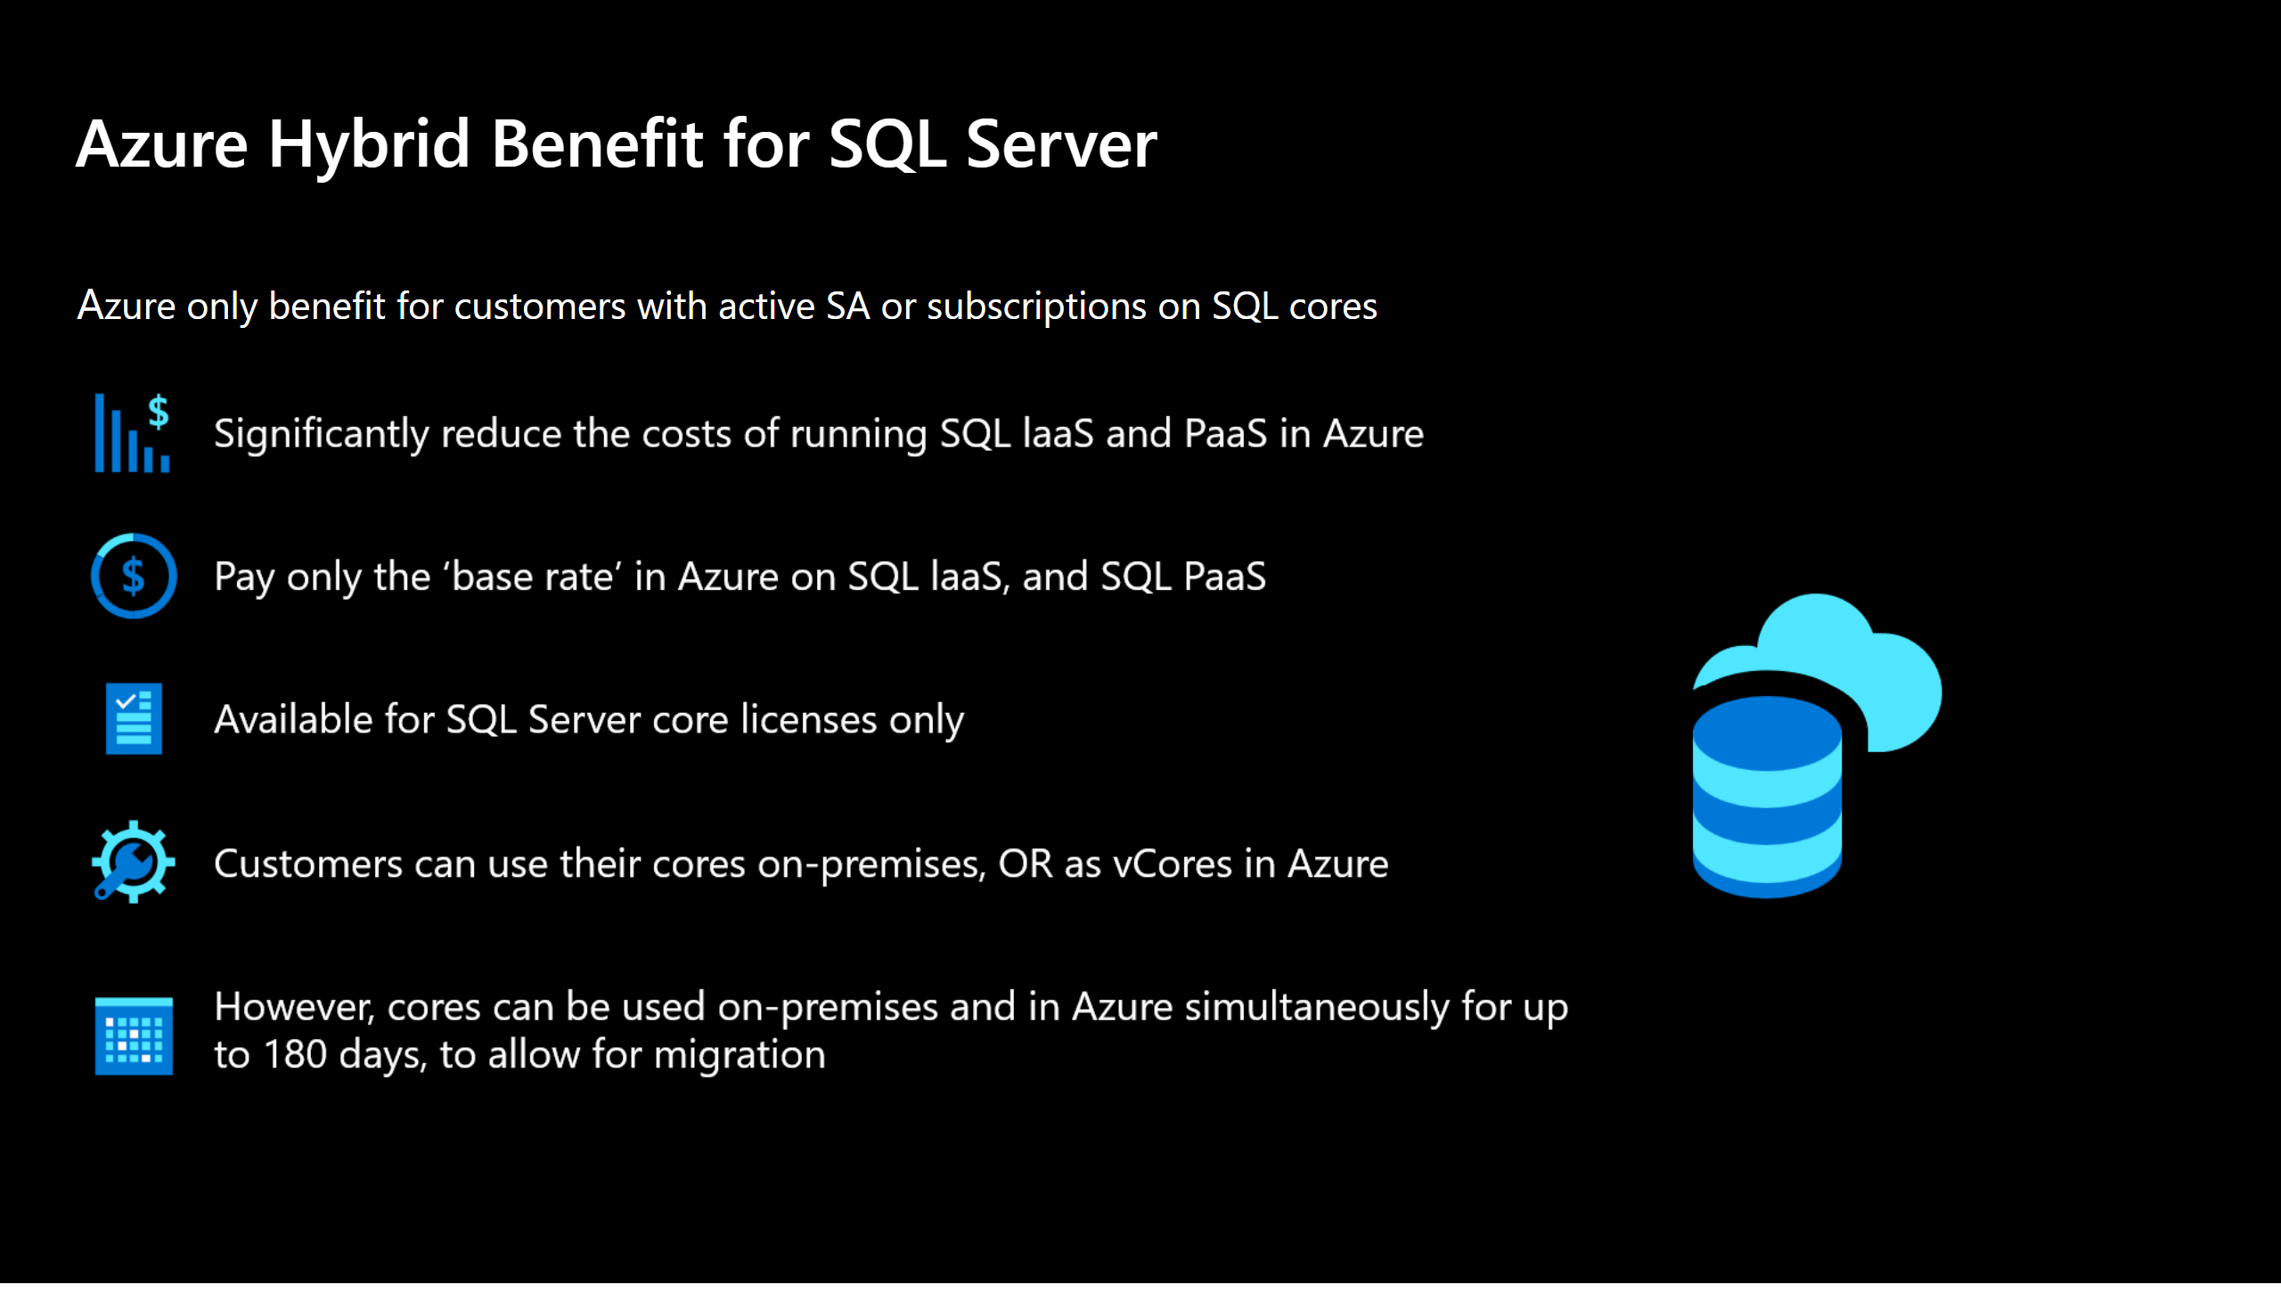
Slide 48
Notes:
Azure Hybrid Benefit for SQL Server
No alt text provided
textbox
No alt text provided
image
No alt text provided

Slide 49
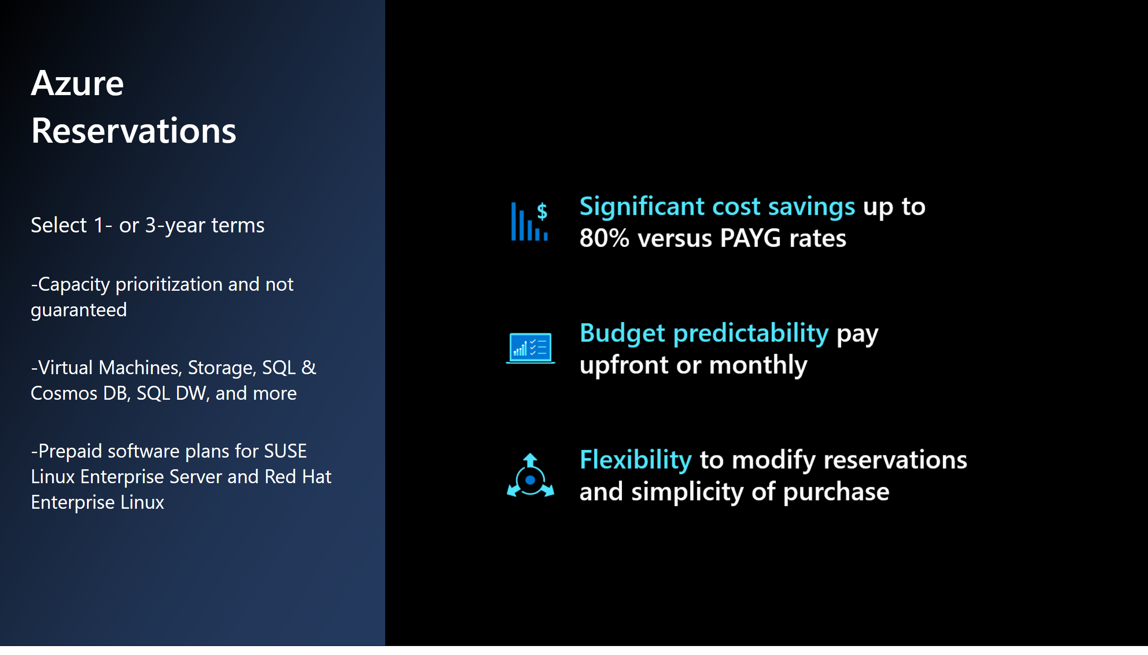
Slide 49
Notes:
actionButton
No alt text provided
Azure Reservations
No alt text provided
textbox
No alt text provided
image
No alt text provided

Slide 50
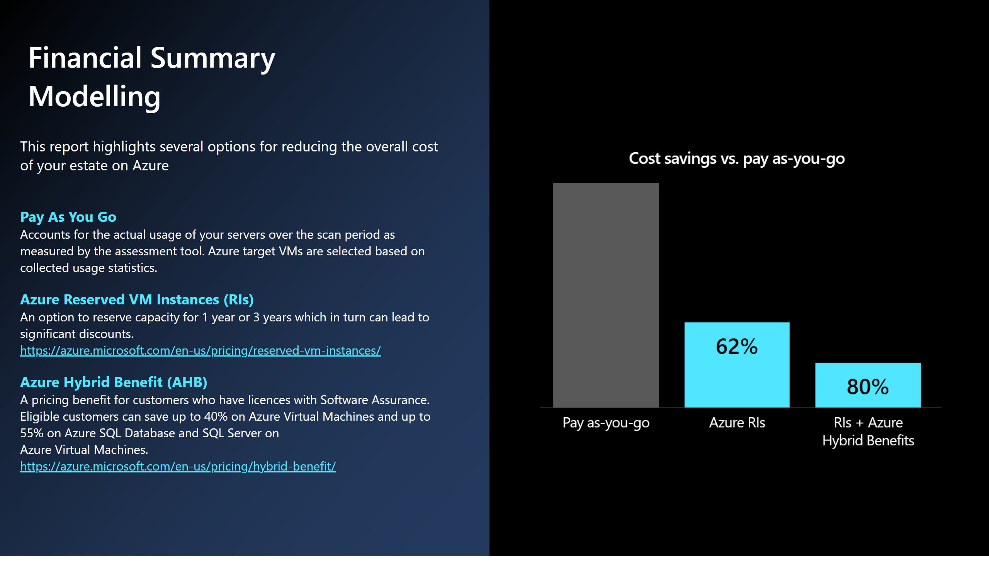
Slide 50
Notes:
actionButton
No alt text provided
Financial Summary Modelling
No alt text provided
textbox
No alt text provided
textbox
No alt text provided
image
No alt text provided

